Slide 1
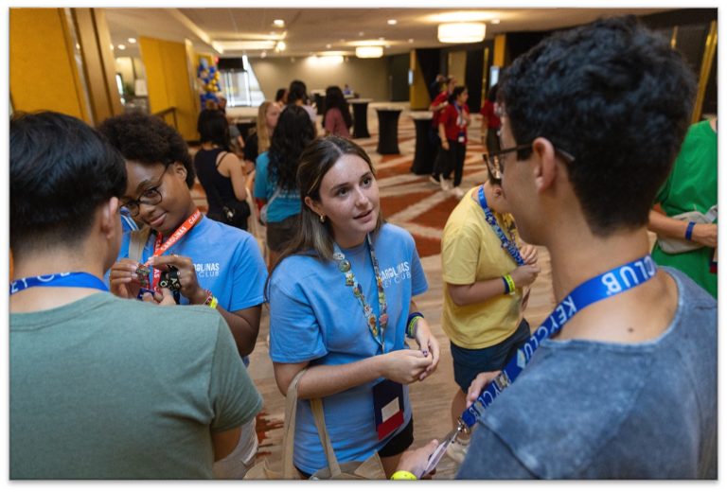
What’s next after Builders Club?
Key Club!
Notes:
Narration: If you are a Builders Club member who is being promoted to high school, you can continue your service leadership journey through Key Club.

Slide 2

What is Key Club?
Notes:
Narration: What is Key Club?

Slide 3
Key Club is ….
A club for high school age youth.
A place to make friends and belong.
A place to do service and continue to grow as a leader.
Part of the Kiwanis family.
Notes:
Narration: Key Club International is a student-led club with opportunities for high school or secondary school youth to do service, build character and develop leadership. There are more than 200,000 Key Club members in over 40 countries.

Slide 4




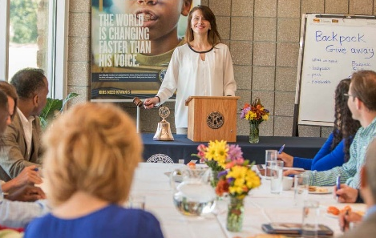
Key Clubs are made up of ….
Members and officers
Faculty
advisor
Kiwanis
advisor
Host school or organization
Sponsoring Kiwanis club
Notes:
Narration: Students are at the center of Key Clubs, as members and officers. Clubs are supported by a faculty advisor (from the host school or organization) and often by a Kiwanis advisor, too.​

Slide 5
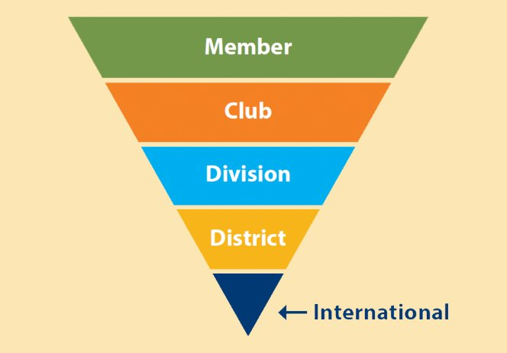
Key Club offers leadership opportunities!
Notes:
Narration: Key Club also has new opportunities that Builders Club did not have. Let’s learn how Key Club is organized so we understand what leadership experiences are open to members. ​
​
There are multiple levels of student leadership in Key Club. Here are the levels and how members can get involved beyond their club.​
​
Member: Every Key Club is made up of members. Each member must be willing to perform at least 50 hours a year of combined service to their home, school and community.​
​
Club: Key Clubs are established in high schools, secondary schools, and community-based organizations. The officers of a Key Club include a president, vice president, secretary, treasurer, editor, webmaster and one director from each class. ​
​
Division: Key Clubs in a geographic area make up a “division.” Each Key Club division is led by a lieutenant governor – a student leader who supports the clubs and carries out district policies. ​
​
District: Two or more divisions make up a Key Club district. These districts have clubs from one or more U.S. states or one or more countries (such as California-Nevada-Hawaii district or Caribbean-Atlantic district). Each Key Club district is led by a governor (this is a student that is elected by students that attend the annual Key Club district convention). (That’s right, as a Key Club member, you can attend a Key Club District Convention!)​
​
International: Key Club International is made up of clubs from more than 30 districts and clubs in other countries not included in any specific district. It is led by an international student board, which is composed of a president, vice president and 11 trustees. ​
​
One of the most exciting events of each year is the Key Club International convention – an annual four-day, four-night event that brings together Key Club members from around the world for fun, fellowship, education and more. Attendees participate in workshops, seminars and interactive sessions that focus on honing leadership skills and promoting fundraising and service initiatives. The convention also acts as a foundation for networking, allowing Key Club members to connect with peers from other districts and share ideas.

Slide 6
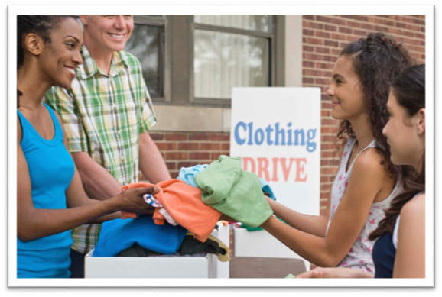

Continue to learn about and improve your community!
Notes:
Narration: You know that communities, and the world, have urgent needs for basic resources and efforts that improve the lives. Like in Builders Club, as a Key Club member, you would learn about these needs and carry out service projects to address them.

Slide 7




Support causes you care about!
Notes:
Narration: Through Key Club, you can support a variety of causes that matter to you. AND, you can educate others about how to help, too.

Slide 8



Key Club creates a positive place to belong!
Help others in big and small ways and boost your happiness!
Work as a team to develop leadership skills and increase self-confidence.
Serve with friends who support you and embrace your uniqueness!
Notes:
Narration: Key Club is good place to be! The activities are designed to build leadership and teamwork. Clubs give students a place to belong and gain confidence.

Slide 9
Here’s what members say about Key Club!
“Key Club is a place where I can really be myself and feel like I’m part of something bigger.”​
“My mental health has drastically improved since joining an organization that is bigger than myself and aims to make the world a better place for all of us.”​
“From food drives and park clean-ups to collecting clothing and organizing blood drives - Key Club helps connect schools and students to their communities.”​
Notes:
Narration: Here are a few things members said about being in Key Club.

Slide 10

Plan to become a
Key Club member!
My school doesn’t have one. I’m starting a Key Club!
I’m joining the Key Club at my school.
Notes:
Narration: Here’s how you can become a Key Club member when you arrive at your new school.

Slide 11

Join a club!
Ask office staff for the name of a faculty advisor.
Meet the advisor.
Attend a meeting.
Join the club!
Notes:
Narration: If the high school or secondary school you’re attending has a Key Club, it’s easy to join. Ask staff in the school office for the faculty advisor’s name. Visit the advisor and find out when and where the club meets. Attend a meeting to see what the club is like. Then, join!

Slide 12
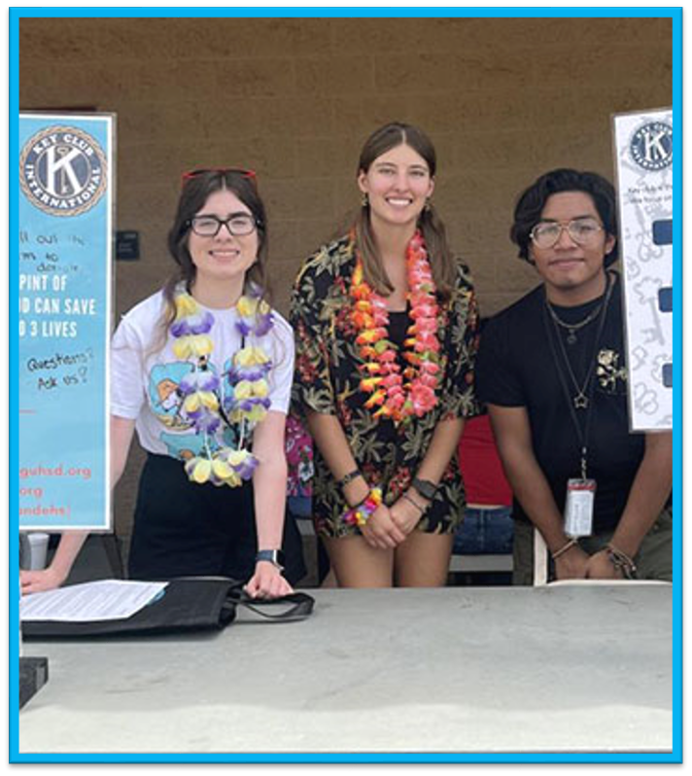

Start a club!
Get approval of the principal or director.
Find a Kiwanis club that will be your sponsor.
Find a faculty advisor.
Recruit members.
Gather funds to pay the charter fee.
Complete the chartering form.
Notes:
Narration: If the new school doesn’t have a Key Club, you can start one. ​
First, talk to the principal or director about your desire to start a club. ​
2. After the principal agrees to the school having a club, contact a Kiwanis club in your community to ask if it will sponsor your Key Club. If the club will not be a sponsor, reach out to Key Club International, and we’ll help you find a sponsor. ​
3. Next, find a faculty advisor. Identify one or more teachers or staff members to be the club advisor. You might consider someone who has particular interest in service or leadership development, or perhaps someone who was a Key Club member when they were a student!​
4. Recruit members. To be chartered, a club must have 11 members or more. Anyone who is a member when the club begins is a charter member, and the initial set of officers are charter officers. Find students who have a passion for helping others and ask them to join. ​
5. Gather member fees or funds from the host school or sponsoring Kiwanis club to cover the cost of chartering a club. Make sure potential members know that part of Key Club membership is paying annual dues.​
6. Complete the chartering form and submit your form and chartering fees to Key Club International.

Slide 13
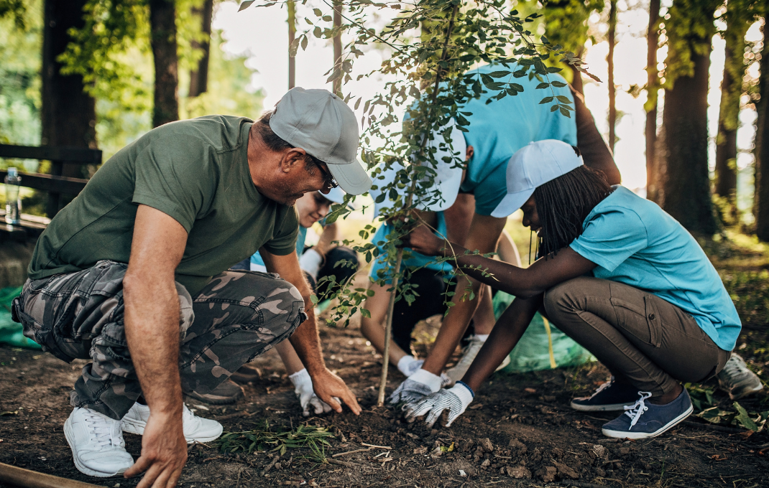
Make an impact as a
Key Club member!
Notes:
Narration: We hope you’ll join Key Club next. You can make a huge impact in the school, community, district and world in Key Club!

Slide 14
Need help?
Contact the
Kiwanis Service Leadership Program Team
at
KeyClub@Kiwanis.org

