Slide 1

What is Builders Club?

Slide 2
Members describe Builders Club as…
Fun.
Encouraging.
Exciting.
Collaborative.
Creative.
Learning.
Inclusive.
Welcoming.
Helpful.
Caring.
Community
Productive.
Service.
Leadership.
Student-led.
Life changing.
Notes:
Builders Club members describe their clubs in positive ways. The descriptions they share on annual surveys show that they understand the purpose of the program and feel a sense of belonging, fun, and positive use of time. Their words show the value of Builders Club to themselves and to their community.

Slide 3
A club for youth in their middle school years.
A place to make friends and belong.
A place to become empowered, confident service leaders.
Part of the Kiwanis family.
Builders Club is…
Notes:
Builders Club is the Kiwanis International club for middle school or middle years age students. It’s the second step in a Kiwanis family lifetime of service (after K-Kids). Youth find a place to belong and to make friends during an age when they search to better understand themselves and where they fit in the world around them. Builders Club is designed with experiences to help students continue to develop and become empowered as they lead and serve others.

Slide 4
Builders Clubs Benefit Kiwanis Clubs
Notes:
Sponsoring a Builders Club has a number of benefits for a Kiwanis club.

Slide 5

Grow the Kiwanis family, adding young members
Notes:
First, a Kiwanis club that sponsors a Builders Club will grow the number of young members in the Kiwanis family internationally and in their local area.

Slide 6
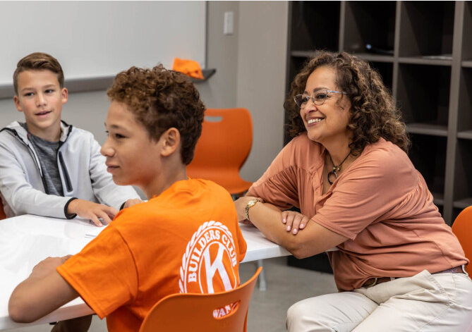
Add opportunities for intergenerational engagement
Notes:
Sponsoring a Builders Club creates opportunities for a Kiwanis member to become the club’s Kiwanis advisor who engages with students during meetings and service. The Kiwanis club can also welcome the Builders Club to participate in joint service opportunities. What a great way to celebrate service across the generations!

Slide 7

Introduce adults in schools and organizations to Kiwanis
Notes:
Adults in the host school or organization – from leaders to teachers to parents – will learn about your Kiwanis club. This is an opportunity for member recruitment!

Slide 8

Build club’s visibility, reputation and leadership in the community
Notes:
As your Kiwanis volunteers engage in service with the Builders Club, your Kiwanis club can benefit from greater visibility with organizations and people that don’t know about Kiwanis in your community.

Slide 9
Builders Clubs Benefit
Communities
Notes:
Like Kiwanis clubs, Builders Clubs benefits your community in many ways.

Slide 10


Fill needs and improve communities by contributing time and resources
Notes:
Communities and the world have urgent and ongoing needs for basic resources and things that improve the lives of people and animals. Builders Club members learn about the needs and carry out service projects that address them. They contribute their time, lead fundraising campaigns and organize donation drives to fill these needs. They give food, warm clothing, blankets, toiletries, books, pet toys, cards, artwork, and so much more. They clean parks and beaches, serve food, visit elderly residents in assisted living facilities, grow community gardens, and more.

Slide 11



Raise awareness about community and world needs and issues
Notes:
Builders Club members learn how to educate and advocate for community needs, social issues and organizations. They advocate for people with disabilities and supporting organizations like the Special Olympics. They promote kindness and lead anti-bullying campaigns. They promote recycling and reducing use of disposable plastic and paper products.

Slide 12
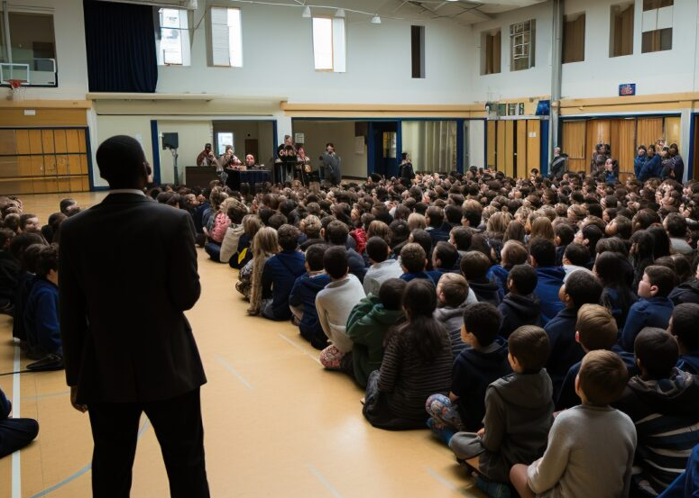
Help youth and schools connect to organizations
Notes:
Having a Builders Club increases engagement between students and their school or organization and the local organizations or groups they connect with and serve. Builders Clubs arrange for staff from organizations to speak at club meetings and assemblies; and members educate others about the needs and issues in their community and important organizations in the community and world.

Slide 13
Builders Clubs Benefit
Young People
Notes:
Belonging to a Builders Club provides many benefits to young members.

Slide 14
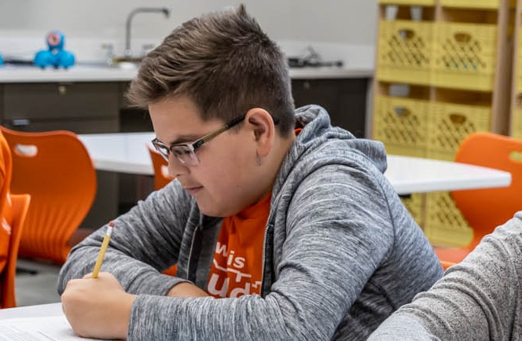


Create a positive place where kids grow
Promotes positive behaviors (like educational attainment) and decreases detrimental behaviors.
Builds leadership in big and small ways, in club officers, committee chairs and members.
Gives students a sense of belonging, connection and confidence.
Notes:
Membership in a club promotes positive behaviors for students and decreases detrimental behaviors. Builders Club is designed to build leadership and teamwork in students, whether they are club officers, committee chairs or members. And, crucial to a youth’s social-emotional wellness in their middle years, Builders Club offers them a place to learn more about themselves, feel connected to other students and adults, find a place to belong, and build considence.

Slide 15








Build essential soft and hard skills
Empathy
Communication
Collaboration
Problem solving
Goal setting
Event planning
Creating a budget
Making a fundraising request
Notes:
Skill development is built into the many Builders Club activities for planning and carrying out service projects, working with teammates in club life, and serving in formal and informal leadership roles. Students develop and hone soft skills like empathy, communication, collaboration, and problem-solving. They also develop hard skills that are task-specific like goal setting, event planning, creating a budget, and making a fundraising request.

Slide 16
Basics of Builders Clubs
Notes:
Here is some basic information about what Builders Clubs look like, who is involved and how they operate.

Slide 17

Partnership forms a Builders Club
School or organization, where the club meets; provides a faculty advisor.
A sponsoring Kiwanis club that pays the Builders Club’s fees and provides a Kiwanis advisor.
Notes:
A Builders Club is usually formed in partnership between two groups. The first is a school, youth organization, library or community center that will host the new club. This host site provides members, a meeting space and a faculty advisor for the club. And your Kiwanis club can be the other partner! A local Kiwanis club usually sponsors a new Builders Club. The Kiwanis club pays its charter and annual renewal fees and provides a volunteer to serve as the Builders Club’s Kiwanis advisor. The sponsoring Kiwanis club can also invite the Builders Club to partner on service projects and attend special Kiwanis events.

Slide 18
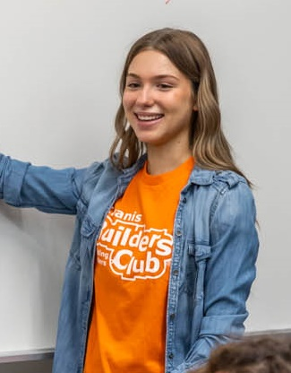





People involved in a Builders Club
Faculty advisor
Members, officers and committee chairs
Kiwanis advisor
School or site administrator
Sponsoring Kiwanis club
Kiwanis district administrator
Notes:
Students are at the center of Builders Clubs. Students are members, officers and committee chairs. Kiwanis recommends at least 15 members in a club. The club has a faculty advisor who communicates with their school or site administrator about the club. Most clubs also have a Kiwanis advisor who supports the Builders Club and is the liaison to the sponsoring Kiwanis club. The Kiwanis district provides an administrator to support advisors and grow Builders Clubs in your state or region.

Slide 19
The Faculty Advisor’s Role
Recruit
Recruit members.
Help
Help members use talents, build skills and learn service leadership.
Mentor
Mentor officers, chairs & members.
Follow
Follow school/site procedures and Kiwanis youth protection policies.
Submit
Submit surveys & reports.
Be a team
Work with Kiwanis advisor.
Liaison
Be a liaison to school/site leadership.
Notes:
The faculty advisor has the primary role in ensuring a club has members, meets regularly and carries out service projects. They recruit members, help them understand their talents and build their skills. The faculty advisor serves as a mentor and guide. The faculty advisor is a teacher, staff member, coach or other adult affiliated with the host site. They work with the Kiwanis advisor to determine how they will help with the club, to keep them informed, and to share updates for the sponsoring Kiwanis Club.
The faculty advisor is familiar with the school or organization’s procedures and acts as liaison between the Builders Club and school administration.

Slide 20
The Kiwanis Advisor’s Role
Attend Builders Club meetings and service events.
Meet with faculty advisor to determine specific responsibilities.
Follow school/site procedures and Kiwanis youth protection policies.
Be the liaison with the Kiwanis Club. Share invitations and Builders Club’s progress and needs.
Update
At start of each year, update Kiwanis club secretary on information to get program kit ordered.
Be a team
Attend
Liaison
Follow
Help
Help with activities, like officer training, service events and making community connections.
Notes:
A big part of the role of Kiwanis advisor is being present and attending meetings and service events. It’s important to meet with the faculty advisor at or before the beginning of the service year to determining how to help the club. For example, Kiwanis advisors can help train officers and can make connections for the club to community organizations and guest speakers. They can help complete the Annual Achievement Report and contest submissions.
A very important role for the Kiwanis advisor is also serving as the liaison between the Kiwanis club and the Builders Club. At the beginning of the year, they can communicate with the Kiwanis club secretary to provide important information including the membership count so the secretary can renew the Builders Club to get the club’s program kit ordered and shipped.

Slide 21



Club meetings and locations
.
How: Clubs meet weekly, twice a month or monthly. Advisor–officer.
When: The new service year starts at the beginning of your school year.
Where: Over 1100 clubs worldwide with about 26,500 members.
Notes:
Club meetings are held weekly, twice a month or monthly or another frequency that makes sense for the faculty advisor availability and time available for activities at the school or host site.
The new service year starts at the beginning of a club’s school year. At Kiwanis, we have new program kit materials ready to ship and start Service Leadership Program activities (like newsletters and training) at the beginning of the North American school calendar in August and September.
As of 2022, there are more than 1100 Builders Clubs worldwide with about 26,500 members.

Slide 22

What Kiwanis International provides
Dedicated staff develop club programming.
Advisor
e-newsletters.
Website with resources and awards information.
Data collection to improve programs.
Youth Protection training and background checks for Kiwanis volunteers & club advisors.
Liability insurance coverage for clubs.
Advisor training.
Annual Builders Club program kit with advisor and member materials.
Notes:
Kiwanis International SLP staff offers lots of support for Builders Clubs and their advisors. This support is made possible through the charter and annual renewal fees paid by sponsoring Kiwanis clubs.
Dedicated staff that develops club resources and programming.
A club program kit with resources sent to clubs (in North America and the Caribbean) annually.
A Builders Club website with many service leadership resources, recruitment resources, awards information, and more.
E-newsletters and virtual training for advisors.
Youth protection training and support.
Liability insurance to protect members and advisors.

Slide 23
How to Start a Builders Club
Notes:
Here is how to start a Builders Club.

Slide 24
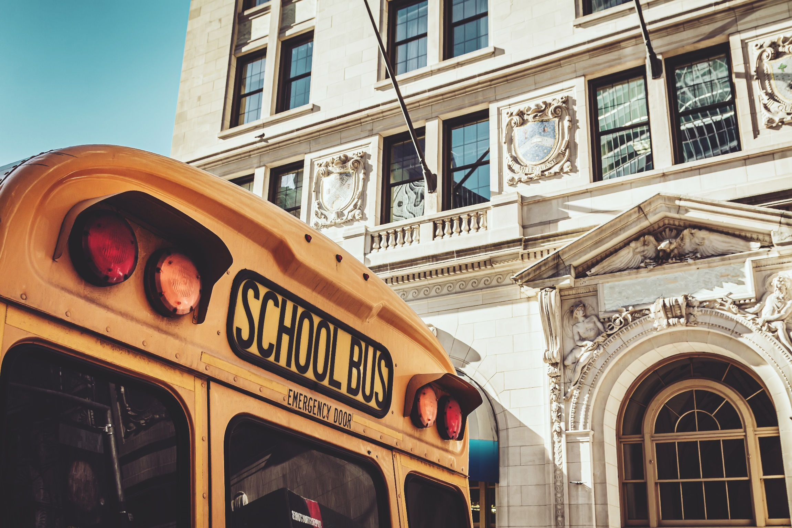
Find a partner to host the club
Notes:
There are just two steps for your Kiwanis club to take to start a new Builders Club! The first is to find a site that wants to host a Builders Club for its students or young members. This can be a middle school/middle years program, a youth organization (like a Boys and Girls Club or YMCA), a community center, a library, a homeschooling group, congregation or other place where students aged 12-14 meet. Consider reaching out to your members to find those who have a relationship with a school or other potential site to help you start a conversation. Also, remember that a Key Club or a Circle K club may also co-sponsor a Builders Club. So, if your Kiwanis club sponsors a Key Club or CKI, invite them to help!

Slide 25
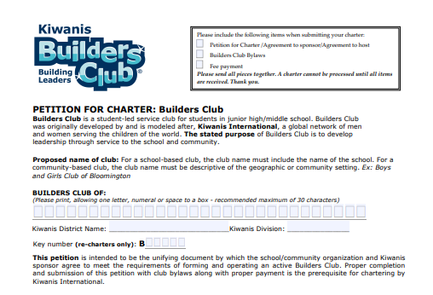
Complete the “Petition to Charter”
Visit buildersclub.org/start-a-club/
Notes:
Once your Kiwanis club has identified a school, youth organization or other community-based place that wants to host a Builders Club, work with your partner to complete the Petition to Charter. This form is found in the “Start a Club” section of the Builders Club website. The form is an agreement between the host site and sponsoring club and has sections for each partner to complete. The final step is for your Kiwanis club secretary to submit the form to Kiwanis International, accompanied by the club chartering fee.

Slide 26
Cost to charter & renew a Builders Club
  Chartering fees:
    North America/Caribbean & Tier A: US$400
    Tier B (outside NA/Caribbean): US$300
    Tier C (outside NA/Caribbean): US$200
  Annual (renewal) fees:
    North America/Caribbean: US$215
    Tier A (outside NA/Caribbean): US$50
    Tier B and C (outside NA/Caribbean): US$25
For questions, contact slpchartering@ kiwanis.org
Notes:
The cost for starting a Builders Club in North America and the Caribbean is US$400 for the chartering fee. For other countries, contact slpchartering@kiwanis.org to find out which tier your country belongs to and the cost for chartering a club in your country. The annual renewal is US$215 in North America and the Caribbean. The annual renewal is lower for clubs outside the U.S., Canada and the Caribbean because they do not receive program materials after their initial charter kit.
Bring Up Grades, or BUG, recognizes elementary students who raise their grades or maintain good grades from one grading period to the next.
Students are motivated to achieve because they set their own goals and participate in peer mentoring, which involves everyone in their success.
When they reach their goals, the entire class celebrates. Kiwanis clubs and members are key to ensuring that the students feel supported in their efforts and recognized appropriately for their achievements.

Slide 27
Resources for Builders Clubs
Notes:
The resources Kiwanis International has created for Builders Clubs are based on research around high-quality service and healthy youth development. They provide a foundation of understanding about self and community.

Slide 28
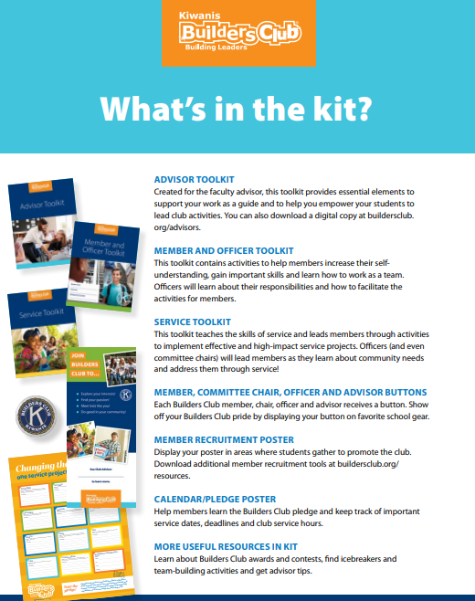
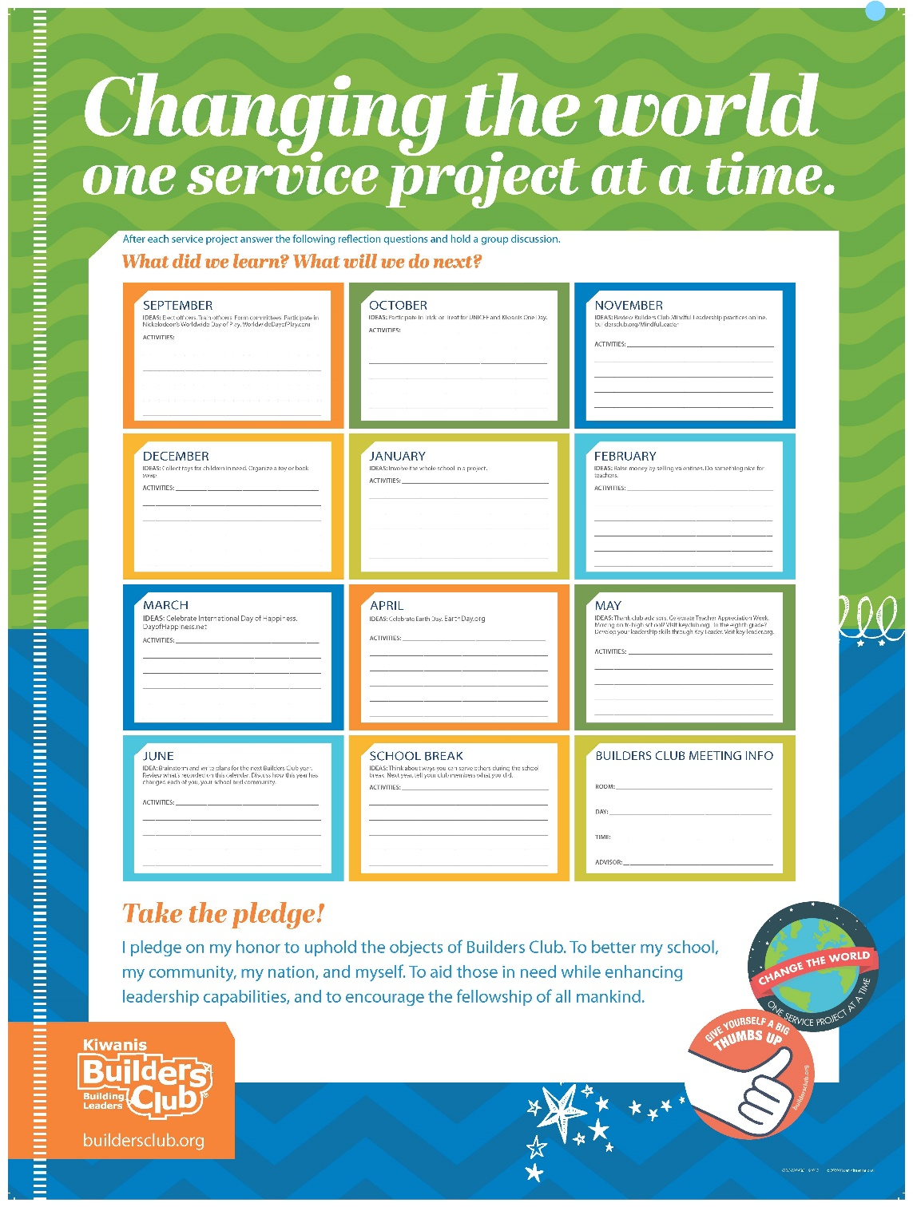
The Builders Club Program Kit
Notes:
Your sponsorship of a Builders Club provides the club with the program kit. This kit contains guides for advisors, members and officers, and service, as well as a planning calendar, teambuilding activities, buttons and more. Program Kits are shipped AFTER Kiwanis receives the club’s charter or renewal fee, member quantities and shipping information from the sponsoring Kiwanis club’s secretary.

Slide 29


Resources for advisors and service
The K-Kids Advisor Guide:
The advisor’s primary resource!
Notes:
The main resources in the program kit are three guides. The Builders Club Advisor Toolkit offers guidance on how to run a club, the roles of officers and committee chairs, tasks to complete throughout the year, and more. The Service Toolkit contains activities with step-by-step instructions to help officers and advisors lead members through each step in a high-quality service project, as well as useful forms for different types of projects.

Slide 30
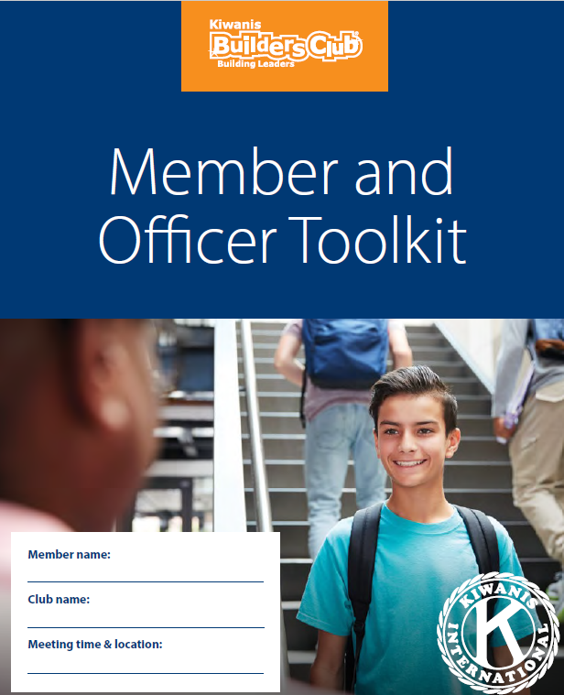
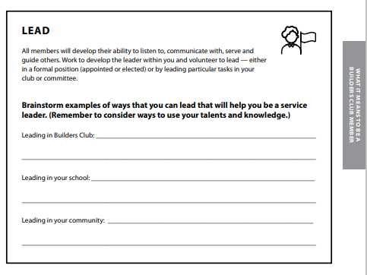
Members and officers learn and act
K-Kids Member Guide
Notes:
Officers, committee chairs and members receive the Builders Club Member and Officer Toolkit. This guide helps members better understand themselves – their interests and skills and their community. It helps them decide how to use their knowledge and skills for service. For example, in the toolkit activity shown here, members brainstorm how they can be leaders in their club, school and community!
The Toolkit also contains an officer and committee chair section that explains the responsibilities and roles of each officer and the chair position.

Slide 31

Start a Builders Club today!
Notes:
Now that you’ve learned about Builders Club, consider how starting a new club will benefit your Kiwanis club, its members, the local community and students in their important middle years.

Slide 32

Service Leadership Program Staff
Luana Nisan
Luana Nissan
SLP Manager
lnissan@kiwanis.org
a J. Pyron
Lisa Pyron
SLP Development Specialist
lpyron@kiwanis.org
Notes:
Kiwanis’ SLP staff can answer questions the role of a Kiwanis club in chartering and supporting a Builders Club. This is their contact information. Thank you!

