Slide 1

Club Advisor Check-in Chat
Tuesday, March 7, 2023

Slide 2

Awards & Recognition
Participating is easy and fun!
Awesome!
Notes:
We are here to share information about how easy and fun the Award process is.

Slide 3




Plan ahead
All releases and forms are posted online at BuildersClub.org/advisors and shared in the Advisor Toolkit.
Review Awards and Recognition Opportunities on the Builders Club website.
Notes:
Keep all your information in an organized manor so you can use it the next year.
Saving information in a sharable place, is best, so that new club members can gain access when it’s time to start the award entry process again the next year.
Great places where you’ll find information are online and in the Advisor Toolkit.

Slide 4
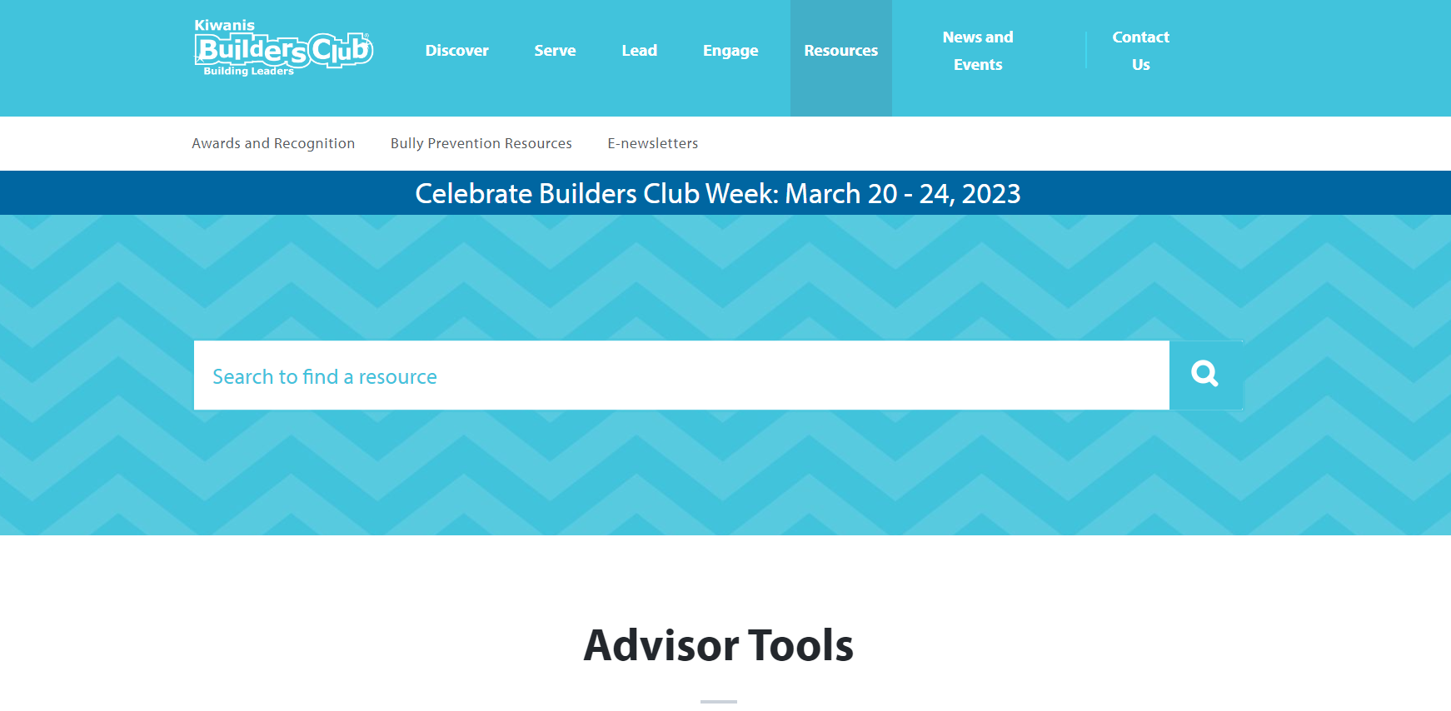
Award Information
https://www.buildersclub.org/awards-and-recognition
Notes:
The Builders Club website is your friend. Let’s look online, review award opportunities and share information with your Builders Club members. Visit BuildersClub.org/awards-and-recognition.

Slide 5

Planning
September
Review and share award opportunities with club members.
Form an Awards and Recognition Committee to track the club’s progress for attaining recognition.
October thru April
Receive updates from the Awards and Recognition Committee during club meetings.
May
Submit award entries online at BuildersClub.org.
Notes:
Be intentional about participating in awards. Tracking the amazing work club members do will make the award entry process easy and fun. There are fun ways to do this that we’ll discuss as we move through the rest of the presentation.

Slide 6

What’s next
Make the award entry process easier by doing these things!
Notes:
Here’s what we can do to make the award entry process easy.

Slide 7
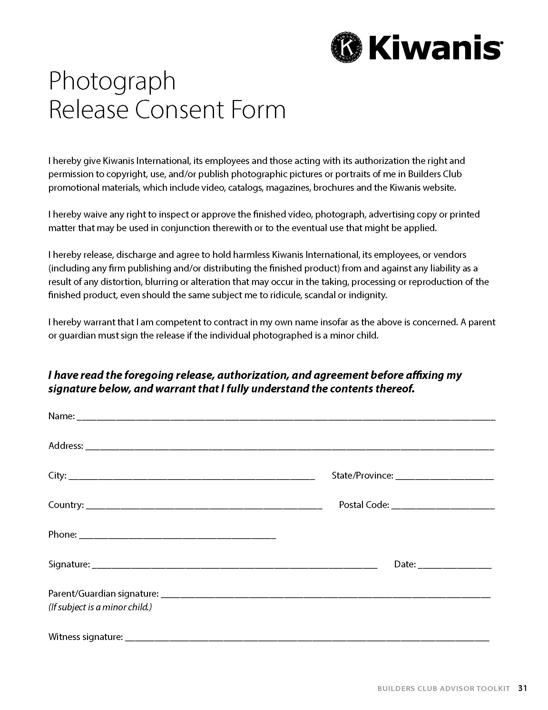
Photo releases
Releases are posted on BuildersClub.org/advisors
Notes:
Make sure to distribute consent releases at the beginning of the year, so that any photos you take of Builders Club members can be included in award entries and in social media posts.
Photo consent releases can be found online at BuildersClub.org/advisors and in the Advisor Toolkit provided in the Builders Club program kit.

Slide 8

Assign club reporters
Notes:
Assign club reporters at the beginning of the year. Ask students to work together to write about the happenings at each club activity and project. Start a shared Google document where information can be saved.

Slide 9

Assign photographers
Notes:
Assign club photographers at the beginning of the year so club members capture the club’s best moments of planning and conducting community service. Ask students to work together to determine what makes the best photograph and everyone will be tasked with following these best practices when taking photos.
Save photos in a shared Google file so that others in the club have easy access to these photos for use.

Slide 10

Award opportunities
Notes:
Here are award opportunities.

Slide 11

Individuals
Distinguished Club Officer
Nomination criteria
General award information
Submit nominations by May 1, 2023
Notes:
Distinguished Club Officer
Do you know a club officer who deserves to be recognized for their outstanding contributions to your club? Nominate them for a Distinguished Club Officers award! Ask your club advisor to help you tell us why you think your club officer has gone above and beyond the call of service.

Slide 12
Award Information
Distinguished Club Officer
There is no limit to which club officers can be selected per district. Any member, fellow club officer, club advisor or district administrator may nominate a club officer. (Club officers may not nominate themselves.)
Names of award recipients are posted on the Builders Club website, announced in the Builders Club monthly e-newsletter, and shared on the official Builders Club Facebook and Twitter pages.
Nominating is easy! Just complete this online form by May 1. Then stay tuned to hear the announcement of winners during the month of May.
Read the Distinguished Club Officers award criteria before getting started to ensure your honoree is eligible for recognition.
Notes:
Distinguished Club Officers
Award information
There is no limit to which club officers can be selected per district. Any member, fellow club officer, club advisor or district administrator may nominate a club officer. (Club officers may not nominate themselves.)
Names of award recipients are posted on the Builders Club website, announced in the Builders Club monthly e-newsletter, and shared through Builders Club official media channels.
Nominating is easy! Just complete this online form by May 1. Then stay tuned to hear the announcement of winners during the month of May.
Read the Distinguished Club Officers award criteria before getting started to ensure your nomination is eligible for recognition.
Award criteria
Any Builders Club officer in good standing in an active Builders Club is eligible to participate.
Submissions must be completed through the Builders Club online Formstack submission form.
Users can each submit only ONE entry for consideration.
Distinguished Club Officer nominations must be submitted by Monday, May 1. Submissions uploaded after this time will not be considered.
Distinguished Club Officer recipients will be posted on the website and announced via the official Builders Club monthly e-newsletter and on social media channels.
By submitting a nomination for Distinguished Club Officers, the honoree and everyone involved with the nomination agrees to the use of the honoree’s name, voice, likeness and photo/video submission in any advertising or promotion without compensation.
Kiwanis International employees, their licensees, associates, affiliates, subsidiaries, exhibitors or their immediate family member and/or those living in the same household are not eligible for this award.
By participating in this award nomination, entrants agree to be bound by the official award criteria.
Nominate: Distinguished Club Officer (Due May 1)

Slide 13

Individuals
Distinguished Club Advisor
Submit nominations by May 1, 2023
Notes:
Distinguished Club Advisor
Do you know a club advisor who deserves to be recognized for their outstanding contributions to your club? Nominate them for a Distinguished Advisors award and tell us why you think your club officer has gone above and beyond the call of service!

Slide 14
Award Information
Distinguished Club Advisor
There is no limit to which club advisors can be selected per district. Any member, club officer, fellow club advisor or district administrator may nominate a club advisor. (Club advisors may not nominate themselves.)
Names of award recipients will be posted on the Builders Club website, announced in the Builders Club monthly e-newsletter, and shared on the official Builders Club Facebook and Twitter pages.
Nominating is easy! Just complete this online form by May 1. Then stay tuned to hear the announcement of the recipients.
Read the Distinguished Advisors award criteria before submitting your nomination to ensure your honoree is eligible for recognition.
Notes:
Distinguished Club Advisor
Award information
There is no limit to which club advisors can be selected per district. Any member, club officer, fellow club advisor or district administrator can nominate a club advisor. (Club advisors may not nominate themselves.)
Names of award recipients will be posted on the Builders Club website, announced in the Builders Club monthly e-newsletter, and shared on the official Builders Club social media channels.
Nominating is easy! Just complete this online form by May 1. Then stay tuned to hear the announcement of the recipients.
Read the Distinguished Advisors award criteria before submitting your nomination to ensure your honoree is eligible for recognition.
Award criteria
Any Builders Club advisor in good standing in an active Builders Club is eligible.
Submissions must include content identified in the online nomination form. Videos, photos and files about subjects other than what is posted in the rules are not eligible and will not be judged
Submissions must be completed through the Builders Club online Formstack form. Other methods of submission will not be considered.
Users can each submit only ONE entry for consideration.
Distinguished Advisor nominations must be submitted by Monday, May 1. Submissions uploaded after this time will not be considered.
Distinguished Advisor recipients will be posted on the Builders Club website and announced via the official Builders Club monthly e-newsletter and on social media channels.
Those nominating a Distinguished Advisor, the honoree and everyone involved agrees to the use the honoree’s name, voice, likeness and photo/video submission in any advertising or promotion without compensation.
Kiwanis International employees, their licensees, associates, affiliates, subsidiaries, exhibitors or their immediate family member and/or those living in the same household are not eligible for this award.
By participating in this award nomination, entrants agree to be bound by the official award criteria.

Slide 15

Clubs
Annual Achievement Report
Reports may be submitted May 1 - June 10, 2023
Notes:
Builders Club members can complete the Annual Achievement Report online with the help of their faculty advisor. This self-scoring report shares activities the club needs to conduct to receive recognition. In fact, think of this report as a guide to what your Builders Club should achieve every year.
Reviewing the Annual Achievement Report at the beginning of the year ensures that the club accomplishes all the requirements to achieve recognition.
Reports are due June 10 and depending on the number of points earned, the club will be honored as a Distinguished Club or an Honor Club.
Faculty advisors of qualifying clubs will receive an email with confirmation of recognition and a link to download a digital badge to display on the school/club website, as well as social media graphics to promote the club’s achievement online.
Point totals: 15 points or more = Distinguished Club, 10 – 14 points = Honor Club

Slide 16
Award Information
Annual Achievement Report
Your club can be recognized as either a Distinguished Club or an Honor Club based on the number of points it earns from responses to the report’s questions.
Earn 15 points or more → Distinguished Club
Earn 10 – 14 points → Honor Club

Slide 17
Award Information
Annual Achievement Report
Did your club members utilize the Member and Officer Toolkit to research and plan one or more service projects?
Did your club elect officers the previous year or within the first three months of the current school year?
Did club officers receive training (virtual or live) utilizing the Member & Officer Toolkit?
Did the club secretary keep minutes for club meetings?
Did the club establish one or more committees?

Slide 18
Award Information
Annual Achievement Report
Did the club utilize online recruitment tools to recruit new members during the year?
Did your club participate in Trick-or-Treat for UNICEF? Visit unicefusa.org/trick-or-treat for more information.
Did your club share about Builders Club projects through the school's social media feeds?
Did your club celebrate Builders Club Week (The 3rd full week of March)?
Were club parents invited to attend a (virtual or live) meeting, projects or events?

Slide 19
Award Information
Annual Achievement Report
Did club members participate in (virtual or live) meetings or events with a Builders Club (middle school), Key Club (high school) or Kiwanis Club?
Did the club members conduct eight or more (virtual or live) club meetings?
Did club officers attend and/or present at least one (virtual or live) Kiwanis club meeting?
Did the club have 15 or more members by April 1?
Did you (or your fellow advisor) complete at least 4 monthly reports in the Kiwanis Online Reporting System? Visit buildersclub.org/monthlyreports for more information.

Slide 20

Clubs
Single Service
The service need
The project plan
Project implementation steps
Final results
Public Awareness
Member impact
Additional information
Entries can be submitted May 1 – June 10, 2023
Notes:
Did your club plan and conduct an amazing service project within the school and/or community? Did it leave a lasting impact with club members and those served by the service conducted? If so, submit your project for recognition as a Single Service Award.
Award criteria
Active Builders Clubs in good standing are eligible to participate.
Submissions must be completed through the online Formstack Single Service Award submission form.
Users can each submit only ONE entry for consideration.
A qualifying club Single Service Project is defined as a club service project planned, organized and produced by the Builders Club that occurred on a single day or consecutive days, or must recur on multiple days and address the same service goal.
The club will be asked to upload a document sharing (7) areas of interest about the service project. This includes: 1. Service need, 2. Project plan, 3. Project implementation, 4. Final results, 5. Public awareness, 6. Member impact, 7. Additional information. An opportunity to upload photos and other supporting documents is also provided. Review award criteriaSingle Service Award Criteria to assist with award submission preparation.
Review Single Service Award criteria at the beginning of the year to ensure club members understand the importance of documenting each step of researching, planning, implementing and evaluating service.
Submissions are due June 10 and depending on the number of points earned, the club will be honored as a Single Service Award recipient.
Faculty advisors of qualifying clubs will receive an email with confirmation of recognition and a link to download a digital badge to display on the school/club website, as well as social media graphics to promote the club’s achievement online.
Single Service Award recipients will be announced in the monthly Builders Club e-newsletter and through Builders Club social media channels.
Submit: Single Service Award (Submit May 1 through June 10)

Slide 21

Submission Process
BuildersClub.org/AwardsandRecognition
Notes:
All award submissions must be completed online using the proper award forms. Visit BuildersClub.org/AwardsandRecognition to view online submission information.

Slide 22
Recognition
How clubs are recognized
Digital award recognition
Award recognition is provided digitally. Presenter and recognition letters, certificates and electronic badges are all posted online for easy download.
The option of downloading and emailing recognition, printing and mailing a hard copy, or sharing the link and allowing the recipient(s) to download recognition is provided.
Award recipients are posted on the Builders Club website and shared in the Builders Club Advisor monthly e-newsletter and through Builders Club social media.
Notes:
Digital award recognition
Award recognition is provided digitally. Presenter and recognition letters, certificates and electronic badges are all posted online for easy download.
The option of downloading and emailing recognition, printing and mailing a hard copy, or sharing the link and allowing the recipient(s) to download recognition is provided.

Slide 23

Promoting the club
Notes:
Use what you’ve created this past year to promote the club. Share information about your club and the awards received on social media. Remember to notify Kiwanis by including #BuildersClub on any social media posts.

Slide 24

Any
questions?
Notes:
Kiwanis staff is always available to help. Call, email or check the website at BuildersClub.org/AwardsandRecognition.

Slide 25
Your thoughts?
Let’s review contests we’ve had in the past.
Digital member recruitment poster
Digital scrapbooks
Year-in-Review (club experience) video
Please share brief thoughts about bringing contest opportunities back.

Slide 26

Send us your thoughts
Luana Nisan
SLP Manager
lnissan@kiwanis.org
Lisa J. Pyron
SLP Development Specialist
lpyron@kiwanis.org

Slide 27
Let’s chat
What’s working this year for your club?

