Slide 1


Administrator Check-in Chat: CLUB GROWTH & RECOGNITION
Monday, March 27, 2023

Slide 2

Starting New Clubs
Awesome!
Notes:
While there are many people that can get clubs started, District Administrators are the primary drivers responsible for opening and supporting new clubs through the chartering process and beyond.

Slide 3

DA Responsibilities
Identify potential host institutions (schools, organizations, agencies) and share information on benefits of Builders Club; follow-up for their decision.
Match potential hosts and local Kiwanis clubs; facilitate a meeting and encourage a relationship. [If a Kiwanis club is not available to sponsor, assist host institution with chartering and how to renew club annually. Inform KI of no Kiwanis sponsor.]
Welcome and check on new club advisors.
Notes:
As a DA you have many responsibilities. Related to club growth, these are new responsibilities. Remember that growth means adding clubs but you also want to make sure that new clubs are thriving, not struggling.

Slide 4

Needed to start a club
A school, youth organization, library or community site that will host the SLP and provide a faculty advisor.
At least 15 students that will serve as members.
A sponsoring Kiwanis club (preferred): Pays fees and celebrates and/or partners on service projects.
Kiwanis advisor to assist with activities and be the liaison to the sponsoring Kiwanis club.
Host site agrees club will follow KI youth protection policies and use club’s program materials/resources for service and leadership.
Notes:
Finding a local Kiwanis club to sponsor a new Builders Club is preferred and usual. A host site may pay its own fees when Kiwanis sponsorship isn’t possible. We recommend at least 15 members in Builders Clubs. Hosts must agree that its club will follow KI policies.

Slide 5

Strategic places to grow clubs
School districts and communities without Builders Clubs where K-Kids and/or Key Clubs exist.
School districts without service or leadership development.
Youth organizations or centers with young members and no service or leadership programs.
Communities where Kiwanis club(s) are active and well-known.
Notes:
Be intentional about spending your new club recruitment efforts strategically. Where K family lines are missing in school districts and communities and where clubs have been but are no longer active are two specific places to explore and build relationships.

Slide 6

Ask Kiwanis clubs to help
Ask clubs sponsoring a K-Kids and/or Key Club to consider sponsoring a Builders Club.
Approach Kiwanis clubs that serve elementary/primary schools already with Terrific Kids or BUGS program.
Invite Kiwanis club members that are current or retired teachers to pitch creating a new club in affiliated middle schools.
Notes:
Similarly, there are Kiwanis clubs that may be more ready to agree to sponsorship of an SLP.

Slide 7
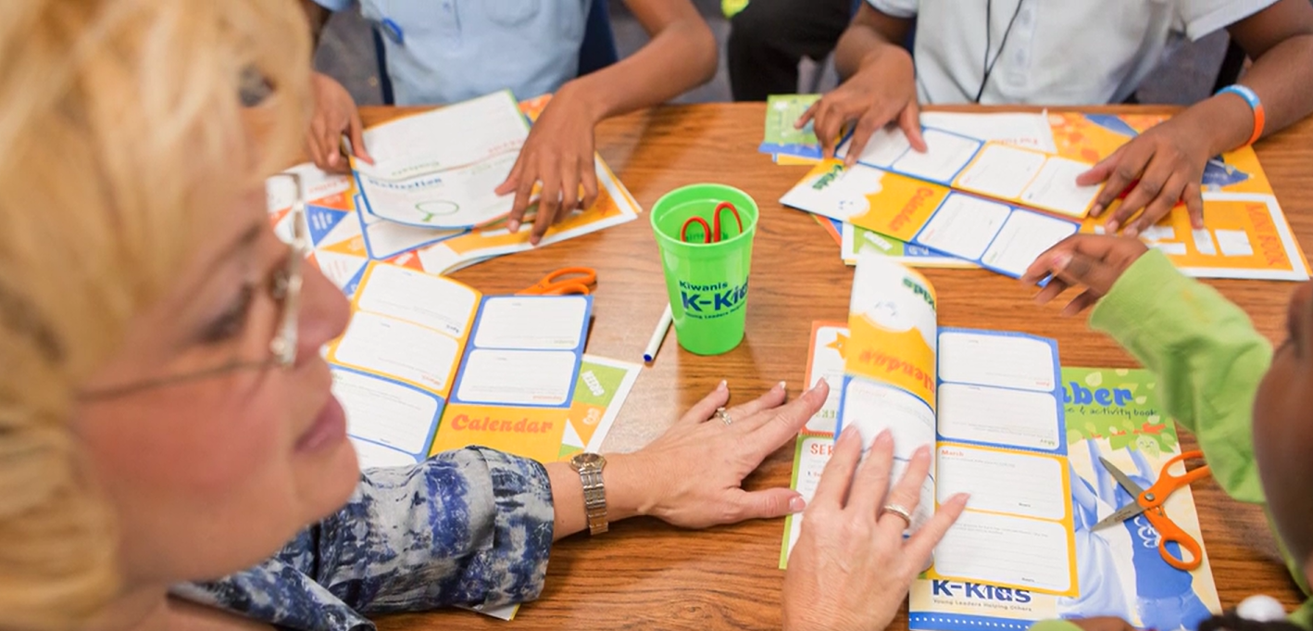
SLPs benefit Kiwanis clubs
Kiwanians gain opportunities for meaningful service and inter-generational engagement.
Provides a stronger connection and relationship to their community’s youth, adults, and schools.
Builds the Kiwanis club’s visibility and leadership in the community.
Notes:
Similarly, administrators can help Kiwanis clubs understand the substantial benefits they will gain from sponsoring and being involved with an SLP club! Sponsorships can make more connections for the Kiwanians to their local community, raise their club’s profile and provide opportunities for intergenerational service partnerships.

Slide 8
Lean into learning
Members learn essential life skills through Builders Club experiences!
SOFT SKILLS (interpersonal, unquantifiable)
collaboration empathy adaptability
communication empowerment creativity
critical thinking problem-solving and more…
HARD SKILLS (quantifiable, knowledge-based)
budgeting organizing creating & delivering presentations
fundraising interviewing email & letter writing
record keeping SMART Goal setting
Notes:
One of the biggest recent changes in K-12 education is a significant focus on building skills rather than memorizing content. As SLP members participate in club activities and events, students develop important social and emotional skills that help them make smarter decisions and avoid risky behavior. Notice that students learn highly valued soft skills (like communication, empathy, and adaptability), as well as hard skills from the specific tasks they do in their roles. In our curriculum revisions for Builders Club last year and K-Kids this year, we have emphasized the role of learning in club experiences. Sharing with schools that “learning” is a large component of what members do in Builders Club is a selling point for school districts – we’re helping schools teach students valuable skills and gain knowledge about their community and world.

Slide 9
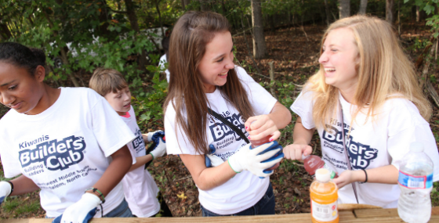








SLPs benefit the community
Fill real needs and improve communities by contributing time and resources.
Raise awareness about community needs and social issues.
Have increased educational attainment and decreased detrimental behaviors.
Help organizations connect to schools and youth.
Notes:
When you have conversations about creating new clubs with schools and other potential partner institutions, listen to the partners’ goals and match these with what Builders Club offers. Often this conversation will involve sharing the benefits youth gain from participation in Builders Club and the meaningful and substantial benefits the club (and school/organization) brings to the community. Particularly, there are the real contributions of time and physical resources a Builders Club makes that better many different community needs and raise awareness about them.

Slide 10
Cost of sponsoring a Builders Club
  Chartering fees in USD (without banner)
    North America/Caribbean & Tier A: $400
    Tier B: $300
    Tier C: $200
  Annual dues for Builders Club
    North America/Caribbean: $215
    Tier A (outside NA/C): $50
    Tier B and C (outside NA/C): $25
Notes:
These are the costs for starting and maintaining a Builders Club. The cost for countries beyond North America and the Caribbean depend on which Tier they fall under. Clubs outside the U.S., Canada and the Caribbean do not receive program materials after their initial charter kit.
Bring Up Grades, or BUG, recognizes elementary students who raise their grades or maintain good grades from one grading period to the next.
Students are motivated to achieve because they set their own goals and participate in peer mentoring, which involves everyone in their success.
When they reach their goals, the entire class celebrates. Kiwanis clubs and members are key to ensuring that the students feel supported in their efforts and recognized appropriately for their achievements.

Slide 11

How KI supports Builders Clubs
Dedicated staff develop Builders Club programming
Monthly advisor
e-newsletters.
Website resources.
Youth Protection training and background checks for Kiwanis volunteers & club advisors.
Data collection to improve programs.
Liability insurance coverage for clubs.
Advisor training.
Creation of annual Builders Club program kit with advisor and member materials.
Notes:
Kiwanis International supports Builders Club with all of the following items that are made possible through the charter and annual renewal fees paid by sponsoring Kiwanis clubs!
Dedicated staff that develops club resources and programming.
Builders Club program kit with resources sent to clubs annually.
Builders Club website offers current resources.
Online advisor training is offered each year.
Monthly e-newsletter for advisors.
Special events, like a new global club connection event coming next year.

Slide 12
Let’s chat
Where have you found the most interest in starting new clubs in your district?
What have been your biggest challenges in your work to start clubs?
What support, resources and tools do you need?
Other thoughts?

Slide 13
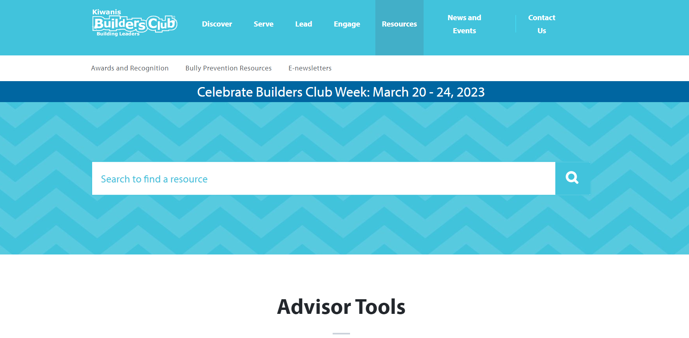
Awards & Recognition
https://www.buildersclub.org/awards-and-recognition
Notes:
Remind your club advisors and share information with them about upcoming award opportunities. All award submissions must be completed online using the proper award forms. For awards information, visit the Builders Club website at www.buildersclub.org/awards-and-recognition.

Slide 14

Planning
September
Review and share award opportunities with club members.
Form an Awards and Recognition Committee to track the club’s progress for attaining recognition.
October thru April
Receive updates from the Awards and Recognition Committee during club meetings.
May
Submit award entries online at BuildersClub.org.
Notes:
In the advisor guide and communications, we remind advisors to be intentional about reviewing awards and report criteria and keeping records about club activities to participate in contests. We encourage advisors to involve officers in this process and keeping track along the way will make the award entry process easy and fun for the students.

Slide 15
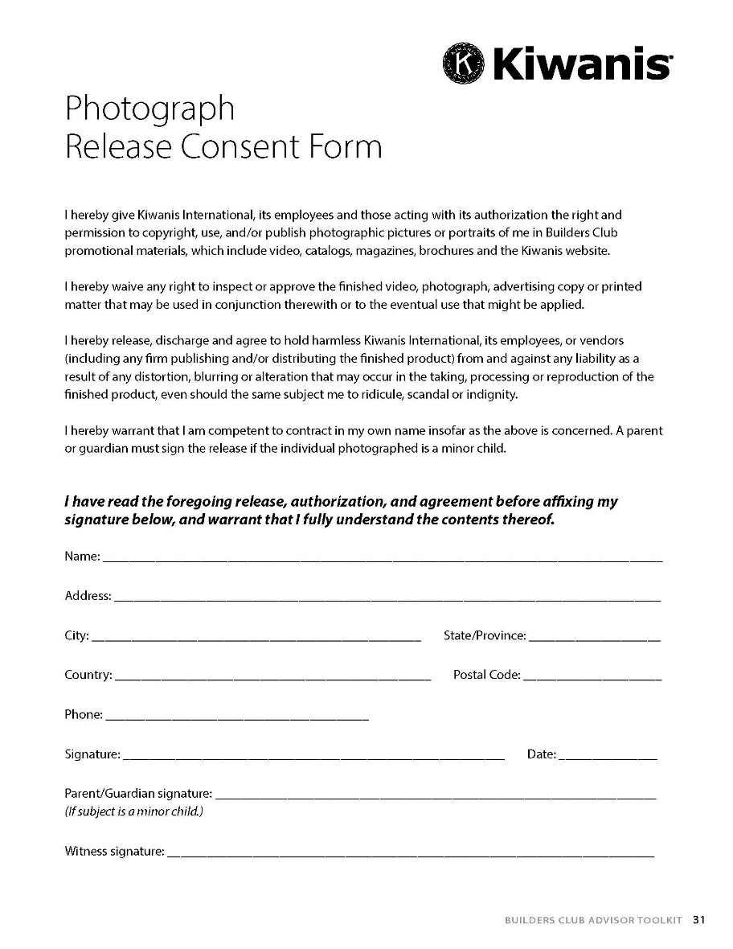
Photo releases
Releases are posted on BuildersClub.org/advisors
Notes:
Remind advisors to make sure to distribute consent releases at the beginning of the year, so that any photos they take of Builders Club members can be included in award submission entries and in social media posts by the club and district. Photo consent releases can be found in the Builders Club Advisor Guide and online on at BuildersClub.org/advisors

Slide 16

Award opportunities
Notes:
Let’s review award categories.

Slide 17

Individuals
Distinguished Club Officer
Nomination criteria
General award information
Submit nominations by May 1, 2023
Notes:
Distinguished Club Officer is for a club officer who deserve to be recognized for their outstanding contributions to their club. Winners will be announced no later than May 15, on Builders Club social media channels and in the May monthly newsletter.
The nomination process is easy.
Any member, fellow club officer, club advisor, or district administrator may nominate a club officer.
Club officers may not nominate themselves.
There is no limit to the number of club officers selected per district.
To enter, complete and submit the form by May 1. Then, share why you nominated a club officer on Facebook or Twitter. Tag us at @BuildersClub so everyone can see the officer’s incredible efforts.

Slide 18

Individuals
Distinguished Club Advisor
Submit nominations by May 1, 2023
Notes:
Distinguished Club Advisor is for club advisors who have made outstanding contributions to their club. Winners will be announced no later than May 15, on Builders Club social media channels and in the May monthly newsletter.
The nomination process is easy.
Any member, club officer, fellow club advisor, or district administrator may nominate a club advisor.
Club advisors may not nominate themselves.
There is no limit to which club advisors that can be selected per district.
To enter, just complete and submit the form by May 1. Then, share why you nominated a club advisor on Facebook or Twitter and tag #Buildersclub so everyone can see the advisor’s incredible efforts.

Slide 19

Clubs
Annual Achievement Report
Reports may be submitted May 1 - June 10, 2023
Notes:
Builders Club members can complete the Annual Achievement Report online with the help of their faculty advisor. This self-scoring report shares activities the club needs to conduct to receive recognition. In fact, think of this report as a guide to what your Builders Club should achieve every year.
Reviewing the Annual Achievement Report at the beginning of the year ensures that the club accomplishes all the requirements to achieve recognition.
Reports are due June 10 and depending on the number of points earned, the club can be honored as a Distinguished Club or an Honor Club.
Faculty advisors of qualifying clubs will receive an email with confirmation of recognition and a link to download a digital badge to display on the school/club website, as well as social media graphics to promote the club’s achievement online.

Slide 20
Clubs
Annual Achievement Report
Your club can be recognized as either a Distinguished Club or an Honor Club based on the number of points it earns from responses to the report’s questions.
Earn 15 points or more → Distinguished Club
Earn 10 – 14 points → Honor Club
Notes:
Points earned on Annual Achievement Report influence recognition. 15 points or more = Distinguished Club, 10 – 14 points = Honor Club

Slide 21
Clubs
Annual Achievement Report
Sample Report Questions
Did your club host an installation ceremony for new members at the start of the club year?
Did your club elect officers the previous year or within the first three months of the current school year?
Did the club organize and conduct at least one school-wide service project during the year?
Did the club secretary keep minutes for club meetings?
Did the club establish one or more committees?
Did your club use the IDEA guide for service?
Did club officers receive training?
Notes:
These are some of the questions asked on the Annual Achievement Report. In the questions, clubs can see the kind of effective practices and activities we encourage clubs to do.

Slide 22

Clubs
Single Service
The service need
The project plan
Project implementation steps
Final results
Public Awareness
Member impact
Additional information
Entries can be submitted May 1 – June 10, 2023
Notes:
Have your clubs planned and conducted amazing service projects within the school and/or community? If so, encourage them to submit their project for recognition as a Single Service Award.
Award criteria
Active Builders Clubs in good standing are eligible to participate.
Submissions must be completed through the online Formstack Single Service Award submission form.
Users can each submit only ONE entry for consideration.
A qualifying club Single Service Project is defined as a club service project planned, organized and produced by the Builders Club that occurred on a single day or consecutive days, or must recur on multiple days and address the same service goal.
The club will be asked to upload a document sharing (7) areas of interest about the service project. This includes: 1. Service need, 2. Project plan, 3. Project implementation, 4. Final results, 5. Public awareness, 6. Member impact, 7. Additional information. An opportunity to upload photos and other supporting documents is also provided. Review award criteriaSingle Service Award Criteria to assist with award submission preparation.
Review Single Service Award criteria at the beginning of the year to ensure club members understand the importance of documenting each step of researching, planning, implementing and evaluating service.
Submissions are due June 10 and depending on the number of points earned, the club will be honored as a Single Service Award recipient.
Faculty advisors of qualifying clubs will receive an email with confirmation of recognition and a link to download a digital badge to display on the school/club website, as well as social media graphics to promote the club’s achievement online.
Single Service Award recipients will be announced in the monthly Builders Club e-newsletter and through Builders Club social media channels.
Submit: Single Service Award (Submit May 1 through June 10)

Slide 23
How recognition is shared
Digital award recognition
Award recognition is provided digitally. Letters, certificates and electronic badges are posted online for download.
Determine how to distribute recognitions:
  email a digital copy
  print to present or mail a hard copy
  share a link for recipients and their families to download recognition themselves.
Award recipients are posted on the Builders Club website and shared in the monthly e-newsletter and social media.
Notes:
Award recognition is provided digitally. Presenter and recognition letters, certificates and electronic badges are all posted online for easy download. This provides the option of downloading and emailing recognition, printing and mailing a hard copy, or sharing the link and allowing the recipient(s) to download recognition is provided. Award recipients are listed on the Builders Club website and shared in the monthly e-newsletter and social media.

Slide 24

Promote the club
Notes:
Share information about your clubs and the awards received on social media. Remember to tag Kiwanis by including @BuildersClub on social media posts.

Slide 25

Any
questions?

Slide 26

Thank you!
Luana Nisan
SLP Manager
lnissan@kiwanis.org
Lisa J. Pyron
SLP Development Specialist
lpyron@kiwanis.org
Notes:
Kiwanis staff are always available to help. Here are our email addresses. Also, this PowerPoint and many resources for administrators are available at: www.buildersclub.org/district-administrator/

