Slide 1

Builders Club
Developing and Empowering Middle Years Service Leaders!
Notes:
Introduce yourself to the group to which you are presenting.

Slide 2

What is Builders Club?
Notes:
What is Builders Club?

Slide 3


Builders Club
Middle/Junior High School
Ages 12 – 15
buildersclub.org
A student-led, community service club for junior high or middle school students.
More than 1,600 clubs in 18 nations.
Notes:
Building self-esteem at a pivotal age
Builders Club members are discovering who they want to become. Builders Club focuses all their raw potential into service for others – empowering them to be themselves, work together, make plans, set goals and take action. As they participate in club activities and events, students develop important social and emotional skills that help them make smarter decisions and avoid risky behavior.

Slide 4
Builders Club Values
Learning: Acquiring skills and knowledge to develop self-awareness and service leadership over time.
Inclusion: Accepting and welcoming the differences and perspectives of others.
Common Good: Committing to making the school and community better for all.
Service: Turning empathy into action that betters the community or the lives of others.
Leadership: Listening, communicating, serving and guiding other effectively.
Notes:
Read the Core Values from the slide.

Slide 5

Builders Club Pledge
I pledge on my honor to uphold the Objects of Builders Club.
To better my school, my community, my world and myself.
To aid those in need while enhancing leadership capabilities and to encourage the fellowship of all.
Notes:
Read the Builders Club pledge from the slide.

Slide 6

How do Builders Club members help the school & community?
Notes:
How do Builders Club members help the school and community? Let’s review service conducted by actual Builders Clubs.

Slide 7
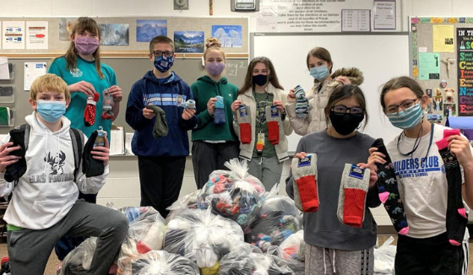
Service to Community
Held a sock drive to benefit the homeless.
Notes:
Having warm, dry feet makes all the difference to those who are homeless. In fact, socks are among the items most frequently requested by homeless shelters. Kiwanis family clubs in the Lincoln, Nebraska, area answered the call and held a sock drive. They collected more than 1,600 pairs.

Slide 8
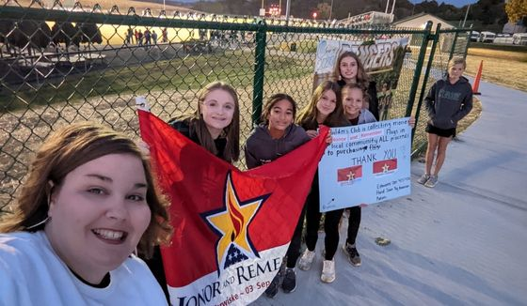
Raised funds to honor families who lost loved ones during military combat service.
Notes:
Members of the Forest Park Builders Club in southwestern Indiana raised more than US$900 to honor families who lost an immediate member during military combat service. The seventh and eighth graders researched projects and then collected money during a football game that will be used to buy personalized flags for three gold star families.

Slide 9
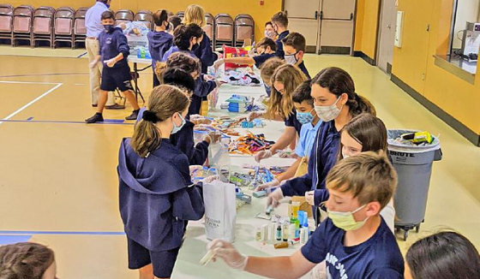
Packed necessities for people homeless
in their community.
Notes:
St. Joseph Builders Club and K-Kids joined forces in Bradenton, Florida, to help provide necessities for those experiencing homelessness.

Slide 10
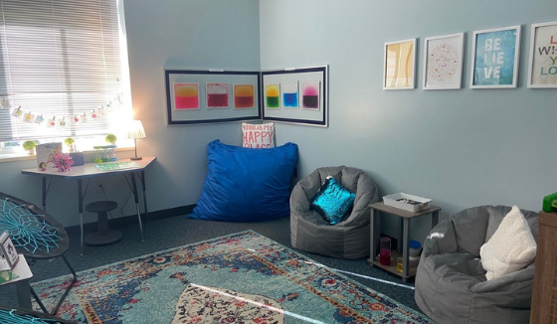
Created a Brave Room, quiet place, where students can de-stress.
Notes:
To help students de-stress this Builders Club rallied to acquire a room at school that could be transformed into a quiet haven. They created a Brave Room, students can access to de-stress.

Slide 11

Built a Little Free Library to provide free books to residents in their community.
Notes:
One of Kiwanis’ service partners is Little Free Library. Discounts and helpful resources are provided, and Builders Club decided to take advantage of this. They built a Little Free Library in their community and donated their favorite books for others to read.

Slide 12
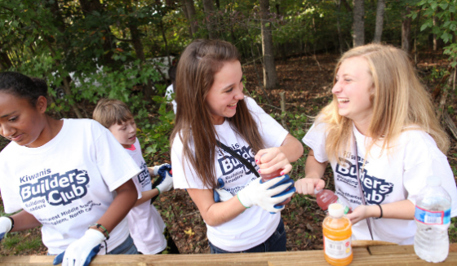
Provided cold drinks to volunteers during a park clean-up.
Notes:
This Builders Club offered refreshments to Kiwanis family volunteers and community volunteers helping with a park clean-up. They also helped with cleaning-up the park but really enjoyed connecting with others and helping they stay hydrated during the event.

Slide 13

Involvement in
Builders Club helps students and communities thrive!

Slide 14
Frequently Asked Questions
How many members are needed to start a club?
Its's suggested that the club start with at least 15 members.
When and how often should a club meet?
Most clubs meet during the lunch hour, before or after school. Club meetings last ½ hour to 45 minutes and clubs meet every other week, or monthly.
What’s the club structure
Club members elect officers (President, Vice President, Secretary & Treasurer)and establish committees. The Builders Club Bylaws offer suggested guidelines for running the club.
Visit BuildersClub.org/FAQ to find the answer to more fun questions.
Notes:
Read information noted on the slide.

Slide 15

Builders Club Support
How does Kiwanis support Builders Club?
Notes:
Now that you know what Builders Clubs do, lets learn how Kiwanis supports Builders Club advisors working with Builders Clubs.

Slide 16

Kiwanis International
Dedicated staff develop Builders Club programming.
Monthly advisor
e-newsletters.
Website resources.
Youth Protection training and background checks for Kiwanis volunteers & club advisors.
Data collection to improve programs.
Liability insurance coverage for clubs.
Advisor training.
Creation of annual Builders Club program kit with advisor and member materials.
Notes:
Kiwanis International supports Builders Club by doing the following:
Dedicated Builders Club staff develop Builders Club programming.
The Builders Club website offers current resources.
Online advisor training is offered each year.
Online service events are provided for members.
Monthly advisor e-newsletter.
Provides a Builders Club program kit with resources to clubs.

Slide 17

Kiwanis District Administrator
Connects Builders Club with other Kiwanis family clubs in the district.
Relays information from Kiwanis International.
Provides advisor training and resources for district clubs.
Provides support to clubs without Kiwanis sponsors.
Builds new Builders Clubs within the district.
Notes:
The Kiwanis District Administrator is the Kiwanis volunteer who provides support to Builders Clubs within a specific state or Kiwanis district.
The administrator does the following:
Connects Builders Clubs with other Kiwanis family clubs in the district.
Relays information from Kiwanis International.
Provides advisor training and resources for clubs in the district.
Provides support to clubs without Kiwanis sponsors.
Builds new Builders Clubs within the district.

Slide 18

Kiwanis Club
Sponsors the Builders Club and provides financial support.
Provides a Builders Club Kiwanis advisor.
Assists with service projects and fundraisers.
Supports the host school/organization as needed.
Provides Builders Club with additional service opportunities.
Notes:
The Kiwanis club sponsors Builders Club. The Kiwanis club offers the following support:
Provides financial support.
Provides a Builders Club Kiwanis advisor.
Assists with service projects and fundraisers.
Supports the host school/organization as needed.
Provides Builders Club with additional service opportunities.

Slide 19

Kiwanis Advisor
Attends Builders Club activities and meetings.
Assists with Builders Club service and fundraising projects.
Serves as the liaison between the Builders Club and Kiwanis club.
Provides Builders Club member, officer and advisor training.
Assists the Builders Club faculty advisor as needed.
Notes:
A volunteer from the Kiwanis club offers to serve as Kiwanis advisor to the K-Kids club. This is how the Kiwanis advisor supports the K-Kids club.
Attends club activities and meetings.
Assists with Builders Club service and fundraising projects.
Serves as the liaison between the Builders Club and Kiwanis club.
Provides Builders Club member, officer and advisor training.
Assists the Builders Club faculty advisor as needed.

Slide 20

Kiwanis Family
THE KIWANIS FAMILY ROCKS!
Notes:
Builders Clubs have even more support and service opportunities when teaming up with other Kiwanis family clubs. These include service clubs for elementary school students, high school students and college students.
Builders Club is part of a family of clubs which includes youth clubs for every age group:
K-Kids for elementary school students
Builders Club – this is you!
Key Club for high school students
Circle K of college students
Kiwanis for adults
Builders Club members can continue to grow as leaders and participate in community service as they get older by continuing membership in the Kiwanis family.

Slide 21
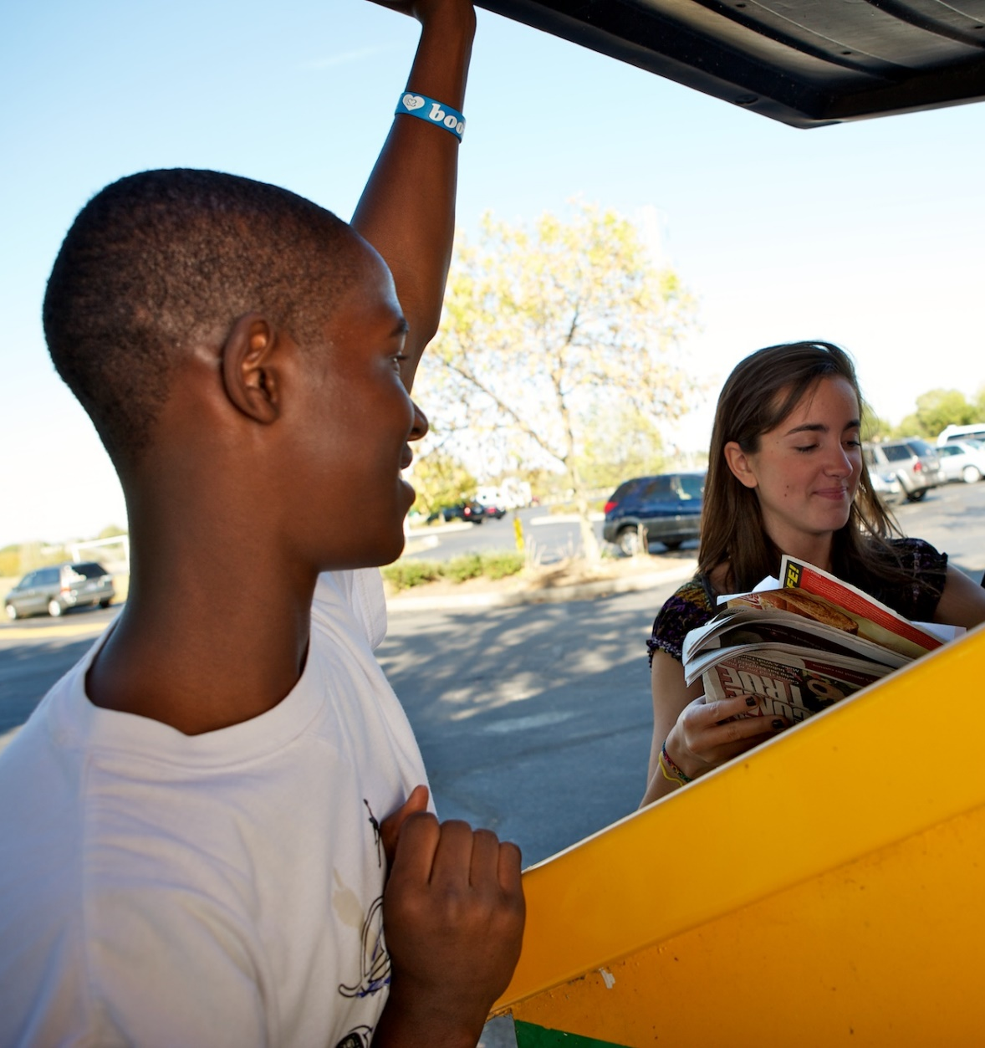

Key Club
I’m using all the skills I learned in Builders Club. Joining Key Club in high school was a great decision!
Secondary/ High School
Ages 14 – 19
keyclub.org
Oldest and largest student-led service club for high school students.
Club, District, International Leadership opportunities.
Located in 34 nations with more than 244,000 members.
Notes:
Builders Club members develop important skills they can continue to use in Key Club.
Learning to lead with compassion
The dedication and enthusiasm of these students has been felt in communities across the globe since the program began in 1925. The student-led organization encourages leadership development through service to others. Students build confidence and character, learn to be effective, strive for academic achievement, create more inclusive environments in their schools and develop empathy of those less fortunate.
Key Club’s structure
Club
District (district board) DCON
International (International board) ICON

Slide 22

Club Resources
Notes:
Now let’s review the resources a faculty advisor will have in order to help guide students in running the club.

Slide 23
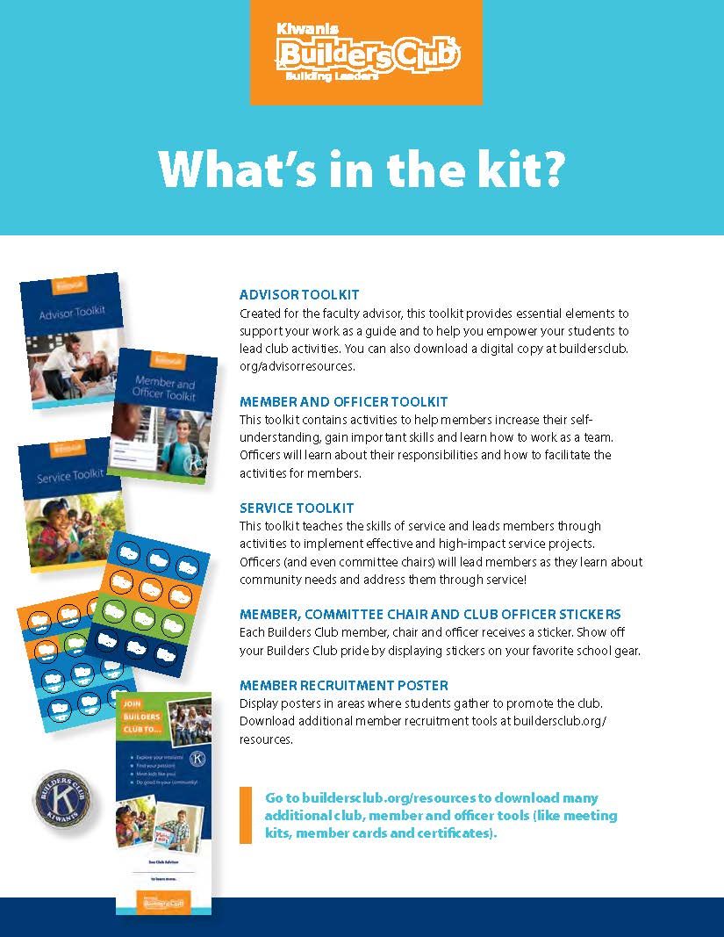
Builders Club program kit
Builders Club advisors
receive a
program kit each year with advisor and member resources.
Notes:
Support to advisors
An international resource is the Kiwanis International Office, located in Indianapolis, Indiana. Staff members produce literature and publications, create online advisor education, manage social media for the Kiwanis family, and more.
One key resource is the Builders Club program kit provided each year to assist club advisors in guiding club members through the year.
Items included in the program kit are shared here and include: Advisor Toolkit, Member and Officer Toolkit, Service Toolkit, Officer and member stickers, and Member recruitment posters.

Slide 24

Advisor Toolkit
BuildersClub.org/advisors
Introduction
Quick start guide
Developing and empowering service leaders in their middle years
Being an effective advisor
Forms and policies
Notes:
The advisor toolkit includes helpful materials for guiding the club.
Sample Bylaws – explaining club structure
Sample Meeting agendas – to help guide club members
How to develop and empower students during the middle years.
How to be an effective advisor
Forms and policies

Slide 25

Member & Officer Toolkit
BuildersClub.org/advisors
What it means to be a Builders Club member
Knowing yourself
Being an effective team member
Being an effective officer and committee chair
Notes:
The Member and Officer Toolkit is a wonderful resource for club members and officers.

Slide 26

Service Toolkit
Provided in program kit & online
This toolkit teaches the skills of service and leads members & officers through activities to implement effective and high-impact service projects.
Notes:
This toolkit teaches the skills of service and leads members & officers through activities to implement effective and high-impact service projects.

Slide 27
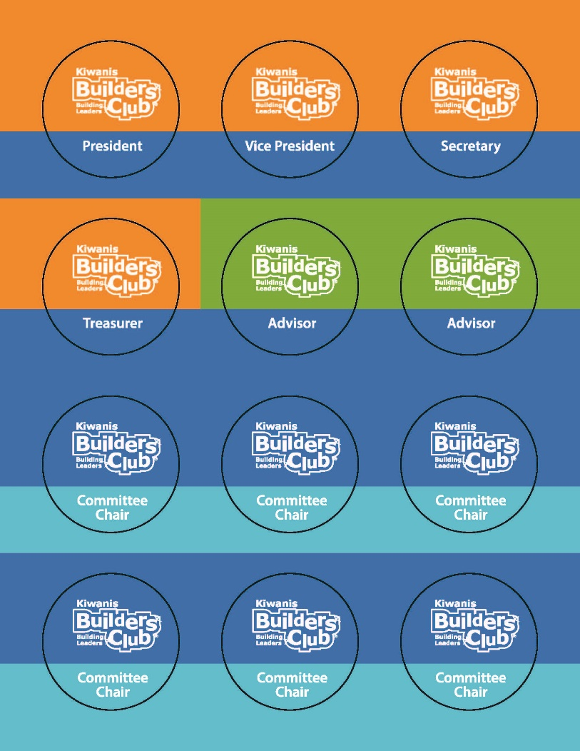

Stickers
Provided in program kit
Members and officers receive stickers to place on their favorite Builders Club gear.
Notes:
Members and officers receive stickers to place on their favorite Builders Club gear.

Slide 28
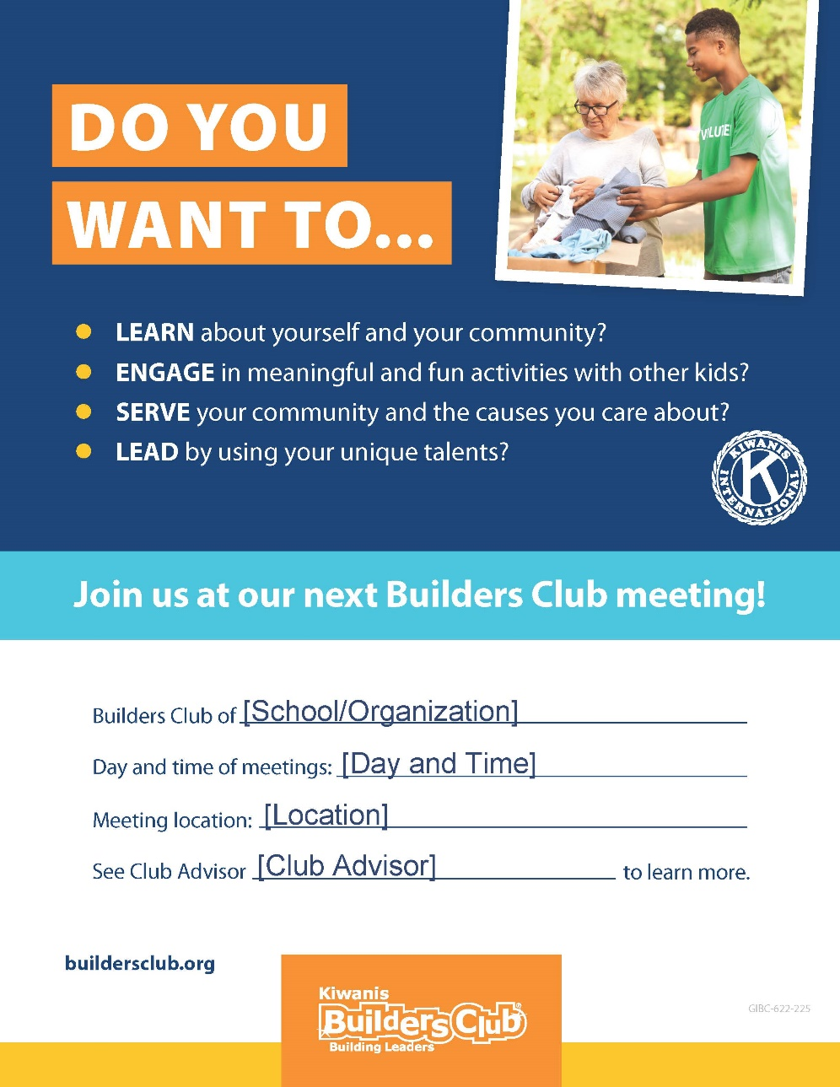
Member Recruitment Posters
Member recruitment posters are provided in the program kit and several downloadable versions are available online.
Notes:
Member recruitment posters are provided in the program kit and several downloadable versions is available online.

Slide 29

Online Resources
Notes:
Member recruitment posters are provided in the program kit and several downloadable versions is available online.

Slide 30
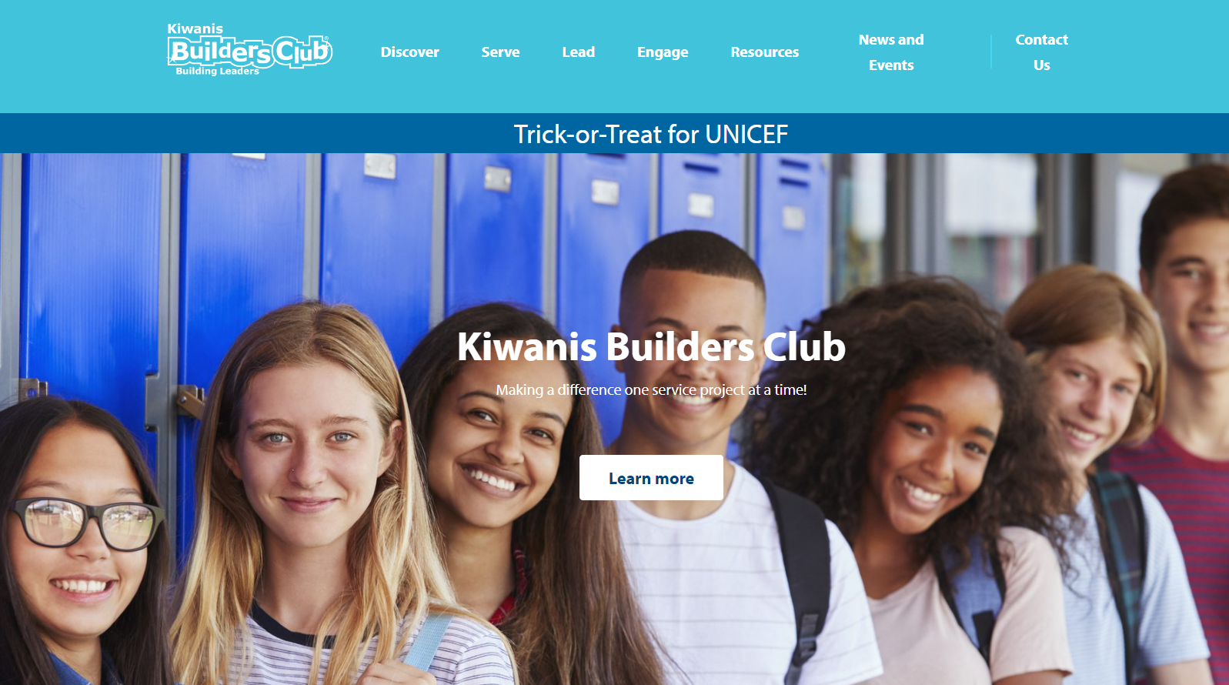
Builders Club Website
Visit BuildersClub.org
Notes:
Builders Club resources are always a click away. Visit BuildersClub.org to find needed information. Everything needed to run the club can be downloaded from the website.

Slide 31
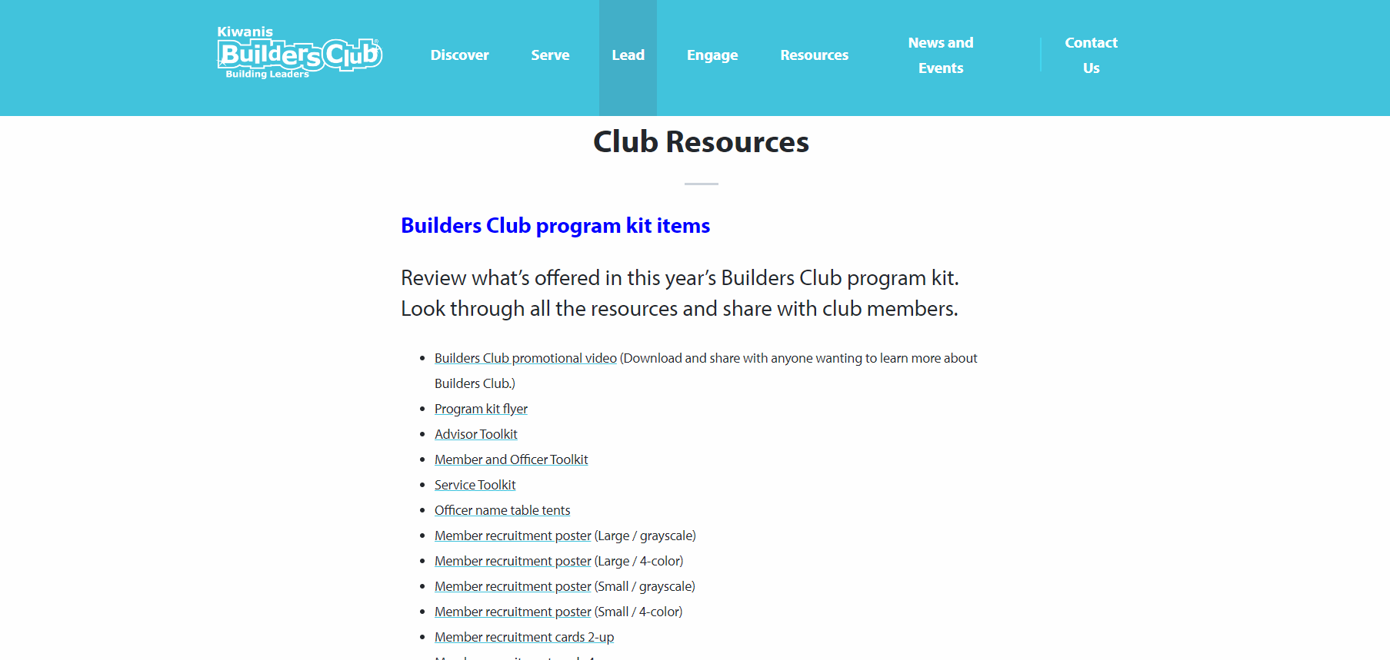
Builders Club Advisor Page
BuildersClub.org/advisors
Notes:
The Advisor page of the website is a one stop shop for club advisors. Links to all needed resources can be found on this page. The Advisor page is located under the Lead navigation.

Slide 32
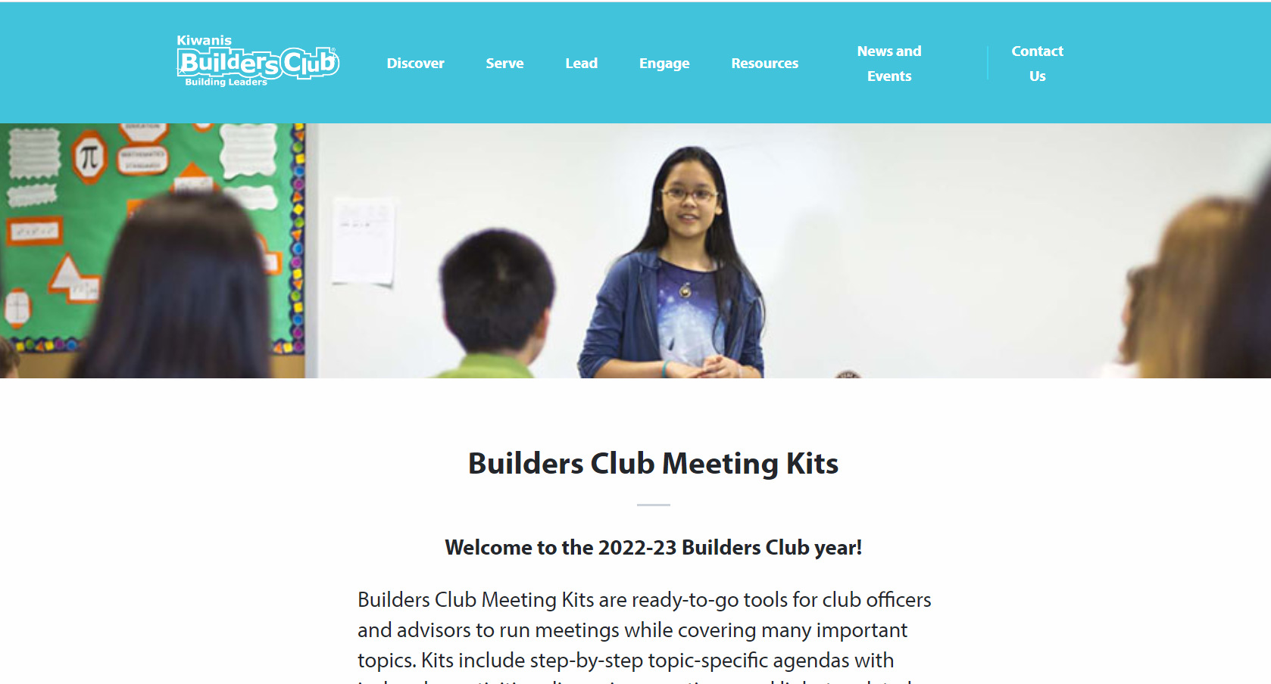
Meeting Kits
Notes:
Builders Club Meeting Kits are ready-to-go tools for club officers and advisors to run meetings while covering many important topics. Kits include step-by-step topic-specific agendas with icebreaker activities, discussion questions, and links to related videos, resources, service ideas and more. Use a kit to run a meeting OR for guidance for club officers to create their own agendas that explore the kit’s topic. The three theme-based Meeting Kits are:
Club Operations Meeting Kit
Service Meeting Kit
Needs and Causes Learning Kit

Slide 33




Virtual Key Leader
Kiwanis.org/VirtualKeyLeader
Builders Club members can enroll in Kiwanis’ free online leadership training course.
Promotional/
Marketing
Class/
Meeting
Independent
Study
Family/Community
Activity
Notes:
Virtual Key Leader is a free, interactive, PDF workbook designed for students (8th grade and up) as well as adults. It includes videos, reflection and discussion topics, and offers a new perspective on some traditional Key Leader activities like the personality test.
The workbook is designed to be self-facilitated. Six “tracks” cover the topics of Service Leadership and the Five Key Leader Principles: Integrity, Growth, Respect, Community, and Excellence, and there are three activities in each track. The activities make for great meeting, classroom, or family activities to help teens discuss their values, goals, and role in the local community.
It also serves as a great primer for in-person Key Leader programs or a re-fresher on the topic for Student Facilitators at upcoming programs. Some districts are organizing virtual events to compliment or promote their in-person Key Leader events. (Nebraska, Ohio)
Free, Interactive, PDF Workbook
Self-led, Group, and/or Family Activities
Primer for in-person Key Leader and Service Leadership
Ages 13 & Up
K-Kids advisors can take this free leadership course and utilize strategies shared when working with K-Kids members.

Slide 34


Key Leader
Key-leader.org
Secondary/high School
Ages 14-19
key-leader.org
A weekend leadership experience that incorporates team-building activities, group discussion and personal reflection.
Notes:
If attending virtual Key Leader was helpful to club members, consider sending members to the real deal, a Key Leader event within your area.
Graduating middle school students can attend Key Leader. Not only are Builders Club members welcome, but any graduating middle school students interested in developing leadership skills and learning more about community service.
A life-changing leadership weekend
Key Leader is an inspirational weekend leadership experience for emerging high school leaders. This life-changing weekend offers students a taste of what servant leadership is all about. Through team-building activities, group discussions and personal reflections, students gain self-confidence, make new friends and learn the joy and power of community involvement.

Slide 35

Interested in starting a club?
Notes:
Interested in starting a K-Kids club?

Slide 36
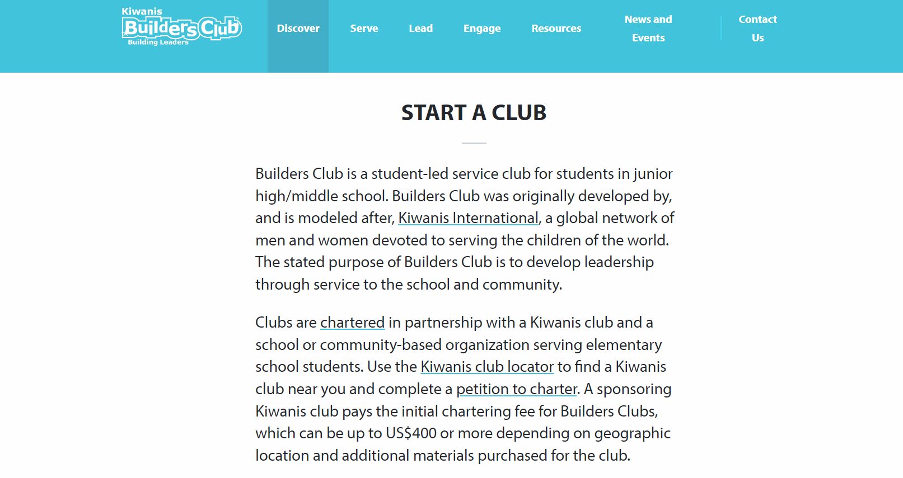
Visit BuildersClub.org/Start-a-club
Notes:
Visit BuildersClub.org/start-a-club to begin.

Slide 37

“Never doubt the power of a small group of people to change the world. Indeed, it’s the only thing that every has.
- Margaret Mead
Thank you!
Notes:
Thank you.

