Slide 1
K-Kids
Builders Club
youth service leadership programs of Kiwanis International
Notes:
Welcome
Welcome the group and let them know that everyone has gathered together to learn about the K-Kids program.
Introduce yourself, any club advisors and other Kiwanis volunteers in the room.

Slide 2
Kiwanis family
YOUTH
K-Kids
Builders Club
Key Club
Key Leader
ADULTS
Circle K
Aktion Club
Notes:
Kiwanis family
Kiwanis has clubs for anyone from age 6 to over 100. K-Kids is part of the Kiwanis family.
K-Kids: primary/elementary school – where young leaders learn to help others – see kkids.org for more info
Builders Club: middle/junior high school – building self-esteem at a pivotal age – see buildersclub.org for more info
Key Club International: secondary/high school – learning to lead with compassion – see keyclub.org for more info
Key Leader: ages 14-18 – a life-changing leadership weekend – see key-leader.org for more info
Circle K International: college/university students – the next generation of community leaders – see circlek.org for more info
Aktion Club: adults with disabilities – where development has no disability – see aktionclub.org for more info
Many Kiwanis clubs sponsor one or more Kiwanis family clubs.

Slide 3
What is
K-Kids?
Largest service organization for elementary school students ages 6-12
More than 37,000 members worldwide
Notes:
What is K-Kids?
Thanks to K-Kids, more than 37,000 elementary school children each year have learned they can change the world.
K-Kids clubs can be found in elementary schools and community-based organizations. Most K-Kids clubs are sponsored by a Kiwanis club.
Students lead the club, plan activities, participate in community service projects and celebrate their successes. Through service and leadership opportunities, members develop empathy, self-confidence and compassion.

Slide 4
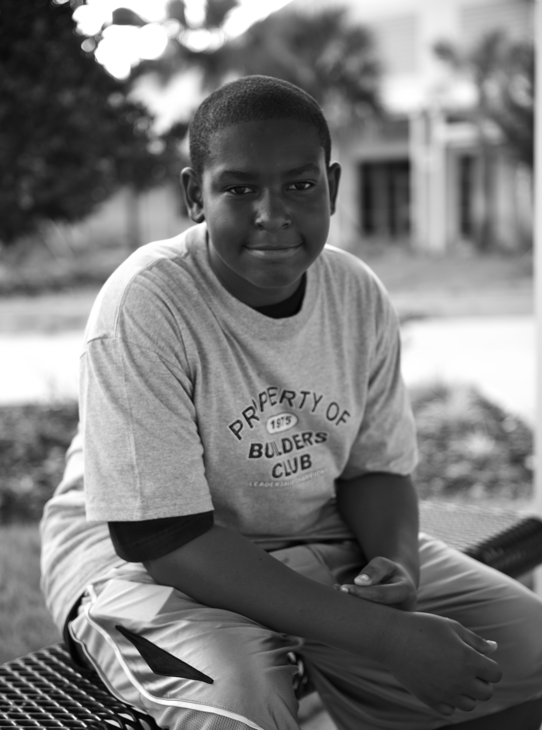
What is
Builders Club?
Largest service organization for middle school students
More than 45,000 members worldwide
Notes:
What is Builders Club?
Thanks to Builders Club, more than 45,000 middle school children each year have learned they can change the world.
Builders Clubs can be found in middle schools and community-based organizations. Most Builders Clubs are sponsored by a Kiwanis club.
Students lead the club, plan activities, participate in community service projects and celebrate their successes. Through service and leadership opportunities, members develop empathy, self-confidence and compassion.

Slide 5
Core values
Character building
The ability to do the right thing, even when it might be the unpopular choice.
Leadership
The ability to listen, communicate, serve and guide others.
Inclusiveness
Accepting and welcoming the differences in others.
Caring
The act of being concerned about or interested in another person or situation.
Notes:
Core values
Members base their leadership and service on these core values.
Take time to discuss these concepts with the group. Ask them how they feel about living by these core values.

Slide 6
K-Kids
Club structure
President
Vice President
Secretary
Treasurer
Sergeant-at-arms
K-Kids are student-led and allow youth to sharpen their leadership skills.
Notes:
Club structure
Each K-Kids club has a student board with elected officers and follows the club’s bylaws. Bylaws clarify the purpose of a K-Kids club and provide guidelines for membership, officers, and meetings.
Each year, K-Kids members elect their club officers sometime during the last two months of the academic year. This allows time in the club year for training and mentoring. Elected officers observe and train under current club officers until taking office. They will take office immediately or at the start of the new academic year.

Slide 7
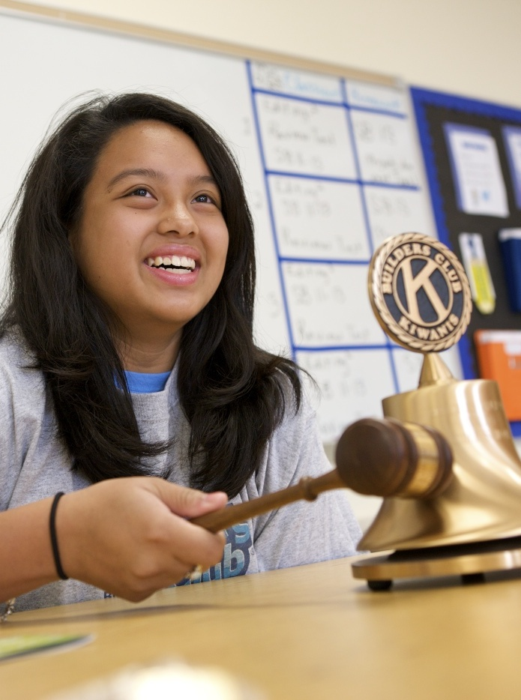
Builders Club
Club structure
President
Vice President
Secretary
Treasurer
Builders Clubs are student-led and allow youth to sharpen their leadership skills.
Notes:
Club structure
Each Builders Club has a student board with elected officers and follows the club’s bylaws. Bylaws clarify the purpose of a Builders Club and provide guidelines for membership, officers, and meetings.
Each year, Builders Club members elect their club officers sometime during the last two months of the academic year. This allows time in the club year for training and mentoring. Elected officers observe and train under current club officers until taking office. They will take office immediately or at the start of the new academic year.

Slide 8
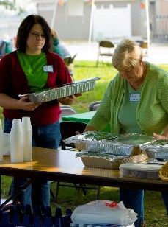
Club
support
Kiwanis advisor
Faculty advisor
Notes:
Club support
The key resource for the K-Kids and Builders club are the advisors.
Both the Kiwanis club and the school or community organization designate an adult advisor to serve as a mentor to the K-Kids club.
These roles are known respectively as the Kiwanis advisor and the faculty advisor.

Slide 9
Kiwanis advisor
Notes:
Kiwanis advisor
The sponsoring Kiwanis club appoints a Kiwanis volunteer to the K-Kids and or Builders Club. This person is known as the Kiwanis advisor. Kiwanis clubs are required to have a clear criminal history background check—conducted and verified by Kiwanis International—for any member serving as a Kiwanis advisor. The Kiwanis advisor serves as a liaison between the K-Kids club and the Kiwanis club.
He or she:
Promotes a connection between the two clubs,
Works with the faculty advisor,
And, attends club meetings.

Slide 10
Faculty advisor
Notes:
Faculty advisor
The school or community organization appoints a staff member to serve the K-Kids and or Builders Club. This person is known as the faculty advisor. The faculty advisor serves as a liaison between the K-Kids club and the school or community organization.
He or she ensures the club:
Operates in accordance with school policies,
Helps to keep the club viable,
And, attends club meetings.

Slide 11
Support to advisors
Notes:
Support to advisors
K-Kids and Builders Club advisors get support from a few different places.
A local resource is the K-Kids district administrator. The district administrator is a Kiwanis member appointed by Kiwanis district leadership to support K-Kids and Builders Clubs in the area. This Kiwanian is dedicated to the success of the organization. This person is also the liaison to Kiwanis International.
A community resource is K-Kids and Builders Club members’ parents when engaged effectively. Advisors keep members’ parents involved by:
Communicating consistently by email or other forms of communication,
Providing updates during both school and summer months,
Inviting parents to regular club meetings and service projects,
Creating special roles for parents to act as liaison between the club and the school’s Parent Teacher Organization,
And, educating and training parents to serve as public advocates of the club.
An international resource is the Kiwanis International Office, located in Indianapolis, Indiana. Staff members produce literature and publications, create online advisor education, manage social media for the Kiwanis family, and more.

Slide 12
K-Kids and Builders Club advisors
receive a
program kit each year with helpful resources.
Notes:
Support to advisors
An international resource is the Kiwanis International Office, located in Indianapolis, Indiana. Staff members produce literature and publications, create online advisor education, manage social media for the Kiwanis family, and more.
One key resource is the K-Kids and Builders Club program kit provided each year to assist club advisors in guiding club members through the year.
Items included in the program kit include: Advisor guide, IDEA toolkit for officers, Officer guides, Officer and member pins or buttons, Member handbooks, pledge poster, and contest flier.

Slide 13
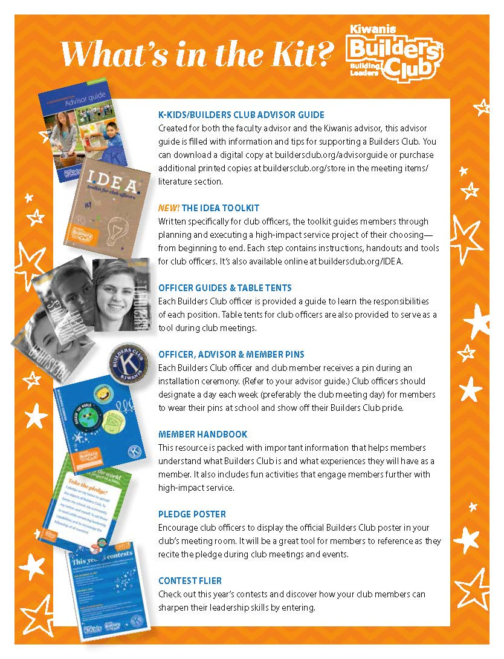
Notes:
Here’s the Builders Club version of what’s in the kit and a peak at the Builders Club IDEA toolkit for club officers.
The IDEA toolkit is written specifically for club officers, the toolkit guides members through planning and executing a high-impact service project of their choosing from beginning to end. Each step contains instructions, handouts and tools for club officers. It’s also available online at kkids.org/idea and buildersclub.org/idea.

Slide 14
Notes:
Member materials help advisors in guiding members through the club experience.

Slide 15
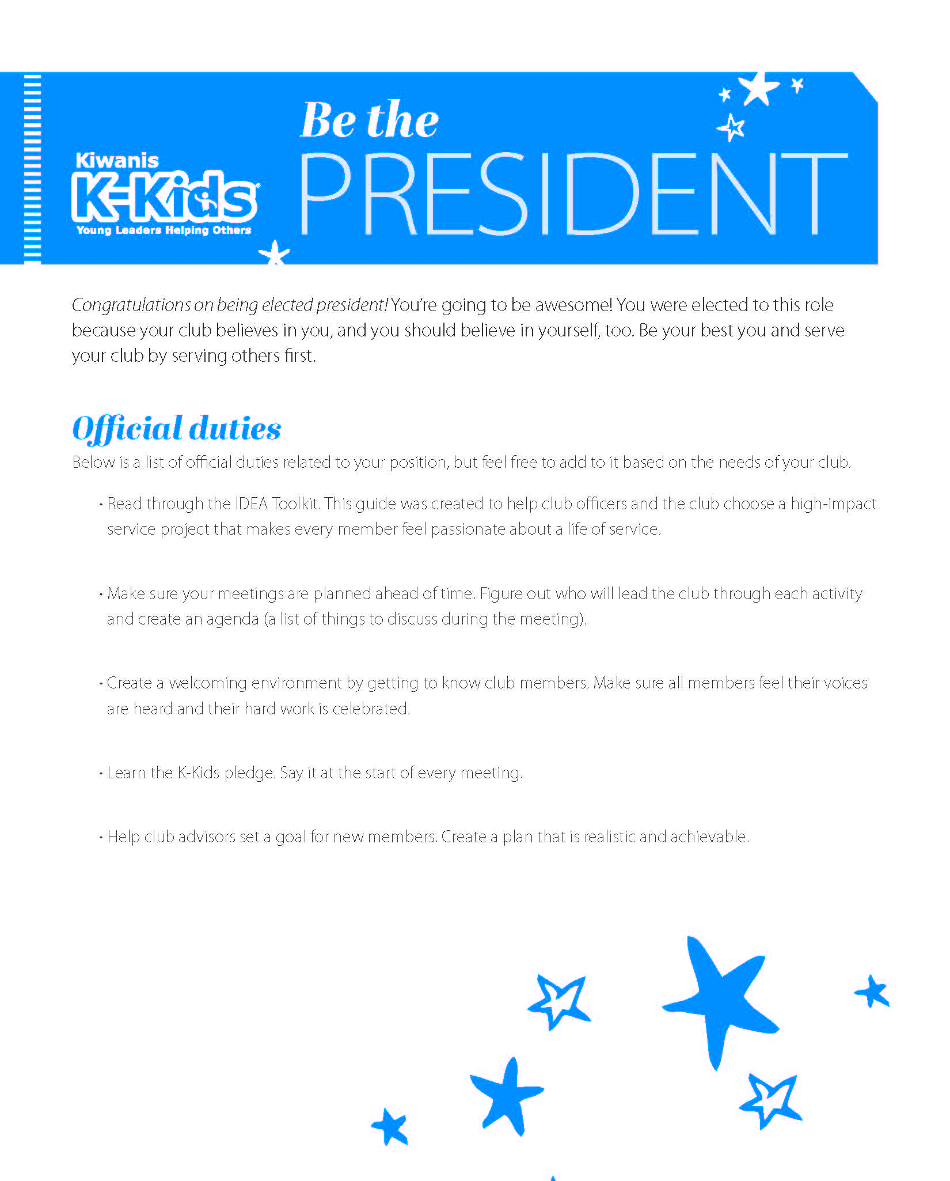
Officer guides help club officers lead the way.
Notes:
K-Kids and Builders Club officer guides also help in preparing club officers for their leadership role in the club.

Slide 16
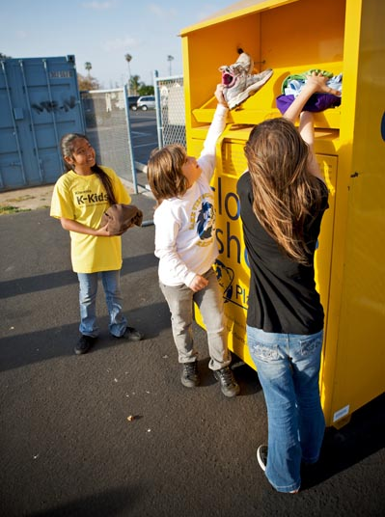
Why K-Kids or
Builders Club?
Hands-on service
Fundraising and philanthropy
Awareness building
Notes:
Why K-Kids or Builders Club?
K-Kids and Builders Club teaches children leadership skills through service. Planning and taking part in service projects a great way for club members to gain leadership skills and make a difference in the community.
Most clubs have a goal each semester to plan one project in each of the three listed categories.
Examples include:
Making special welcome baskets for students relocating to a school.
Show appreciation to teachers through thank you notes, treats, or classroom chores.
Food or clothing drives.
Hosting a bake sale.
Sponsoring a speaker to bring attention to a particular topic.
Hosting a movie night by showing a documentary addressing a specific cause or message.

Slide 17
Notes:
K-Kids and Builders Club service leadership model
The primary educational objective of K-Kids and Builders Club is to prepare members to be the most engaged members of their current and future communities.
By participating in K-Kids or Builders Club and experiencing service leadership, members discover their heart to serve, answer their call to lead and summon the courage to engage.
When students discover their heart to serve, they decide that serving others is a new, exciting way of life. When students answer their call to lead, they step forward when the easier choice might have been to stand still. When students summon the courage to engage, they decide to live a life of collaboration and not isolation.

Slide 18
Working
together
Through K-Kids and Builders Club, the school and the club members have a direct connection to the community through the sponsoring Kiwanis club.
Notes:
Working together
Here are just a few ways a Kiwanis club and a K-Kids and Builders Club work together:
The Kiwanis advisor informs the Kiwanis club about what the K-Kids club/Builders Club is doing.
The Kiwanis club invites K-Kids club/Builders Club members to help with service projects.
The Kiwanis club invites K-Kids club/Builders Club members to attend Kiwanis club meetings.
The Kiwanis club is available to deliver programming for the K-Kids club/Builders Club. Example: Career Day or a club program speaker.

Slide 19
Starting a
K-Kids club
kkids.org/start-a-club
Notes:
Starting a K-Kids club
The first step is finding advisors, members and a place to meet. Your home base (and meeting place) may be at an elementary school, a community center, or somewhere else. A Kiwanis club could sponsor your club—offering both financial support and hands-on guidance—and a Circle K club or Key Club can co-sponsor. Who will help steer your club in the right direction? It takes two: an advisor from your site and an advisor from your local Kiwanis club.
Once you’ve laid the groundwork for your club, it’s time to get organized, file paperwork, train club leaders and build enthusiasm. The chartering process makes your club a reality. Put all the pieces together. Get together with new members to adopt club bylaws, officially elect officers and directors, plan your club’s meeting schedule and start brainstorming service project ideas. Make time to train officers, create a budget and set goals for your club.
Once your club is official, you’ll be ready to reach out to the community and make a difference through meaningful service projects. Empower yourself with liability information, project ideas and tips on working with youth.
Visit kkids.org/charter for more info.
K-Kids charter fee: $300
K-Kids renewal fee: $180

Slide 20
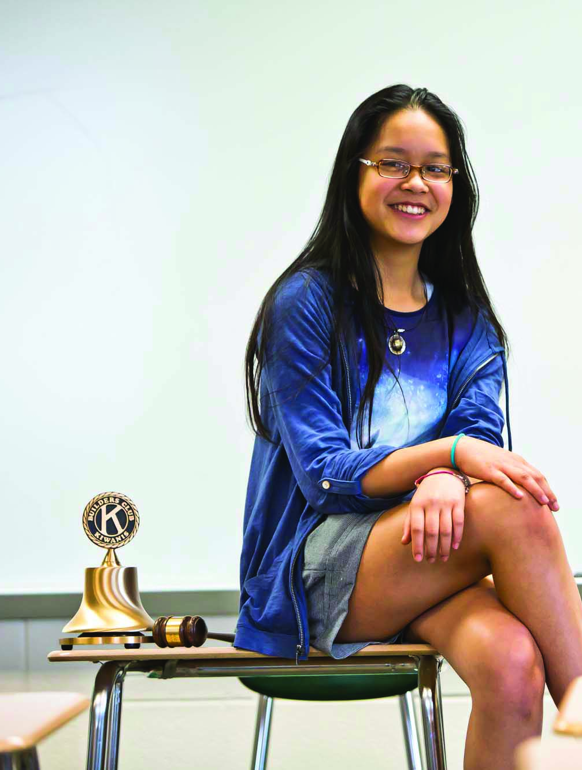
Starting a
Builders Club
buildersclub.org/start-a-club
Notes:
Starting a Builders Club
The first step is finding advisors, members and a place to meet. Your home base (and meeting place) may be at a middle school, a community center, or somewhere else. A Kiwanis club could sponsor your club—offering both financial support and hands-on guidance—and a Circle K club or Key Club can co-sponsor. Who will help steer your club in the right direction? It takes two: an advisor from your site and an advisor from your local Kiwanis club.
Once you’ve laid the groundwork for your club, it’s time to get organized, file paperwork, train club leaders and build enthusiasm. The chartering process makes your club a reality. Put all the pieces together. Get together with new members to adopt club bylaws, officially elect officers and directors, plan your club’s meeting schedule and start brainstorming service project ideas. Make time to train officers, create a budget and set goals for your club.
Once your club is official, you’ll be ready to reach out to the community and make a difference through meaningful service projects. Empower yourself with liability information, project ideas and tips on working with youth.
Visit buildersclub.org/charter for more info.
Builders Club charter fee: $400 or $600 depending on the charter package selected.
Builders Club renewal fee: $180

Slide 21
Web and
social media
kkids.org
facebook.com/kiwaniskids
twitter.com/kiwaniskids
pinterest.com/kiwaniskids
buildersclub.org
facebook.com/buildersclub
twitter.com/buildersclub
pinterest.com/buildersclub
Notes:
Web and social media
Encourage the group to connect with K-Kids online.

Slide 22
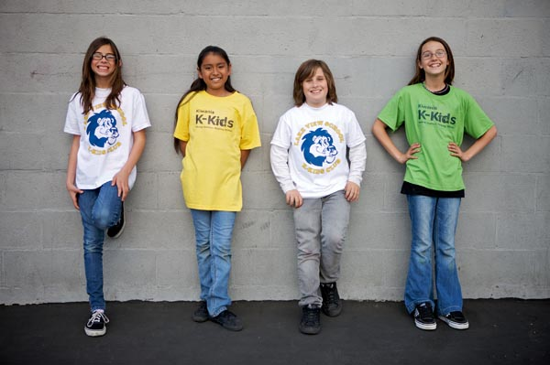
“Since joining K-Kids, I don’t wait to run into situations that put me in someone else’s shoes, I seek them out. Seeing what others go through and imagining myself in their place has changed me. One day I hope it will help me change the world.”
Emma, 5th grade, West Tennessee district
Notes:
Thank You
Ask the group if they have any questions.

Slide 23
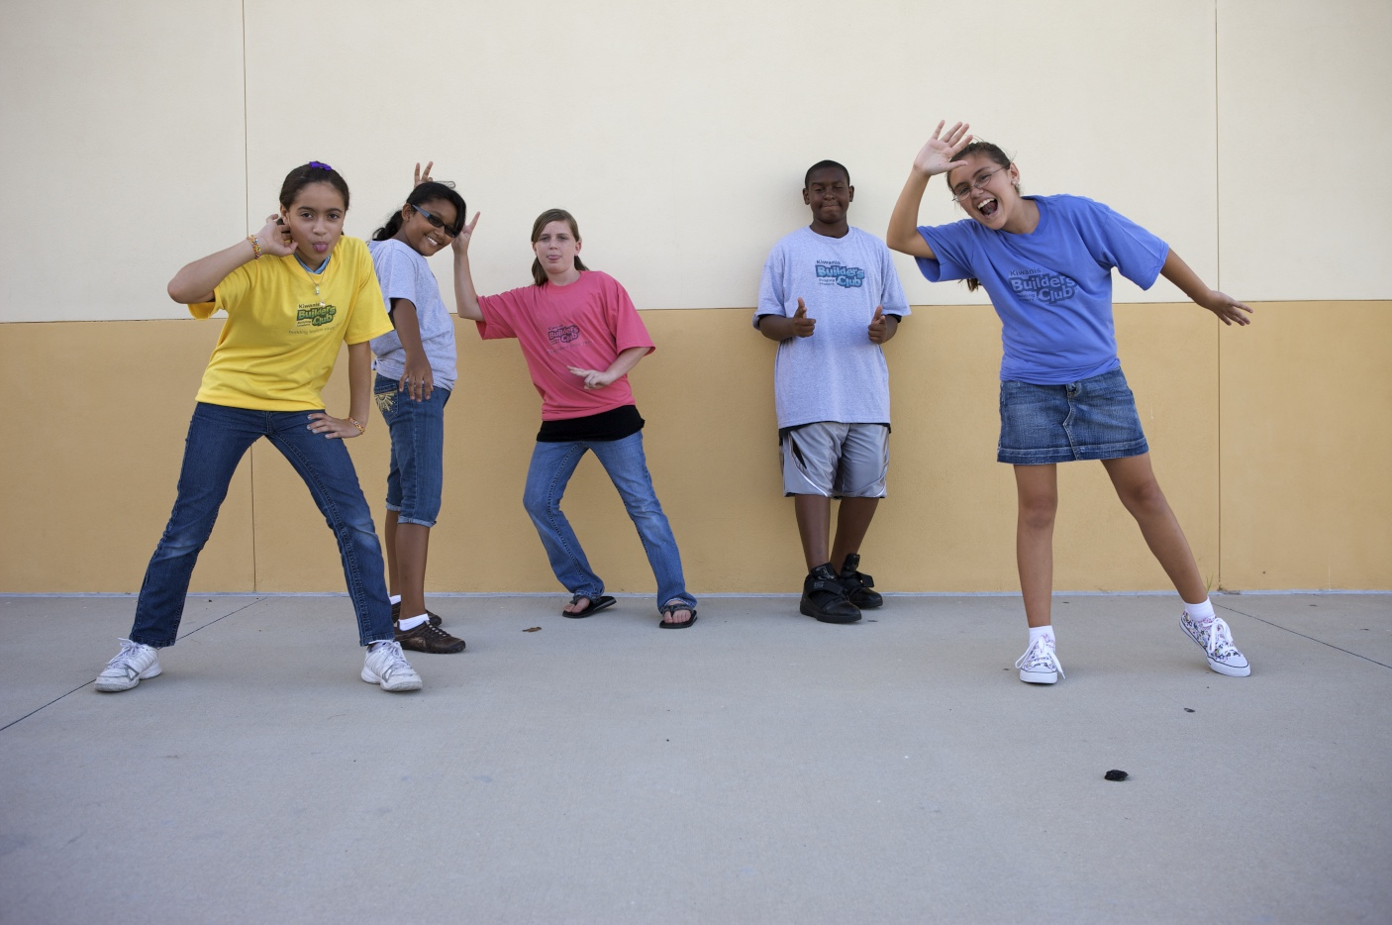
“Builders Club has taught me how to help people that are affected by poverty and homelessness. By participating in service projects, I have learned a lot about the struggles of others and the true meaning of empathy.”
Amber, 7th grade, Florida district
Notes:
Thank You
Ask the group if they have any questions.

