Slide 1

Supporting K-Kids and Builders Club

Slide 2


Elementary/Primary School | Ages 6 – 12 | kkids.org
A student-led, community service club for elementary-age students.
More than 36,000 members worldwide.
More than 983 active clubs.

Slide 3

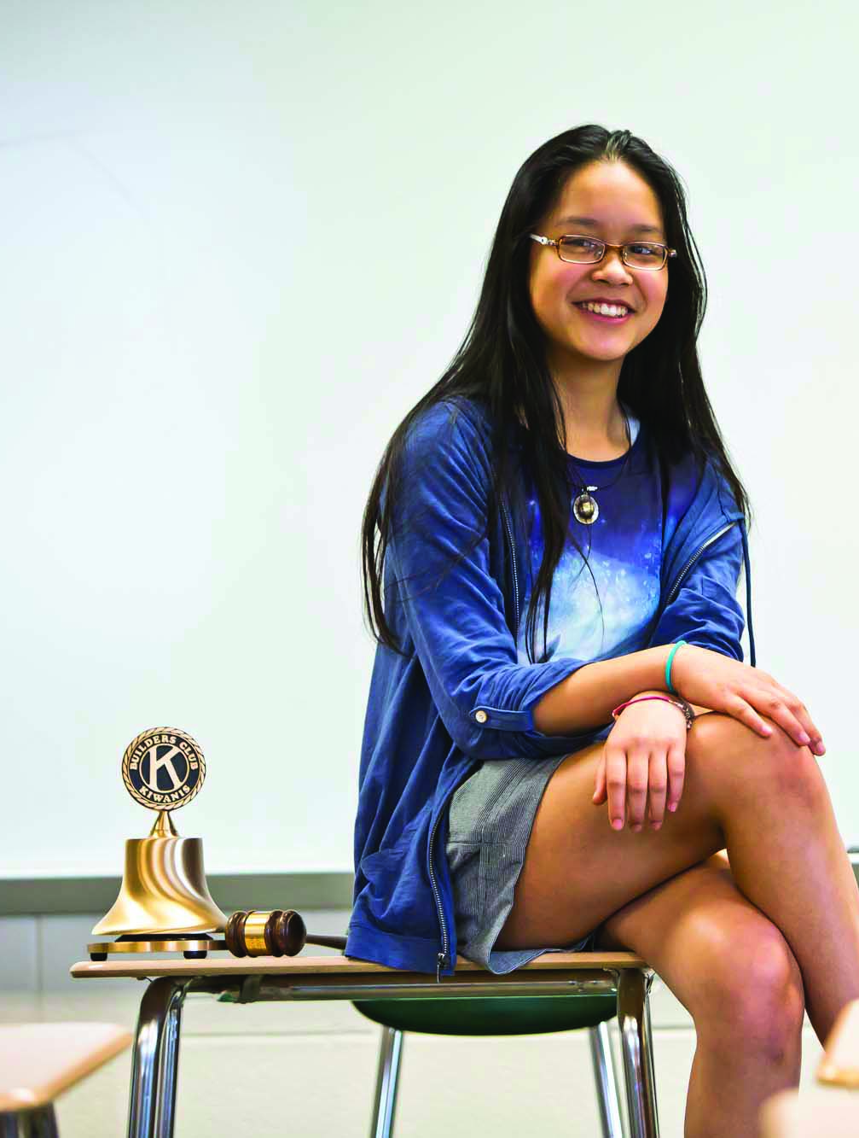
Middle/Junior High School | Ages 12-15 | buildersclub.org
A student-led, community service club for junior high or middle school students.
More than 1,200 clubs in 18 nations.

Slide 4

Know your resources

Slide 5
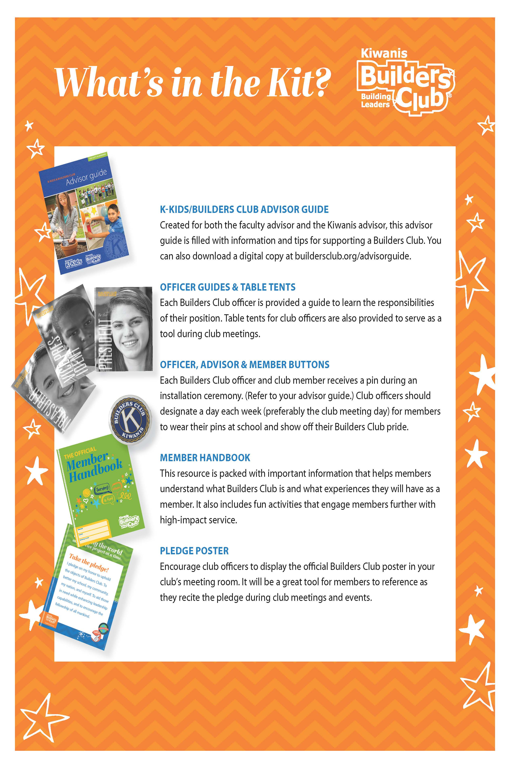
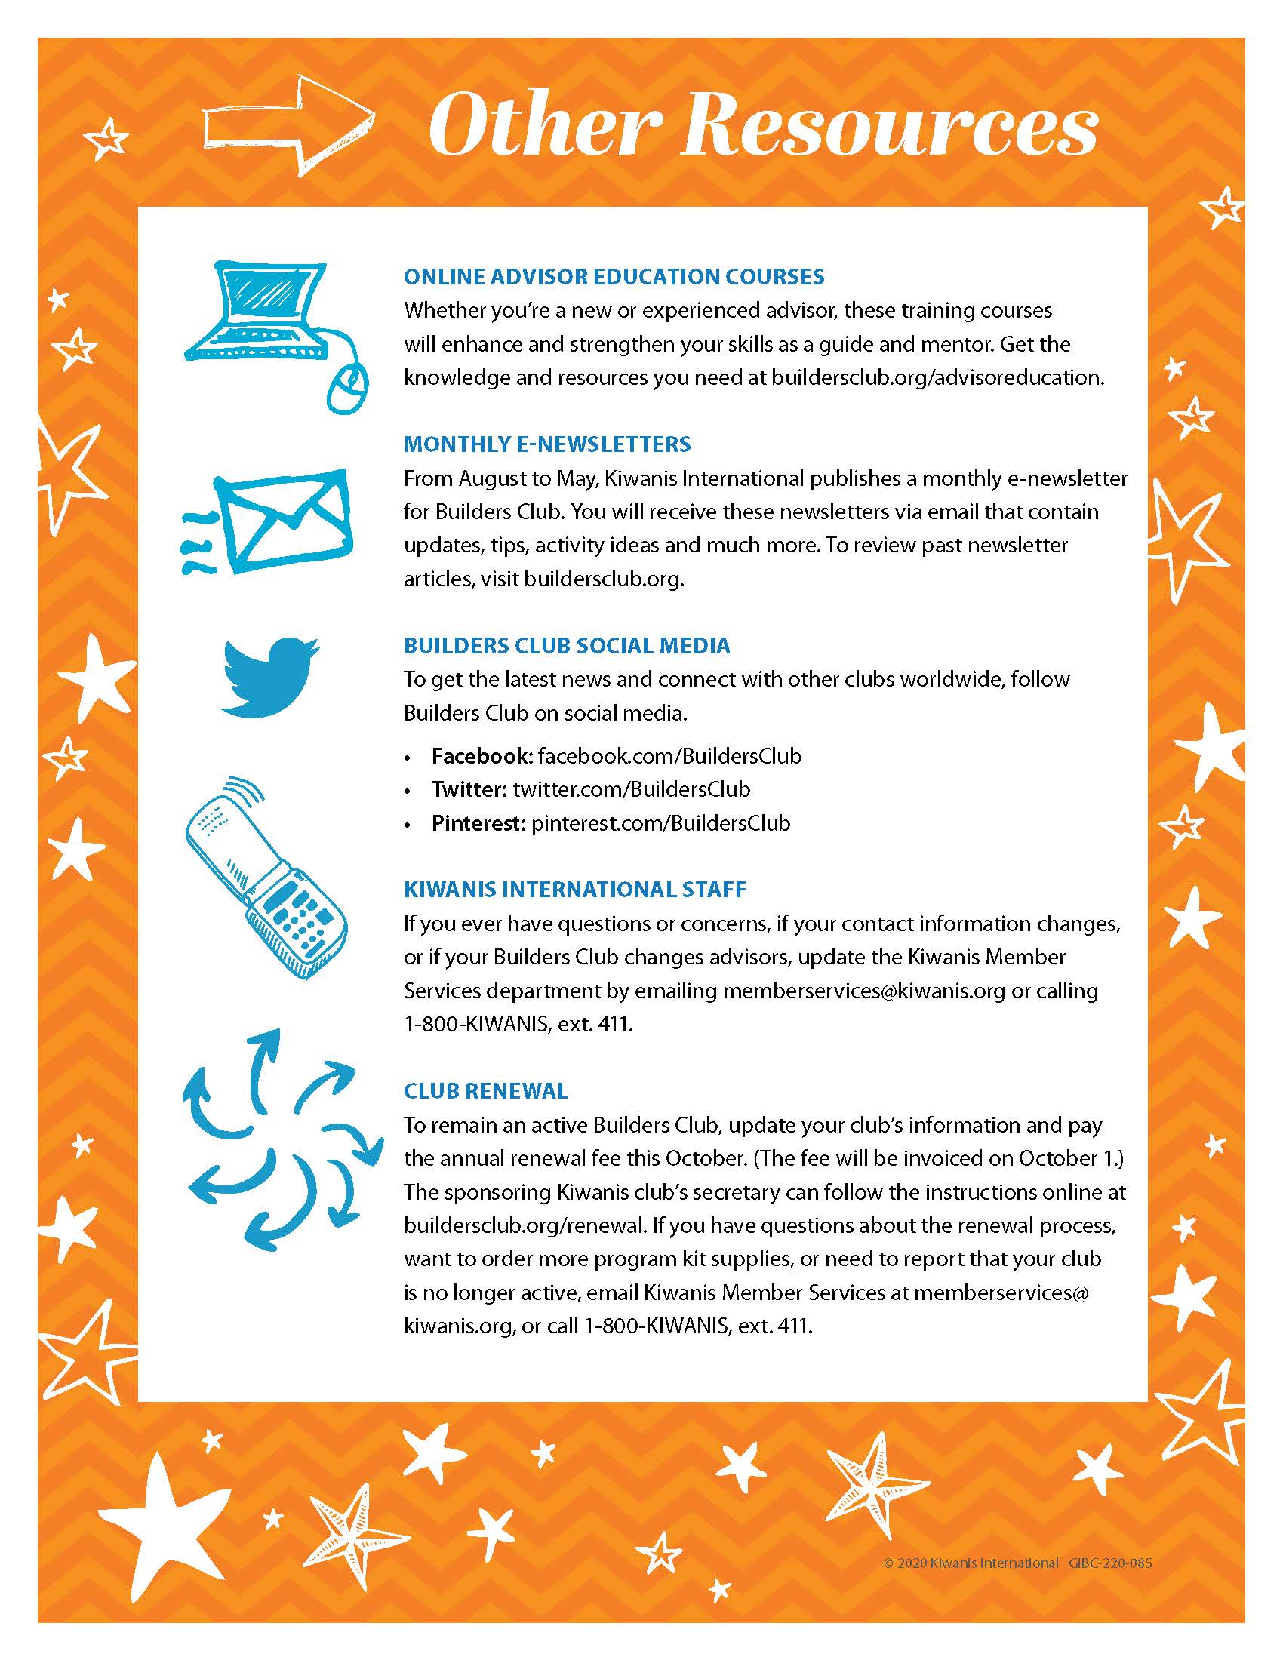
Program kit items

Slide 6

Advisor guide
Advisor Tools
Working with members
Serve / Lead / Engage
Officer training
Policies
Kiwanis Family

Slide 7
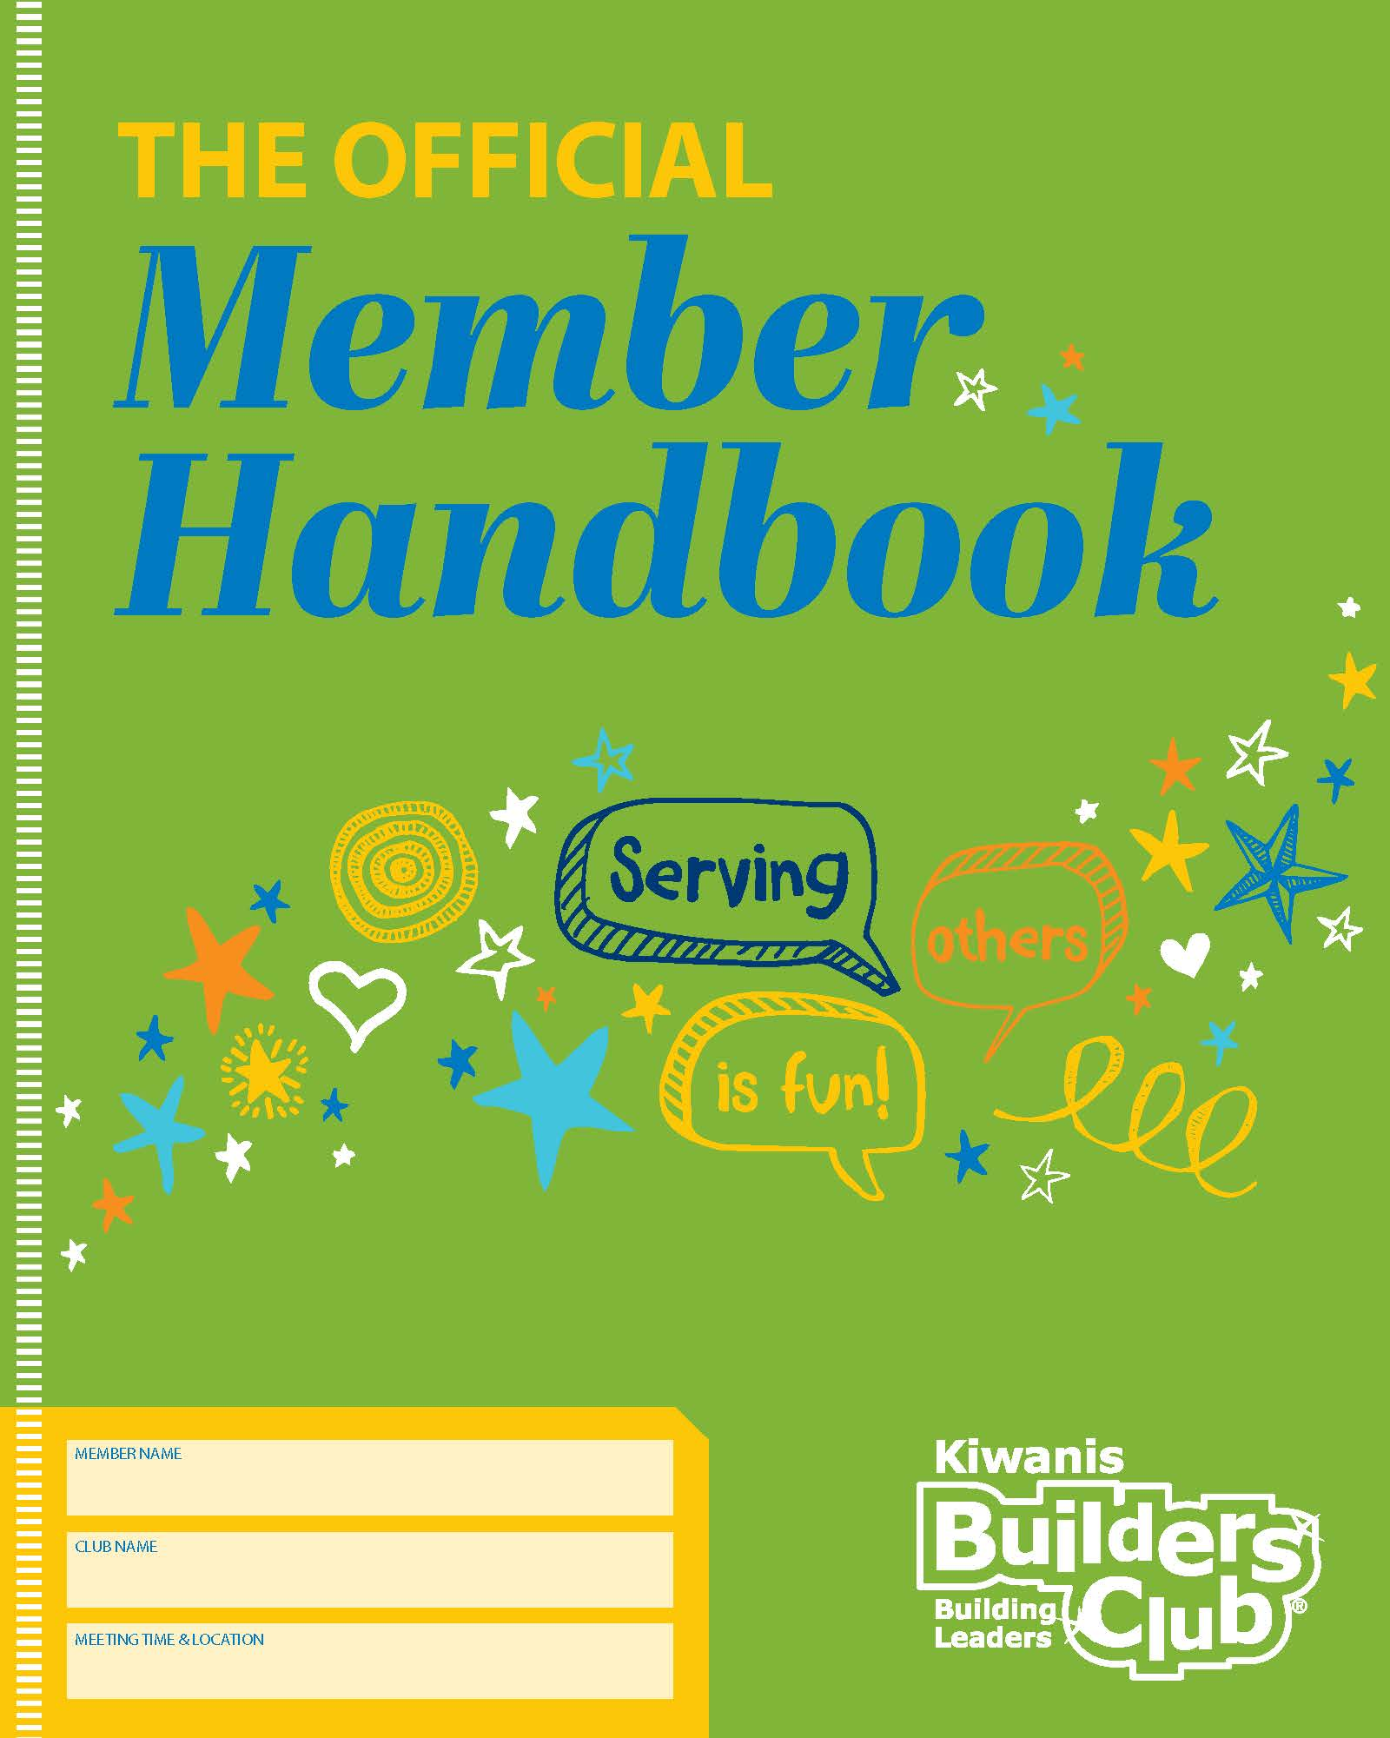

Member handbook
Welcome
Intro to K-Kids / Builders Club
Activities / icebreakers
Planning service projects
Kiwanis family

Slide 8
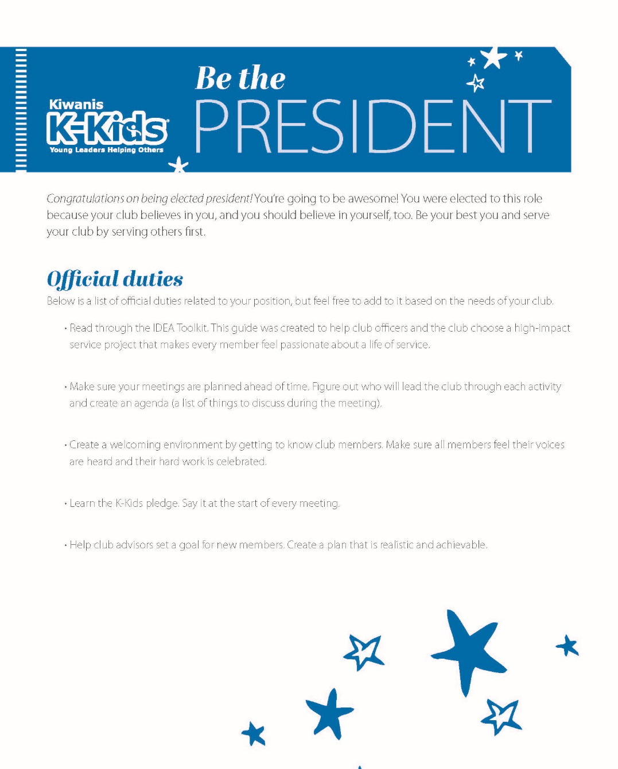

Officer guides
Role of each officer
Working as a team
Tips to lead
Sample agendas
IDEA Toolkit

Slide 9
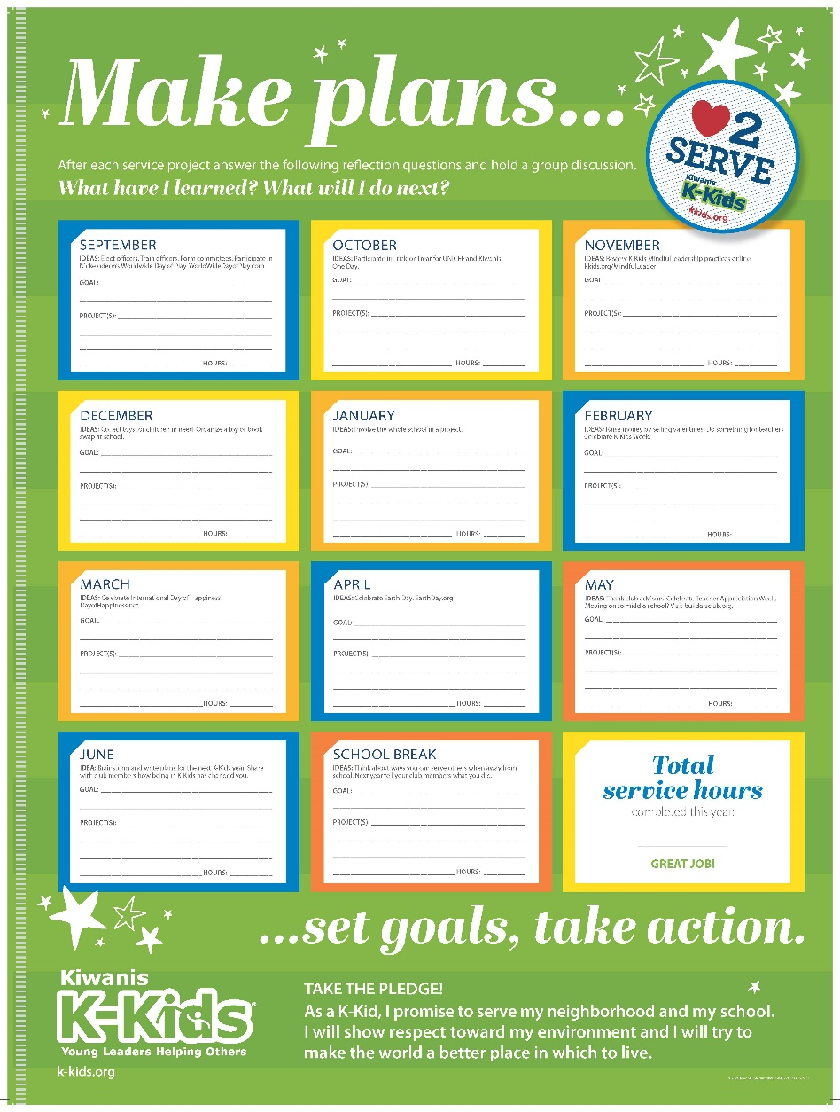
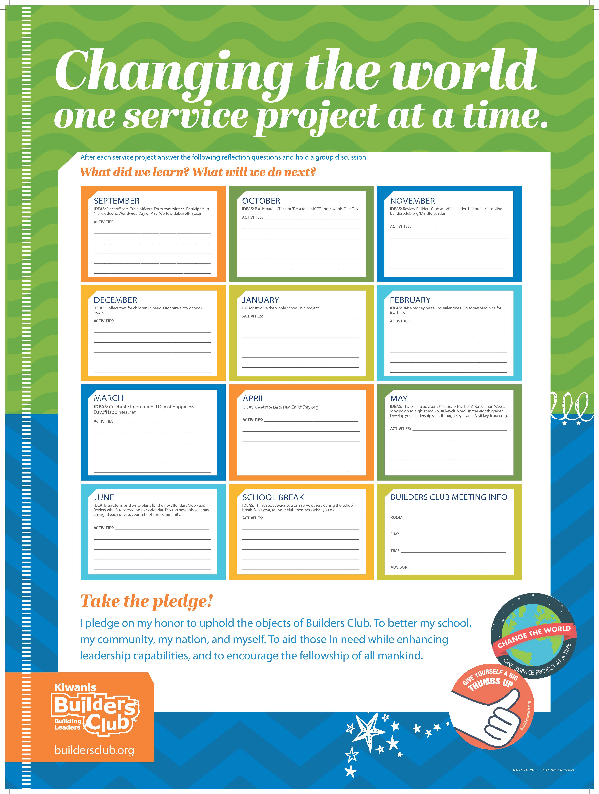
Calendar
Schedule projects
Plan ahead
Track hours
Learn the pledge

Slide 10
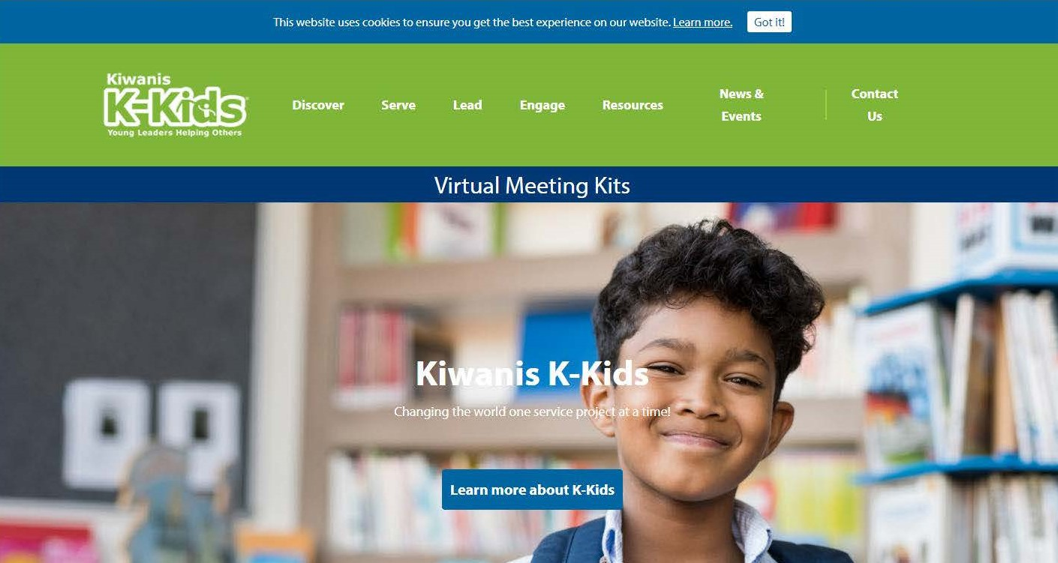
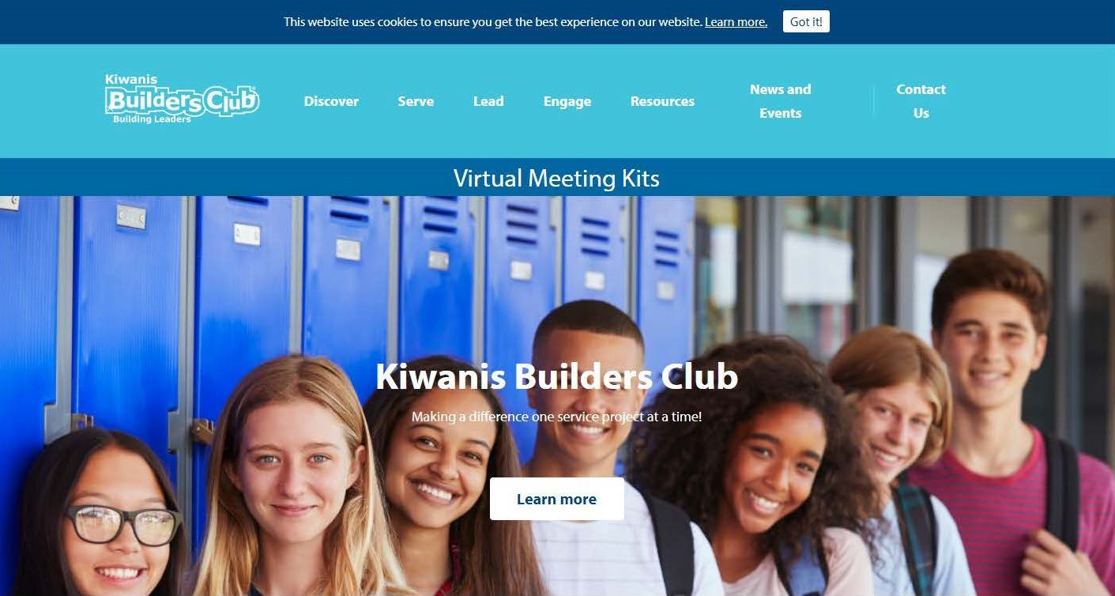
Website resources
BuildersClub.org
K-Kids.org

Slide 11

IDEA Toolkit
BuildersClub.org/IDEA
K-Kids.org/IDEA
Identify the need
Develop the passion
Execute the project
Advance the impact

Slide 12
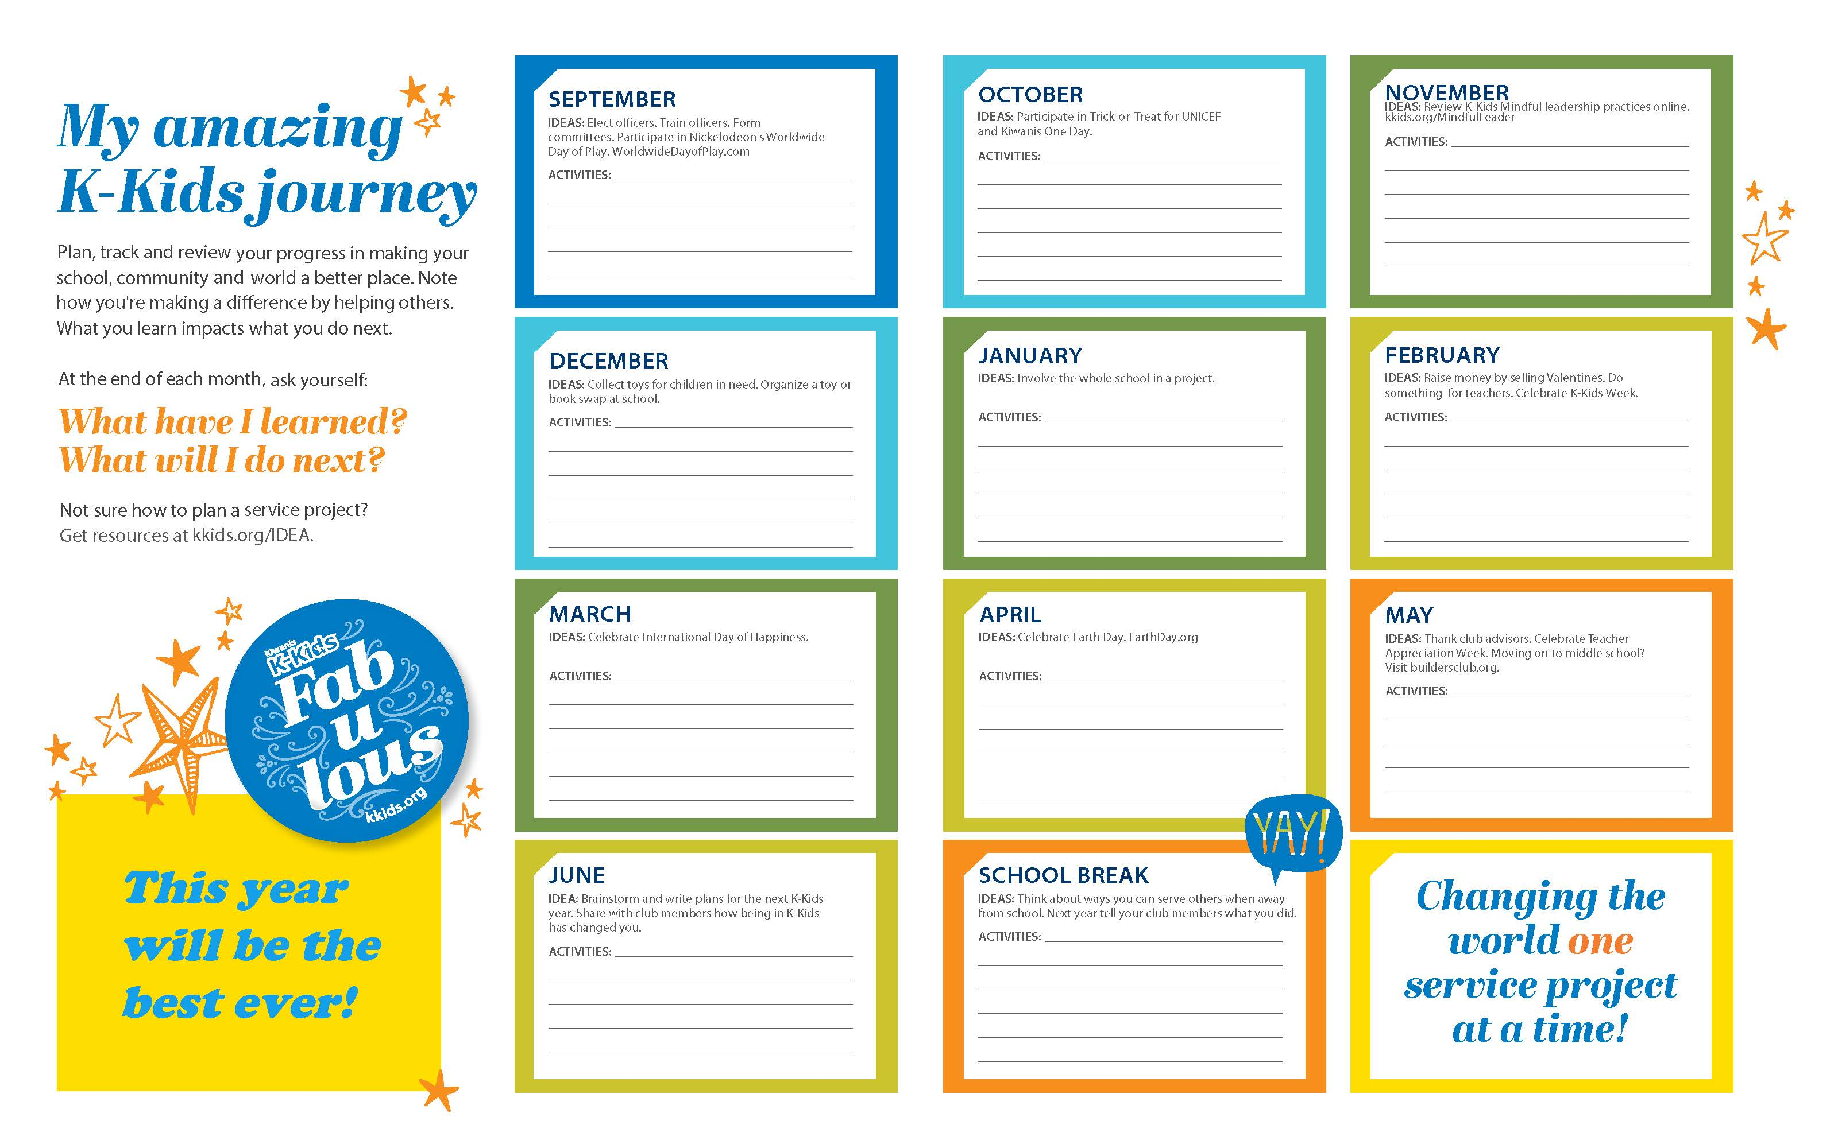
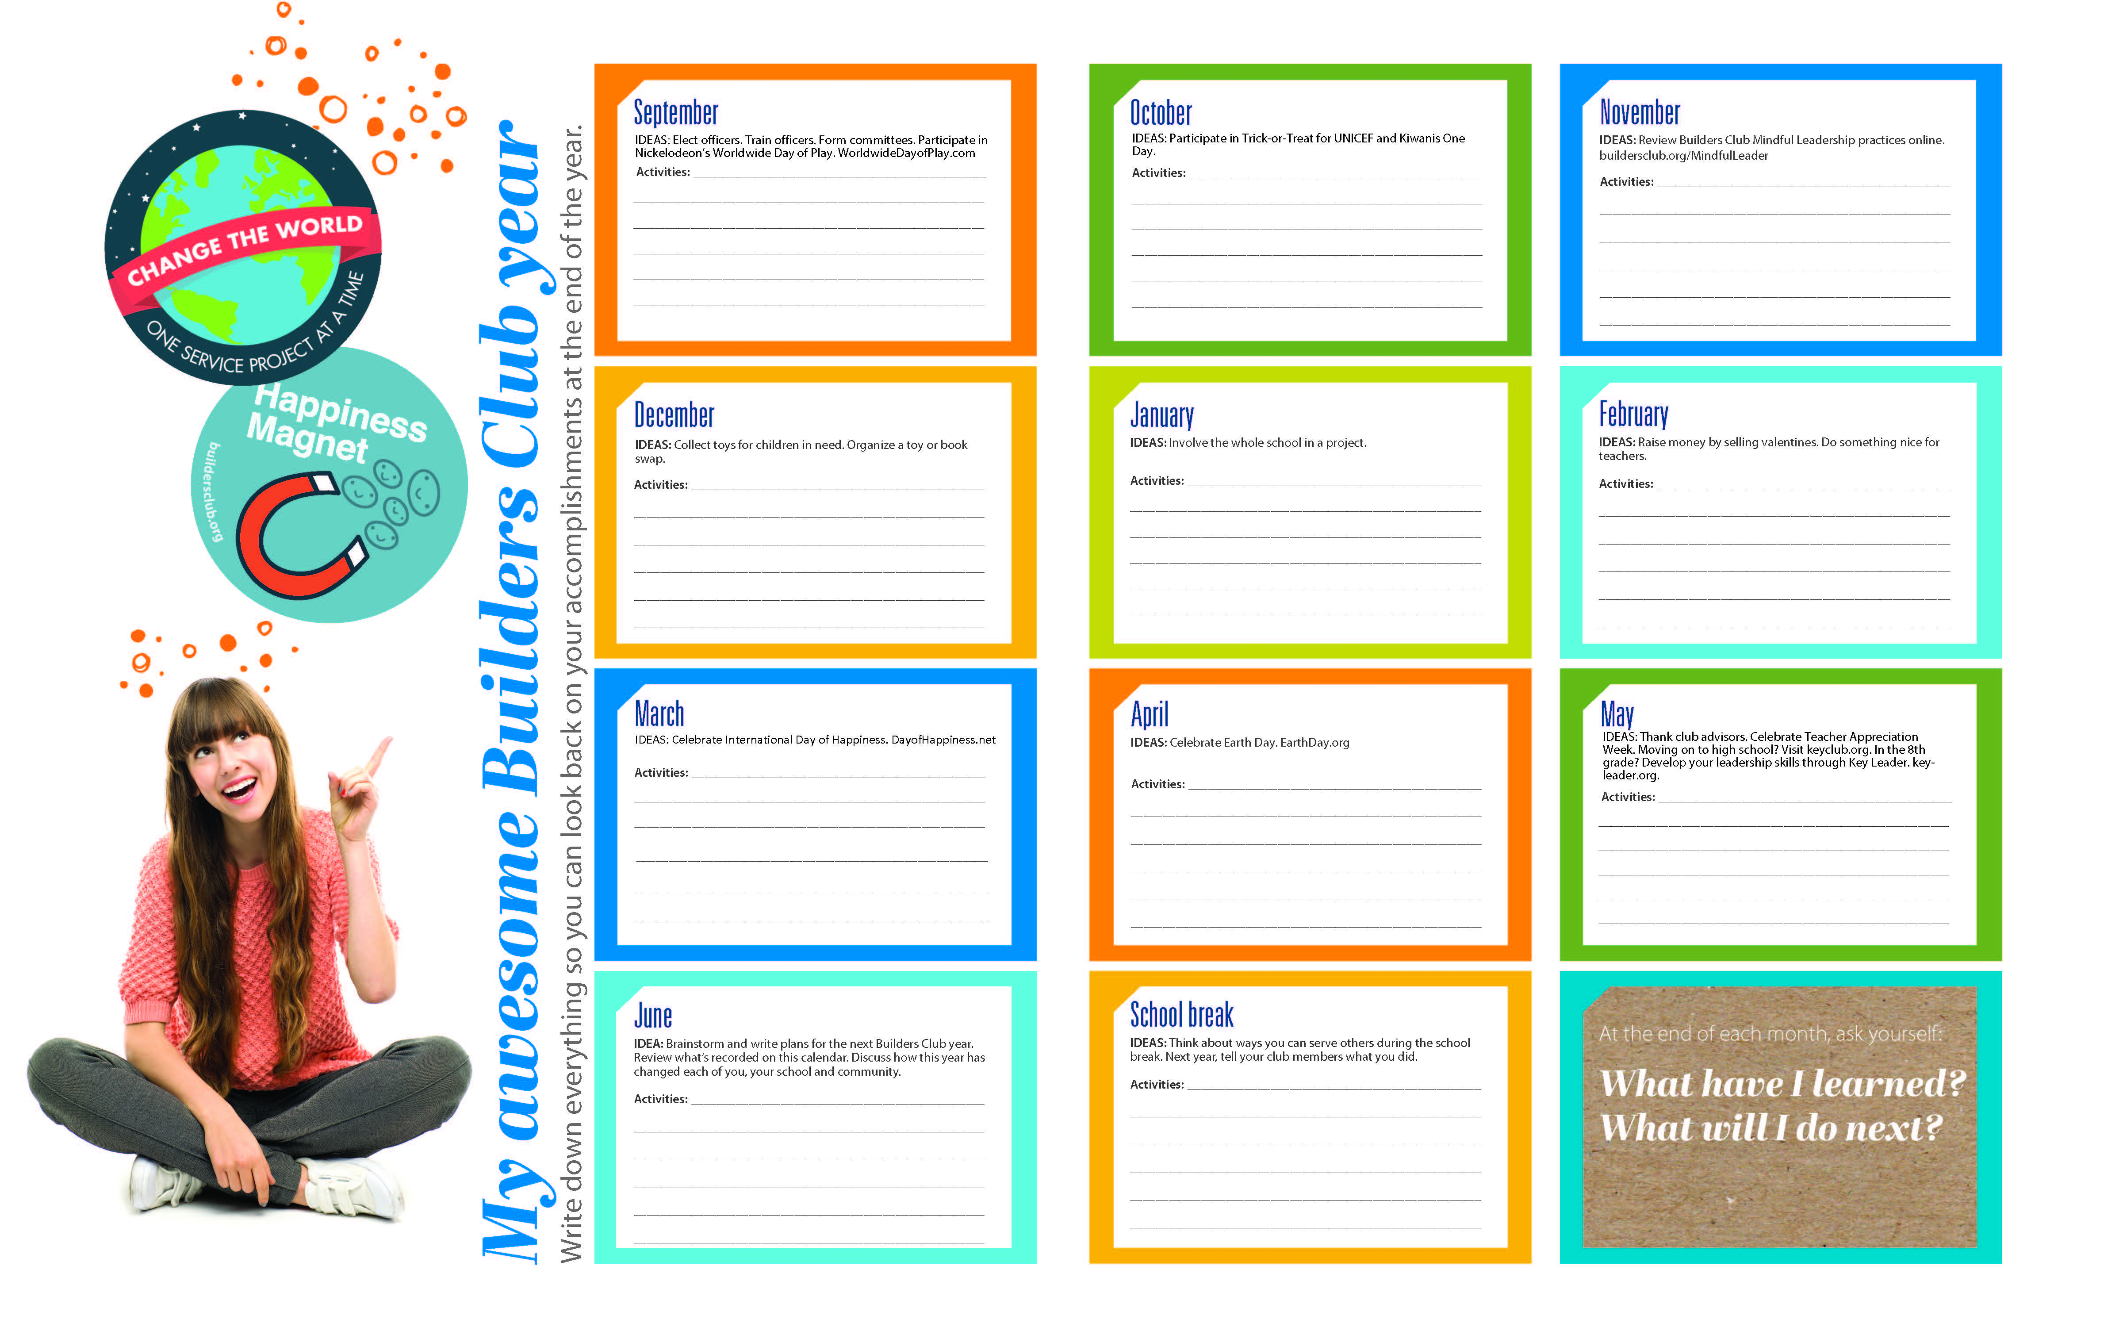
Downloadable member calendars

Slide 13


Member recruitment fliers
This fillable PDF can be shared with potential members.
Notes:
The Pandemic has changed the way we support and build Aktion Clubs at the moment.

Slide 14

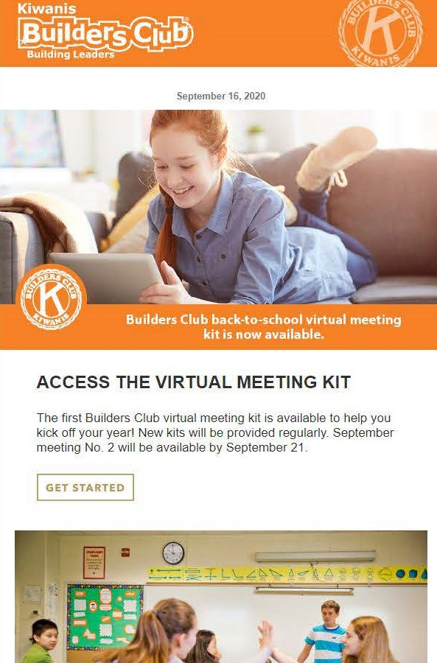
Advisor e-newsletter
Advising tips
Service project ideas
Links to resources
Well-being tips
Upcoming Kiwanis events

Slide 15
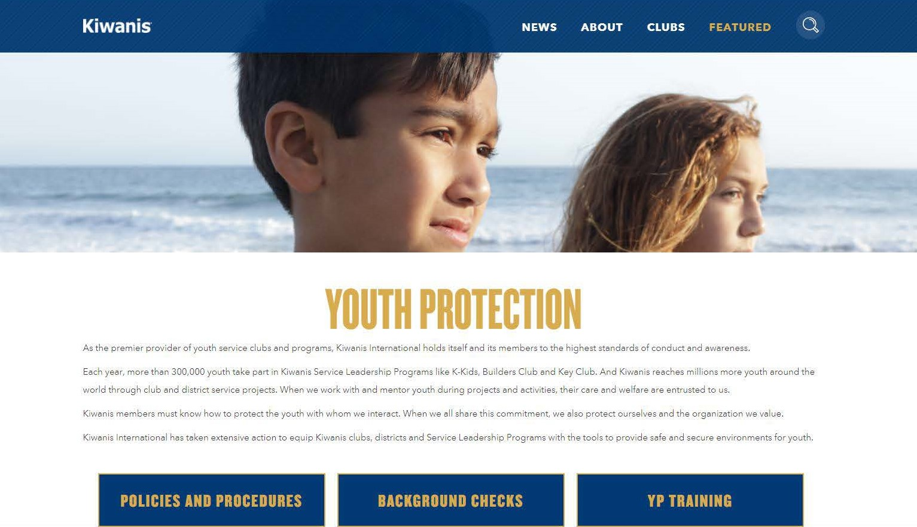
Kiwanis.org/YouthProtection

Slide 16
What's new?
L.E.A.D efforts
Moving paper/snail mailed pieces online to club websites and the “MUC”
New advisor training launched online
Feedback loops and more surveys
Updated websites and online experiences
Notes:
LEAD
Listening to our members
Education and Engagement
Agile and Accessible
Dedicated to Service

Slide 17
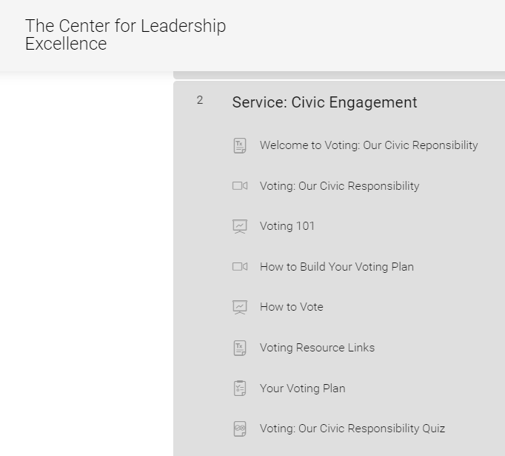
Key Club Global Leadership Certificate
Currently in a test phase with Civic Engagement Course
5 courses/modules in Fall 2020 for Key Club and CKI (of 39 planned)
Service, Fellowship, Leadership
Center for Leadership Excellence
Includes videos, presentations, and quizzes for a variety of life skills and developmental assets

Slide 18
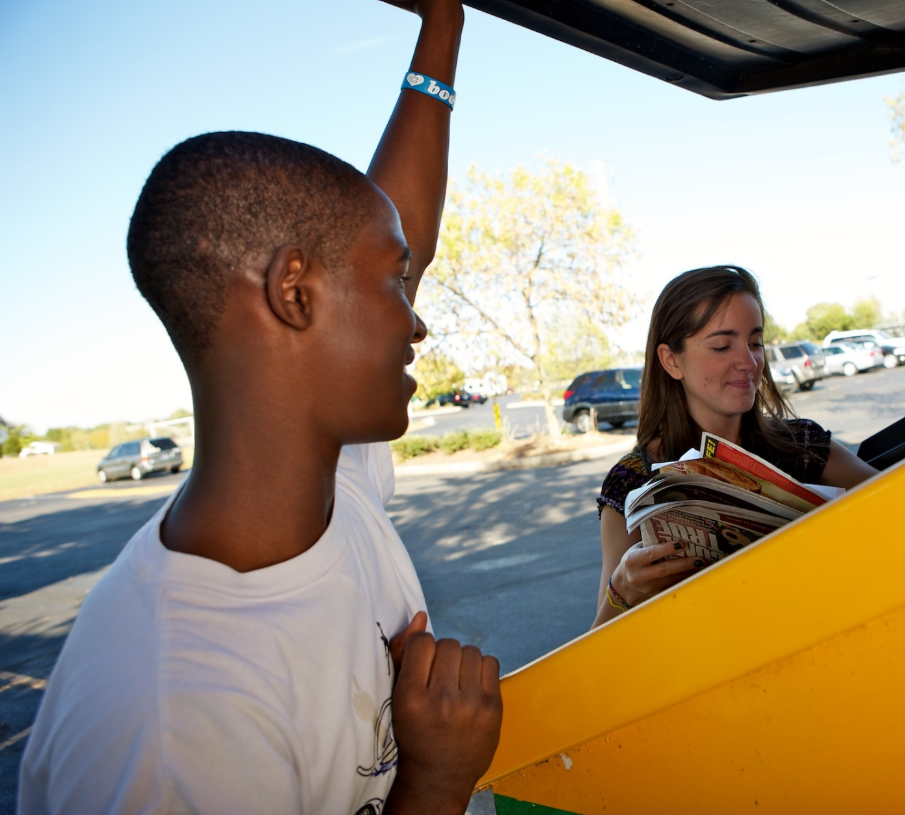

Secondary/High School | Ages 14-19 | keyclub.org
Oldest and largest student-led service club for high school students.
Club, District, International Leadership opportunities.
Located in 34 nations with more than 230,000 members.

Slide 19
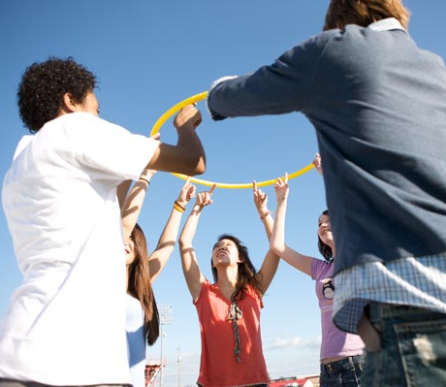

Secondary/High School | Ages 14-19 | key-leader.org
A weekend leadership experience that incorporates team-building activities, group discussion and personal reflection.

Slide 20
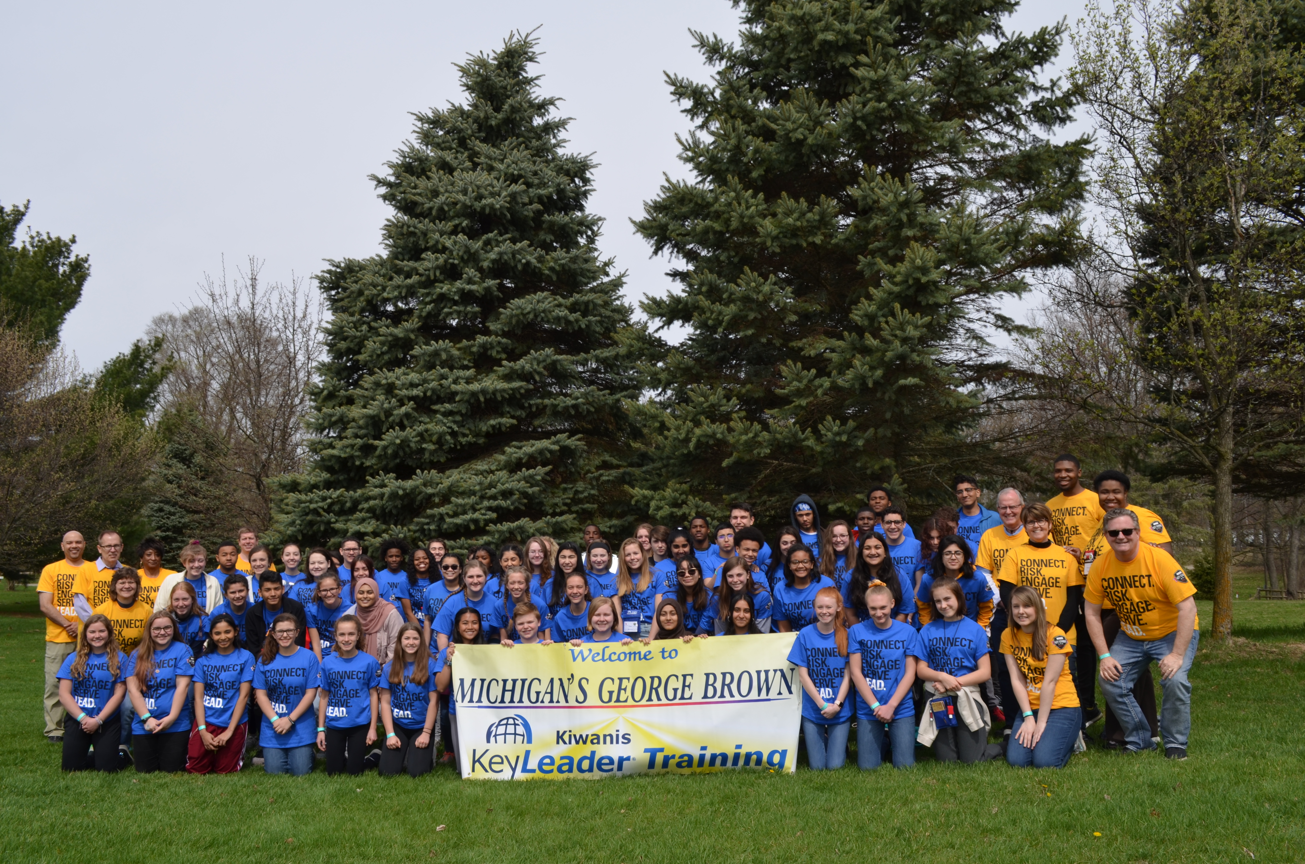
Virtual Key Leader
Fresh Content. Multi-Use.
Free, Interactive, PDF Workbook
Self-led, Group, and/or Family Activities
Primer for in-person Key Leader and Service Leadership
Ages 13 & Up
Notes:
VKL is a free, interactive, PDF workbook designed for students (8th grade and up) as well as adults. It includes videos, reflection and discussion topics, and offers a new perspective on some traditional Key Leader activities like the personality test.
The workbook is designed to be self-facilitated. Six “tracks” cover the topics of Service Leadership and the Five Key Leader Principles: Integrity, Growth, Respect, Community, and Excellence, and there are three activities in each track. The activities make for great meeting, classroom, or family activities to help teens discuss their values, goals, and role in the local community.
It also serves as a great primer for in-person Key Leader programs or a re-fresher on the topic for Student Facilitators at upcoming programs. Some districts are organizing virtual events to compliment or promote their in-person Key Leader events. (Nebraska, Ohio)

Slide 21
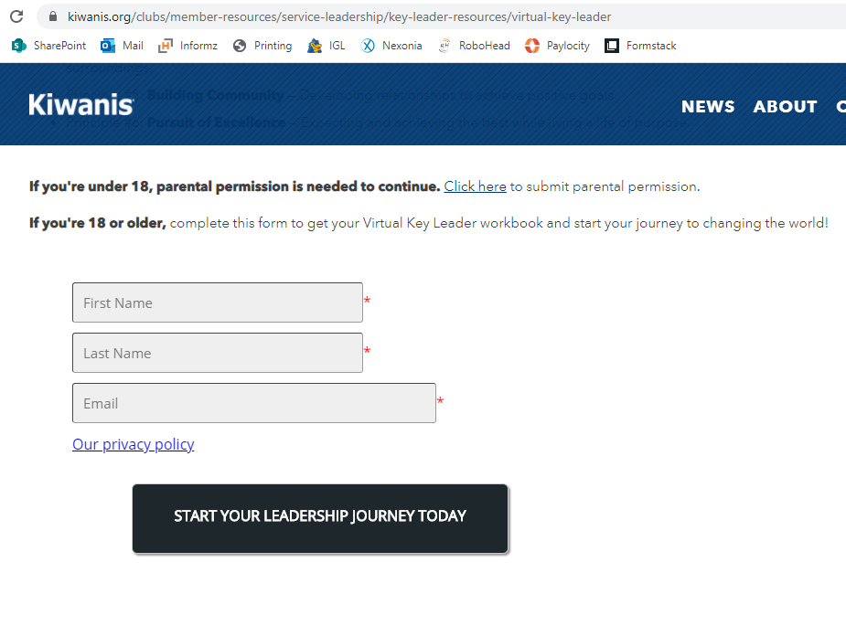
https://kiwanis.org/virtualkeyleader
Form for anyone under 18. This requires permission from a parent.
An email with the digital workbook will arrive within 30 minutes of registering.

Slide 22
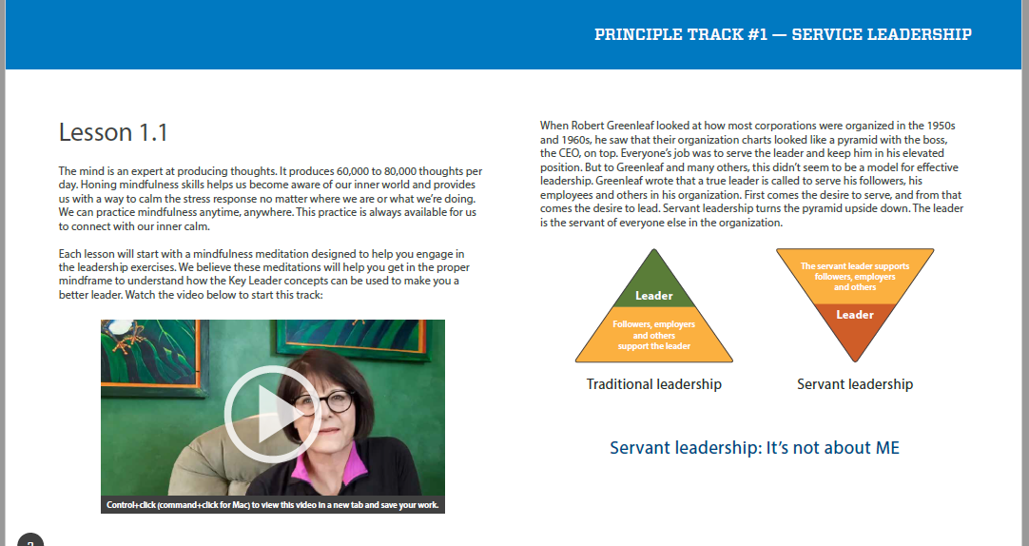
Videos in each exercise. Each of the 6 tracks starts with a Mindfulness exercise.

Slide 23
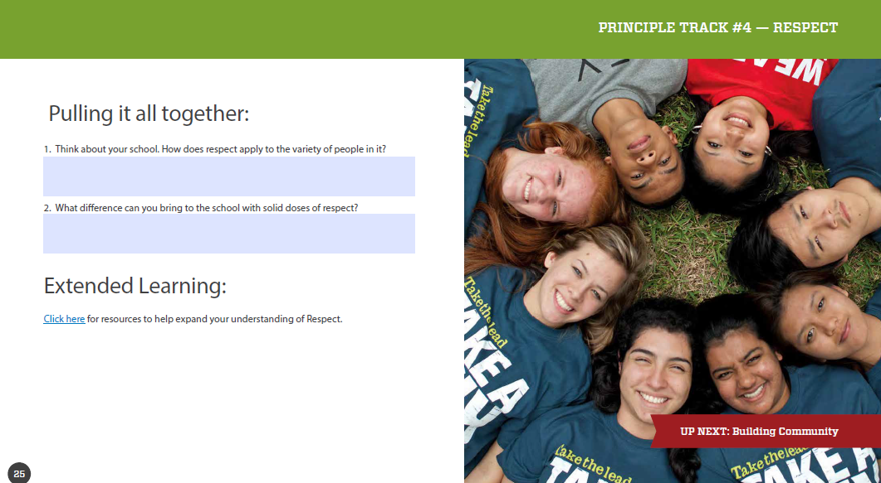
Type answer in the PDF.
Includes links to web resources.

Slide 24




Many Uses
Class/
Meeting
Independent
Study
Family/Community
Activity
Promotional/
Marketing

Slide 25
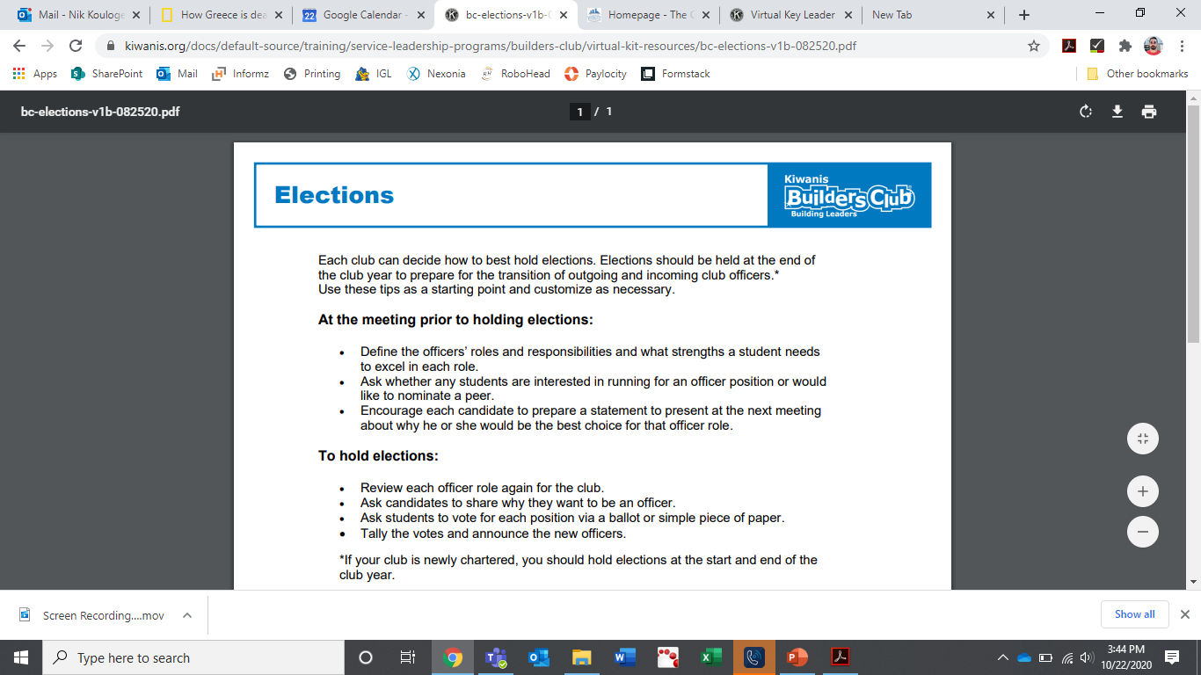
Virtual Meeting Kits
For Key Club, Builders Club, K-Kids Club,
and Aktion Club
Activities and agendas work for in-person or digital meetings
All new resources & worksheets
Topics include goal-setting, project planning, elections, and specific causes like bullying, hunger, and civic engagement.

Slide 26
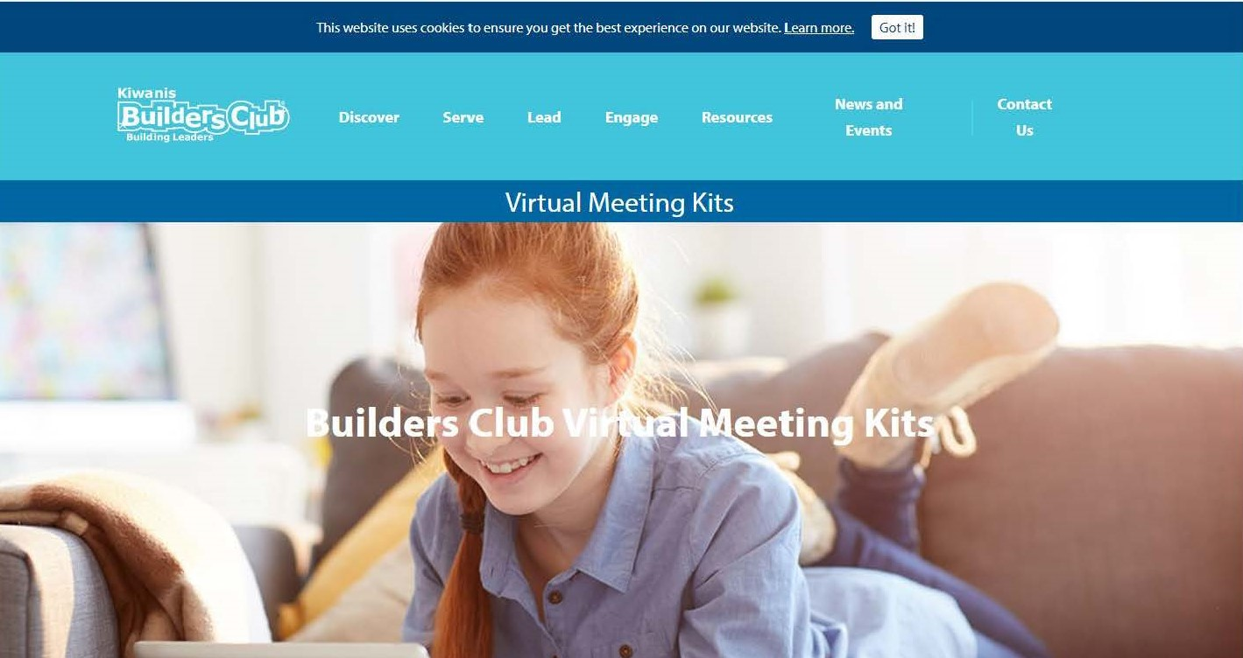
Notes:
This video shows how to find the resources on KeyClub.org and what they look like on the website. The Builders Club and K-Kids kits include unique videos and activities catered to middle and elementary students respectively. They are otherwise identical in appearance on Kiwanis.org.
BUILDERS CLUB: https://www.kiwanis.org/clubs/member-resources/service-leadership/builders-club-resources/builders-club-virtual-meeting-kits
K-KIDS: https://www.kiwanis.org/clubs/member-resources/service-leadership/k-kids-club-resources/k-kids-virtual-meeting-kits
KEY CLUB: https://keyclub.org/key-club-virtual-meeting-kits/

Slide 27
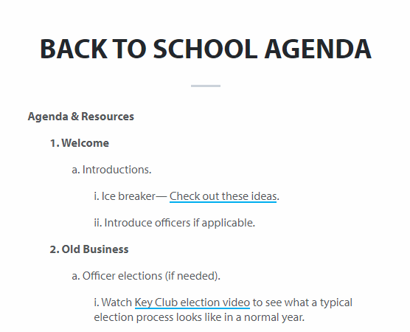
Virtual Meeting Kits
Back to School
Community Needs
Civic Engagement
Anti-Bullying | Culture of Care
Hunger & Food Insecurity
Thankfulness & Gratitude
Happy New Year of Service
Mental Health Awareness
Global Health Challenges

Slide 28

How can you help Kiwanis Service Leadership Programs thrive?
Notes:
Identify an individual or a committee to become the community advisor(s).
Become familiar with our Youth Protection Guidelines and make sure the community advisor has fulfilled the background check requirement.
Maintain an expense line item in your budget and ensure all dues and fees are paid.
Ensure that club officers receive proper training and help officers and members attend training opportunities beyond the club level.
Build a relationship with the club by attending club meetings and events, hosting or participating in joint activities, and inviting club members to your organization’s meetings.
Build a relationship with the school/host site, which includes regular meetings with school leaders or facility staff.

Slide 29

Good Growth
Preparing & Supporting New SLP’s
Know your resources
Youth Protection expectations
Add expense item to budget
Officer training & support
Establish familiarity with club
Strengthen relationship with school
Notes:
Identify an individual or a committee to become the community advisor(s).
Become familiar with our Youth Protection Guidelines and make sure the community advisor has fulfilled the background check requirement.
Maintain an expense line item in your budget and ensure all dues and fees are paid.
Ensure that club officers receive proper training and help officers and members attend training opportunities beyond the club level.
Build a relationship with the club by attending club meetings and events, hosting or participating in joint activities, and inviting club members to your organization’s meetings.
Build a relationship with the school/host site, which includes regular meetings with school leaders or facility staff.

Slide 30
Thank you for your service to the children of the world through Service Leadership Programs!

