Slide 1
Kiwanis
K-Kids and Builders Club Programs
Notes:
Introduction
Hello my name is Lisa Pyron and I’ve worked here at Kiwanis for 25 plus years. I’m a Kiwanis member and a K-Kids advisor, which is Kiwanis’ service club for elementary students. I’m a parent who witnessed my children encounter terrible difficulty in school because of mental health issues and bullying and advocate to help young people learn important social and emotional skills to help them attain overall well-being and succeed in life.

Slide 2
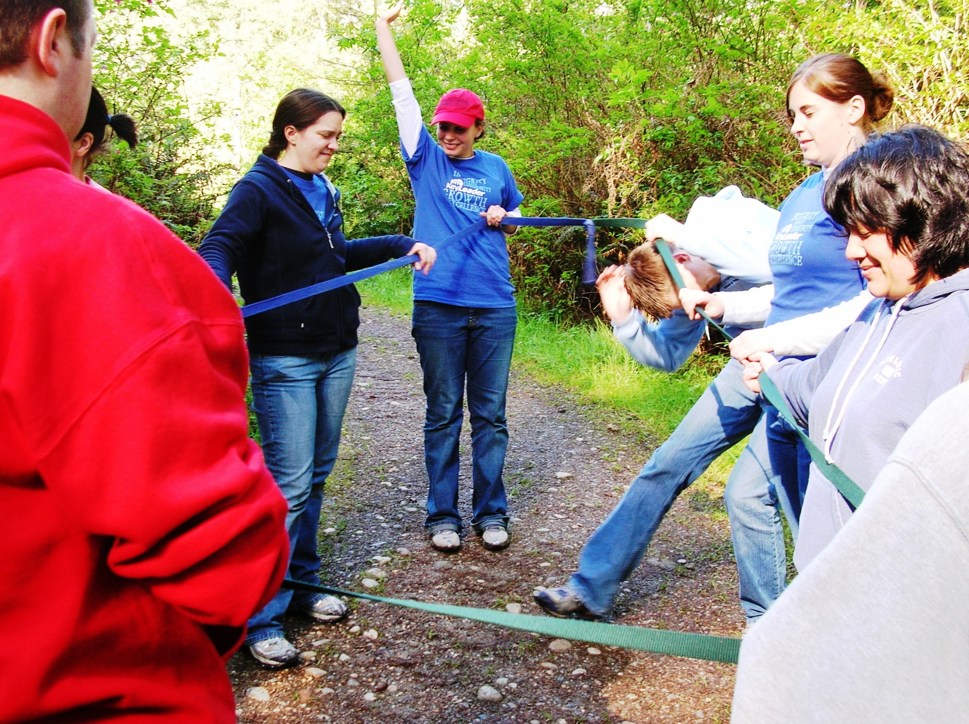
Kiwanis Rocks!
Notes:
Kiwanis supports K-Kids and Builders Club by sponsoring these youth clubs in elementary and middle schools.
Kiwanis is a global organization of volunteers dedicated to improving the world one child and one community at a time. Each year the Kiwanis family dedicates more than 18.5 million hours to service and raises more than US$100 million for local and global causes. Through local and global service projects, we strive to create a lifelong commitment of caring in people of all ages and abilities.
Our Service Leadership Programs are sponsored by local Kiwanis clubs or approved community organizations, which gives members access to service-minded adults in their communities. Numerous mentoring studies have demonstrated the positive effects of having caring adults – beyond parents-as role models.
Our programs are member-led. Adult advsiors mentor and guide. Members select their leaders, plan their agendas, choose their service projects, decide when their clubs will meet and make most of the major decisions for their clubs.

Slide 3
Our youth programs are unique!
There are programs for all ages supported by adult Kiwanis volunteers.
Volunteers participate in Youth Protection Training and must comply with background check requirements.
Clubs are covered by Kiwanis’ liability insurance.
Clubs are student-led.
Youth learn leadership skills and develop a strong social and emotional skill set through service to others.
Notes:
Kiwanis’ Service Leadership Programs are unique. Programs for all ages.
Designed to equip members with skills they can use throughout their lives.
Use proven social and emotional learning techniques.
Develop a heart to serve, answer the call to lead and summon the courage to engage.

Slide 4
Everyone can be a hero!
Notes:
Everyone can be a hero. Especially when we all work together in a community service club to help others and make a difference. Let’s take a look at the amazing Service Club Experience.

Slide 5
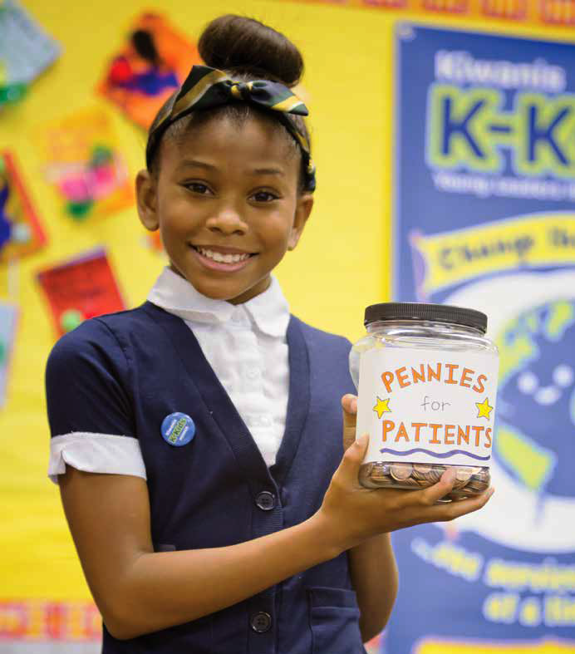
K-Kids
Elementary/Primary School
Ages 6 – 12
kkids.org
A student-led, community service club for elementary-age students.
More than 32,000 members worldwide.
Notes:
Where young leaders learn to help others
In ways large and small, K-Kids change the world around them and, in the process, transform themselves. Students lead the club, plan activities, participate in community service projects, celebrate their successes and develop empathy, self-confidence and compassion along the way. Through service to others they begin to understand the impact they can have on their school, their community and their world.

Slide 6
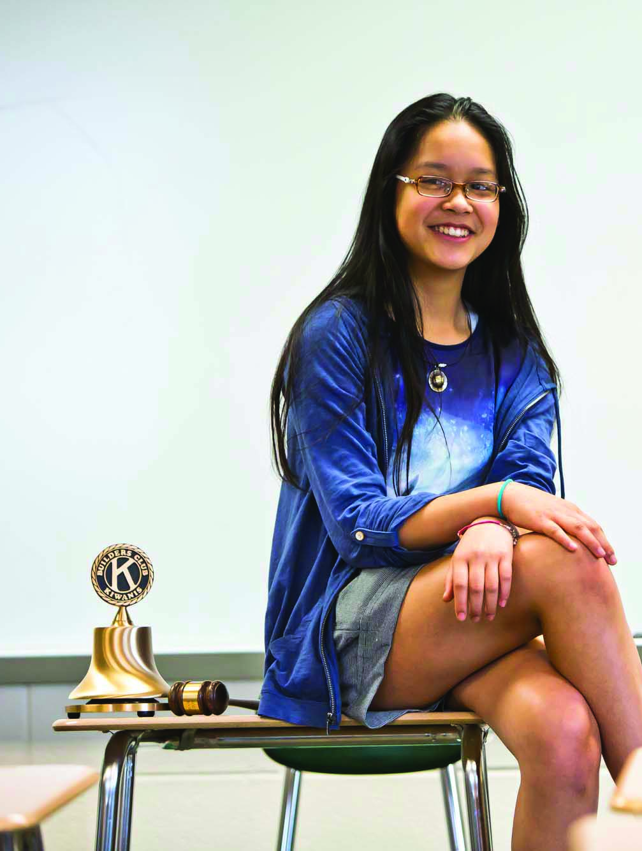
Builders Club
Middle/Junior High School
Ages 12 – 15
buildersclub.org
A student-led, community service club for junior high or middle school students.
More than 1,600 clubs in 18 nations.
Notes:
Building self-esteem at a pivotal age
Builders Club members are discovering who they want to become. Builders Club focuses all their raw potential into service for others – empowering them to be themselves, work together, make plans, set goals and take action. As they participate in club activities and events, students develop important social and emotional skills that help them make smarter decisions and avoid risky behavior.

Slide 7
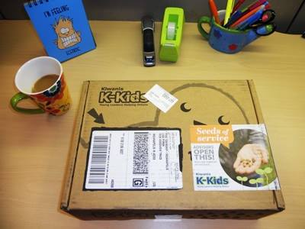
Club Resources
Notes:
Building self-esteem at a pivotal age
Builders Club members are discovering who they want to become. Builders Club focuses all their raw potential into service for others – empowering them to be themselves, work together, make plans, set goals and take action. As they participate in club activities and events, students develop important social and emotional skills that help them make smarter decisions and avoid risky behavior.

Slide 8
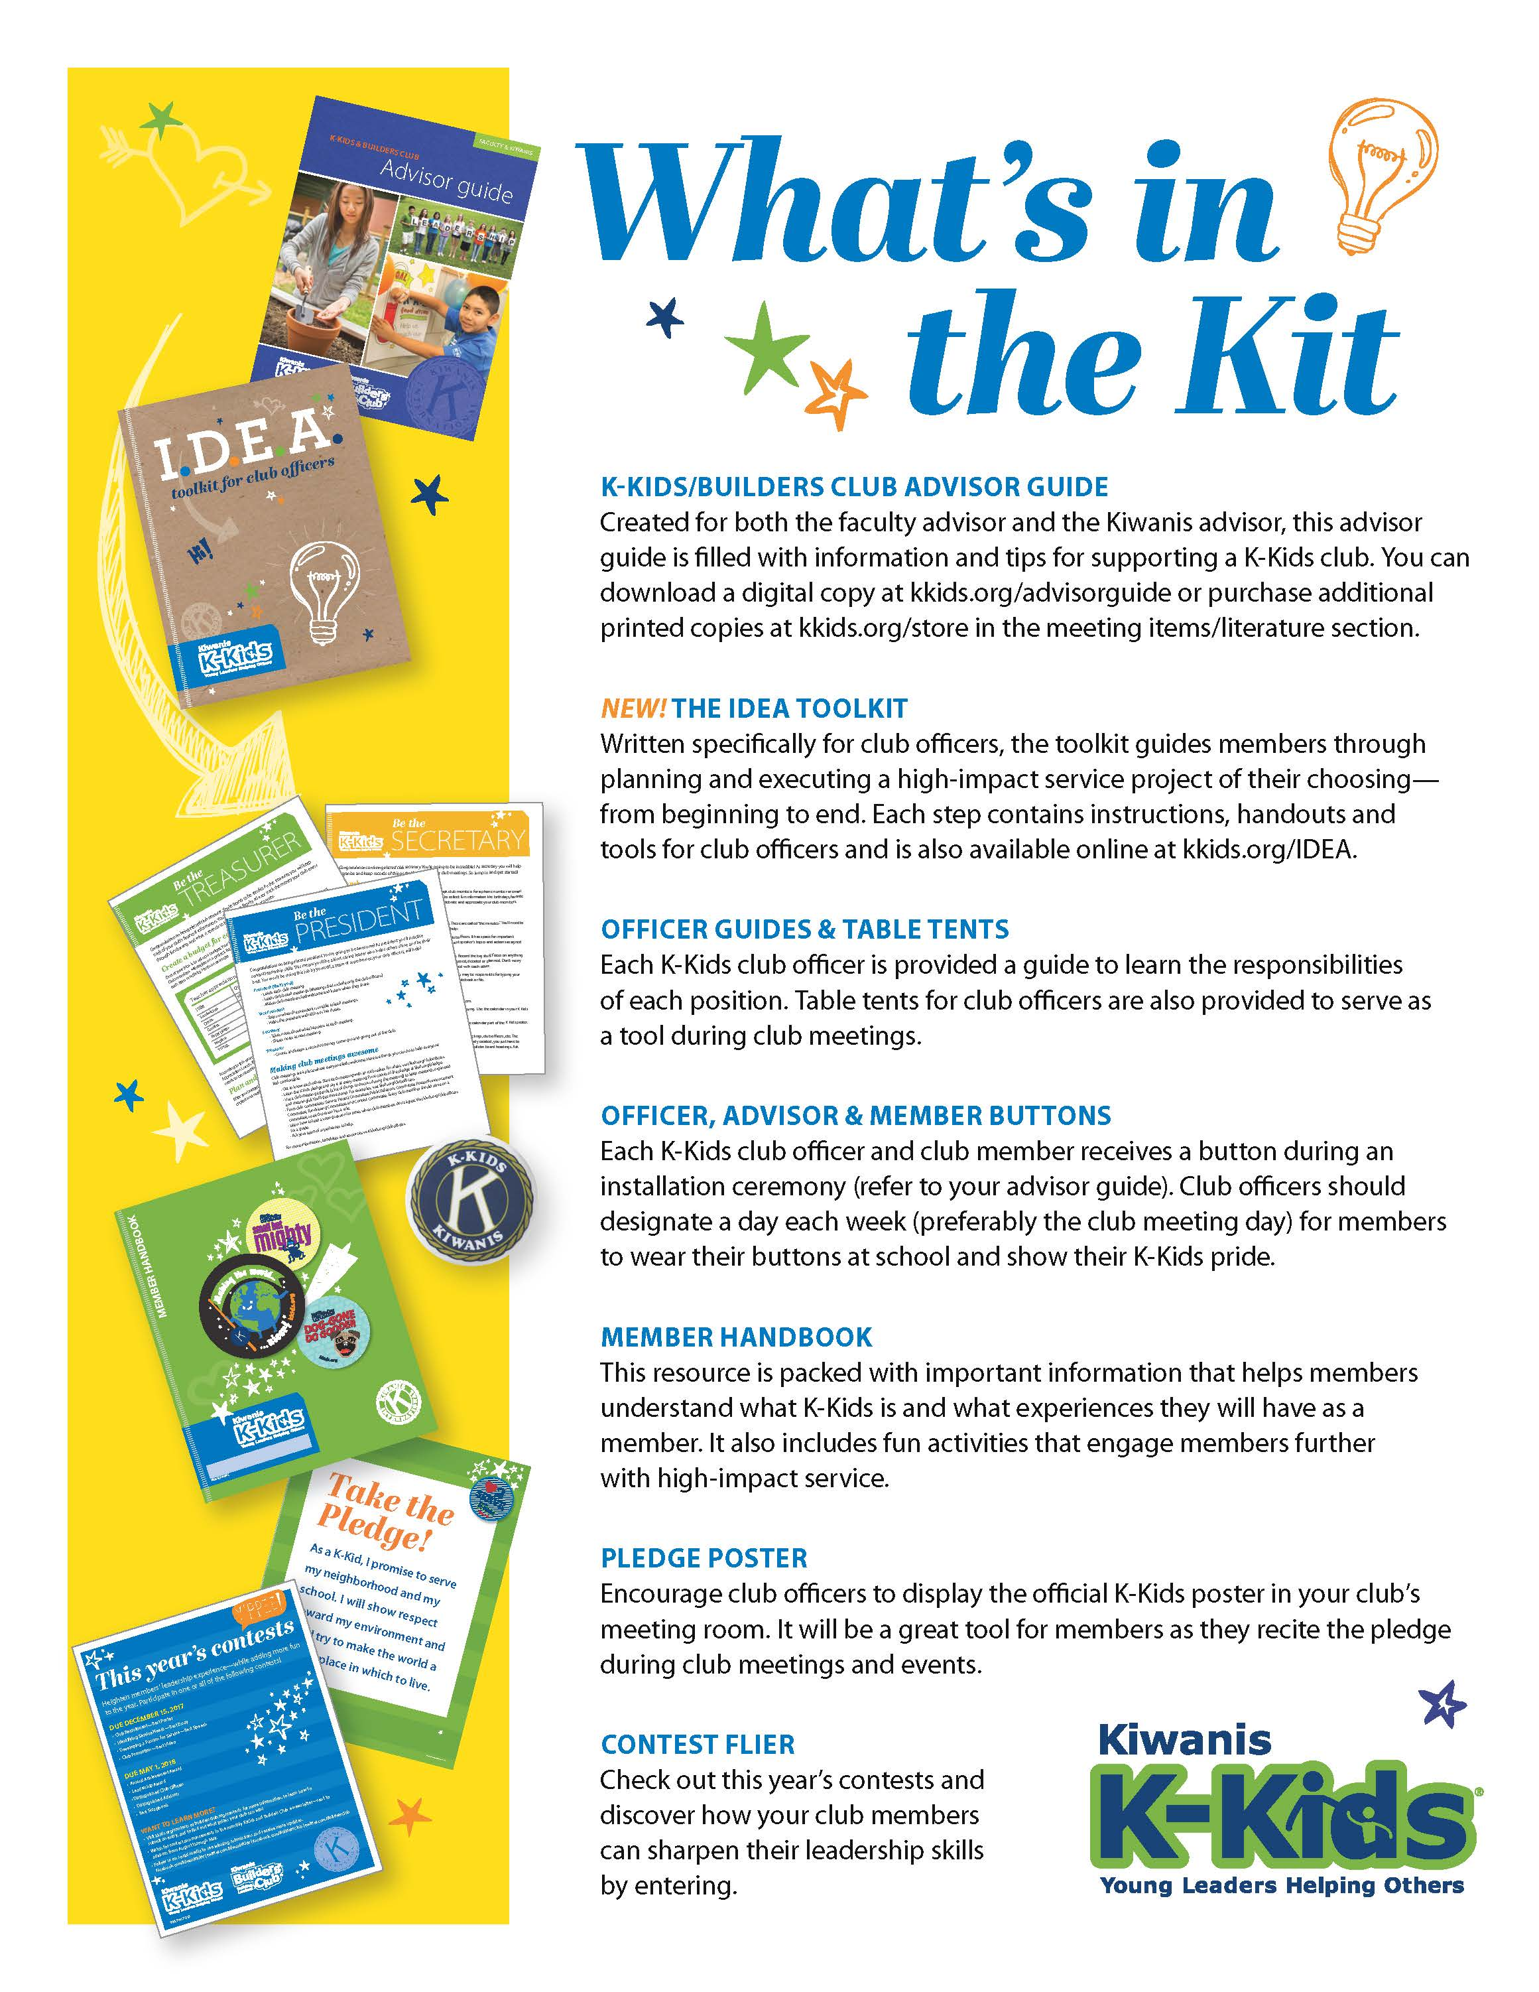
K-Kids and Builders Club advisors
receive a
program kit each year with helpful resources.
Notes:
Support to advisors
An international resource is the Kiwanis International Office, located in Indianapolis, Indiana. Staff members produce literature and publications, create online advisor education, manage social media for the Kiwanis family, and more.
One key resource is the K-Kids and Builders Club program kit provided each year to assist club advisors in guiding club members through the year.
Items included in the program kit include: Advisor guide, IDEA toolkit for officers, Officer guides, Officer and member pins or buttons, Member handbooks, pledge poster, and contest flier.

Slide 9
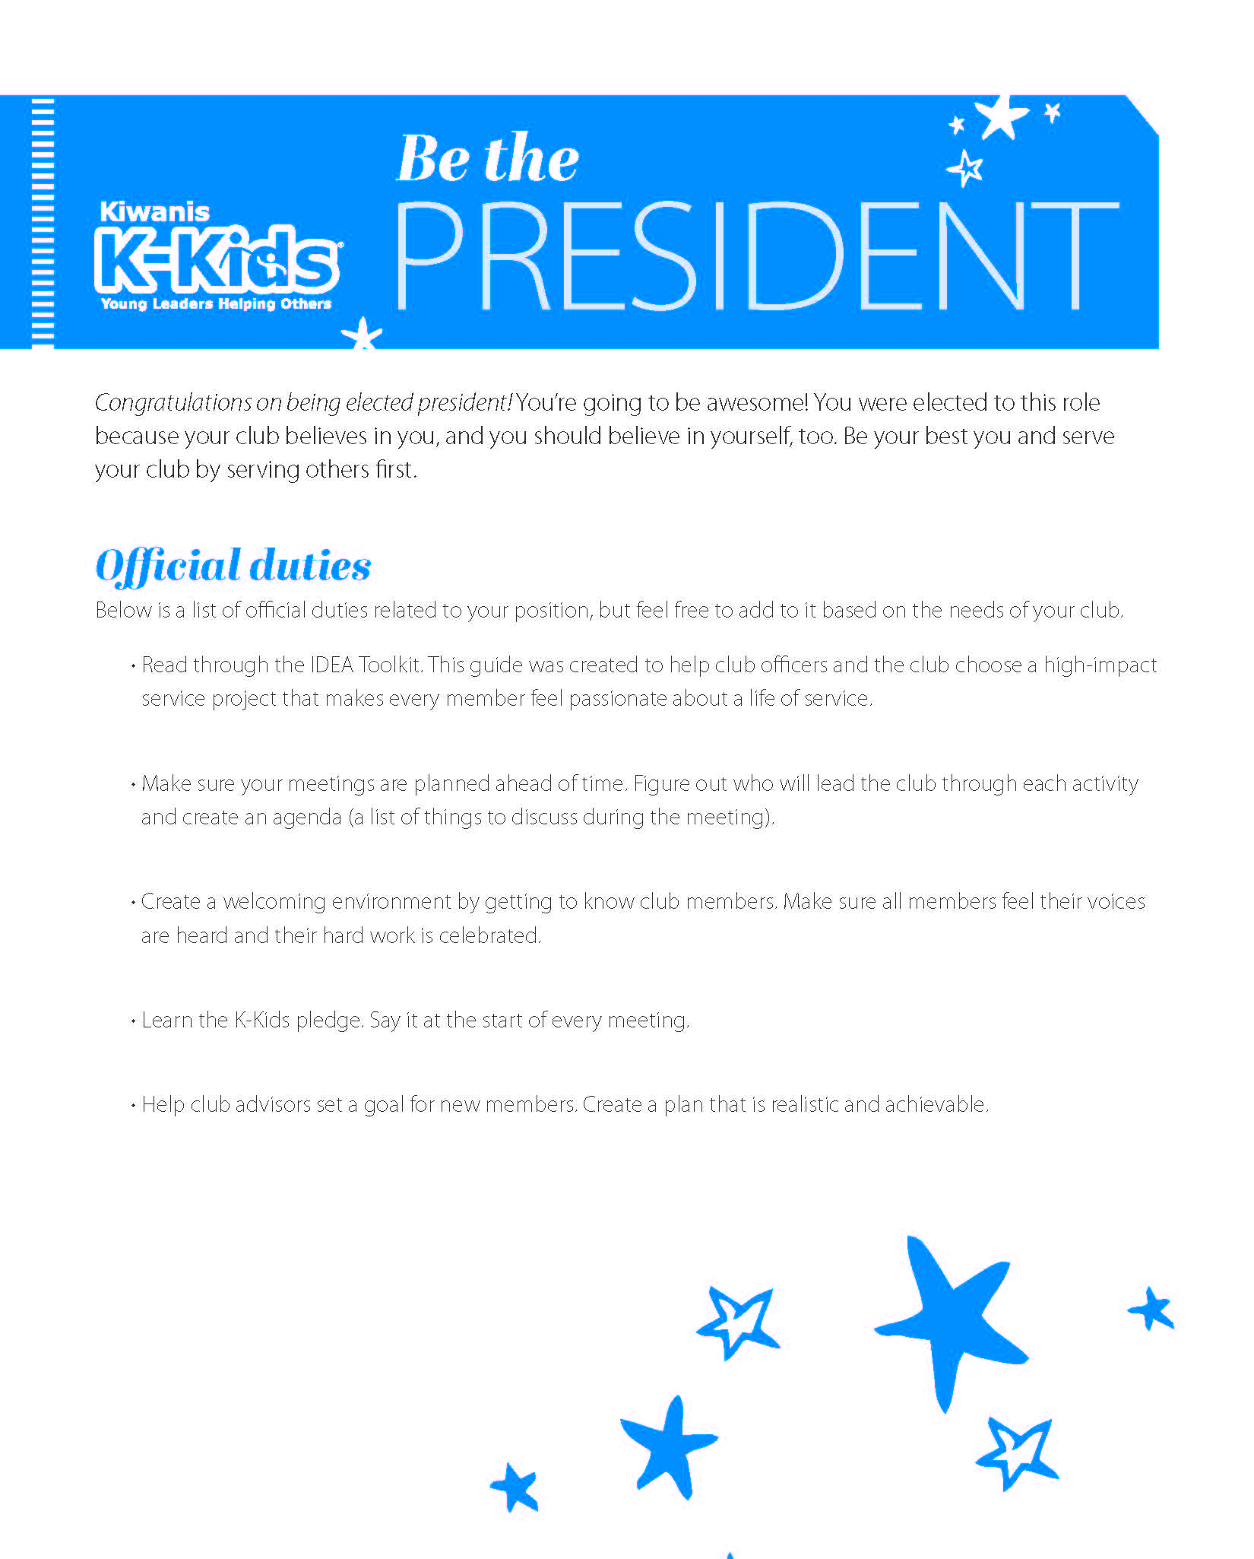
Officer guides help club officers lead the way.
Notes:
K-Kids and Builders Club officers also receive guides specific to their role in the club. These help to prepare club officers for their leadership role.

Slide 10
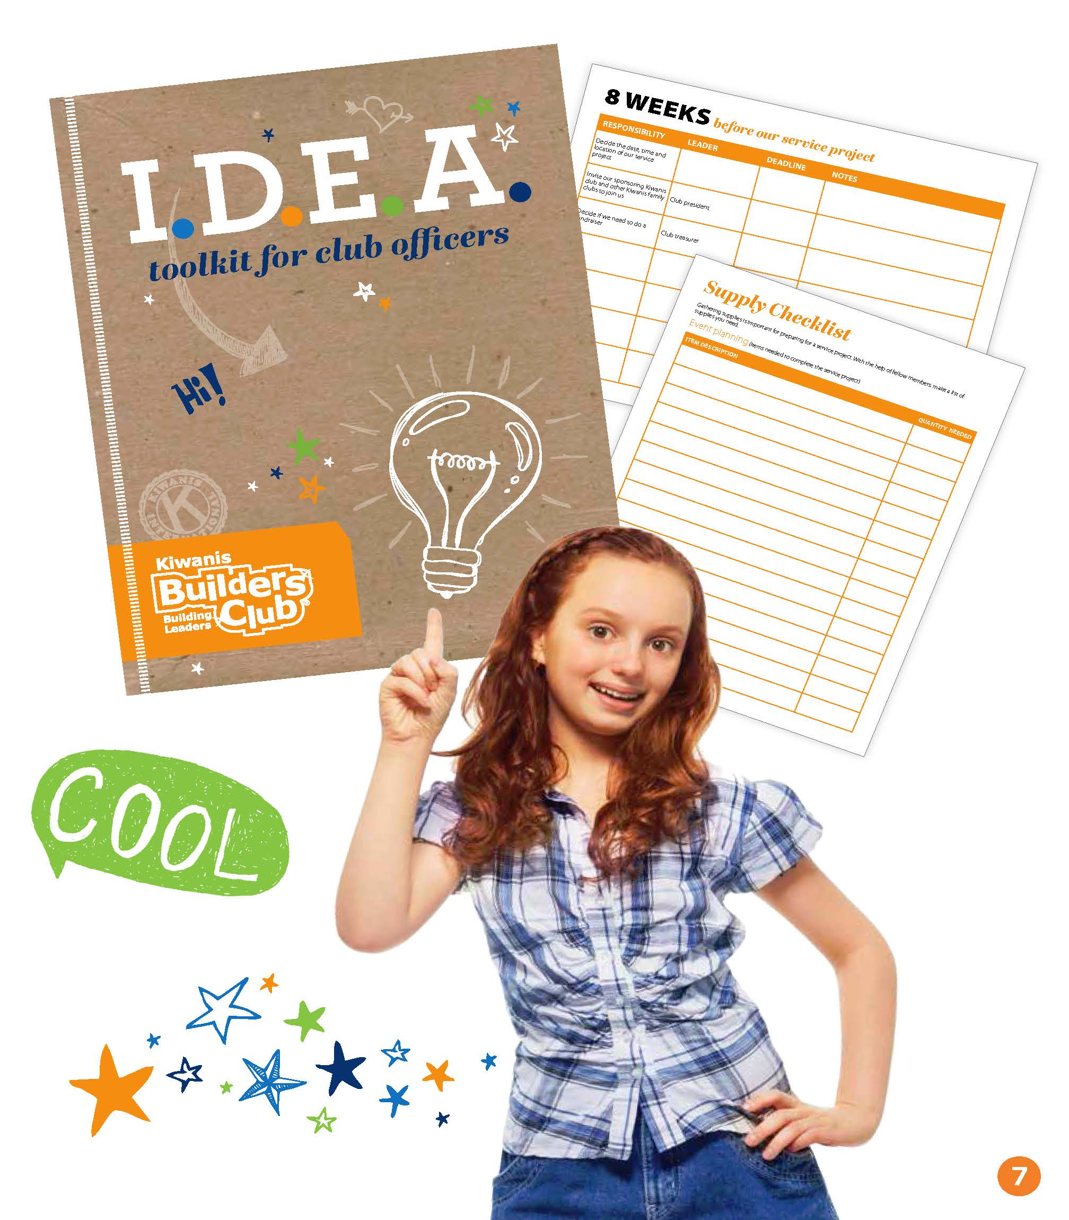
Online Club Officer Resources
Notes:
The IDEA toolkit is included in both the K-Kids and the Builders Club program kits. It’s written specifically for club officers, the toolkit guides members through planning and executing a high-impact service project of their choosing from beginning to end. Each step contains instructions, handouts and tools for club officers. It’s also available online at kkids.org/idea and buildersclub.org/idea.
Identify the Need
Develop the Passion
Execute the Project
Advance the Impact

Slide 11
Member handbooks
Notes:
Member materials help advisors in guiding members through the club experience.

Slide 12
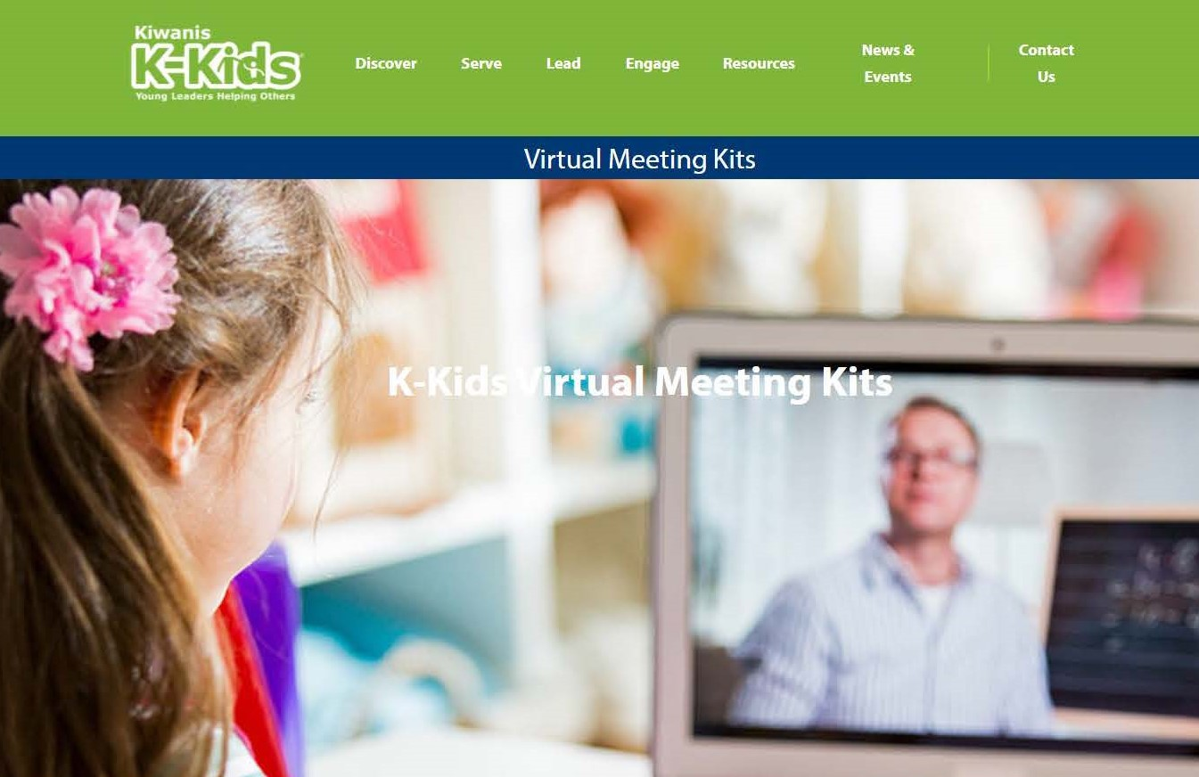
Virtual Meeting Kits
Notes:
Virtual meeting kits are available on each of the websites. They can be used to lead virtual meetings or in person meetings. These kits include the following.
Activities and agendas for in-person or digital meetings
All new resources and worksheets
Topics include:
Back to School
Community Needs
Civic Engagement
Anti-Bullying | Culture of Care
Hunger & Food Insecurity
Thankfulness & Gratitude
Happy New Year of Service
Mental Health Awareness
Global Health Challenges

Slide 13
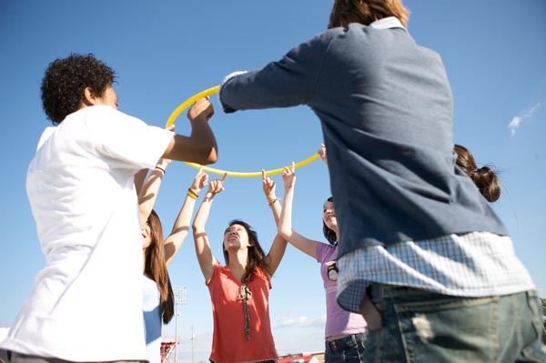
Key Leader
Secondary/high School
Ages 14-19
key-leader.org
A weekend leadership experience that incorporates team-building activities, group discussion and personal reflection.
Notes:
Graduating middle school students can attend Key Leader. Not only are Builders Club members welcome, but any graduating middle school students interested in developing leadership skills and learning more about community service.
A life-changing leadership weekend
Key Leader is an inspirational weekend leadership experience for emerging high school leaders. This life-changing weekend offers students a taste of what servant leadership is all about. Through team-building activities, group discussions and personal reflections, students gain self-confidence, make new friends and learn the joy and power of community involvement.

Slide 14
Virtual Key Leader
Class/
Meeting
Independent
Study
Family/Community
Activity
Promotional/
Marketing
Notes:
VKL is a free, interactive, PDF workbook designed for students (8th grade and up) as well as adults. It includes videos, reflection and discussion topics, and offers a new perspective on some traditional Key Leader activities like the personality test.
The workbook is designed to be self-facilitated. Six “tracks” cover the topics of Service Leadership and the Five Key Leader Principles: Integrity, Growth, Respect, Community, and Excellence, and there are three activities in each track. The activities make for great meeting, classroom, or family activities to help teens discuss their values, goals, and role in the local community.
It also serves as a great primer for in-person Key Leader programs or a re-fresher on the topic for Student Facilitators at upcoming programs. Some districts are organizing virtual events to compliment or promote their in-person Key Leader events. (Nebraska, Ohio)
Free, Interactive, PDF Workbook
Self-led, Group, and/or Family Activities
Primer for in-person Key Leader and Service Leadership
Ages 13 & Up

Slide 15
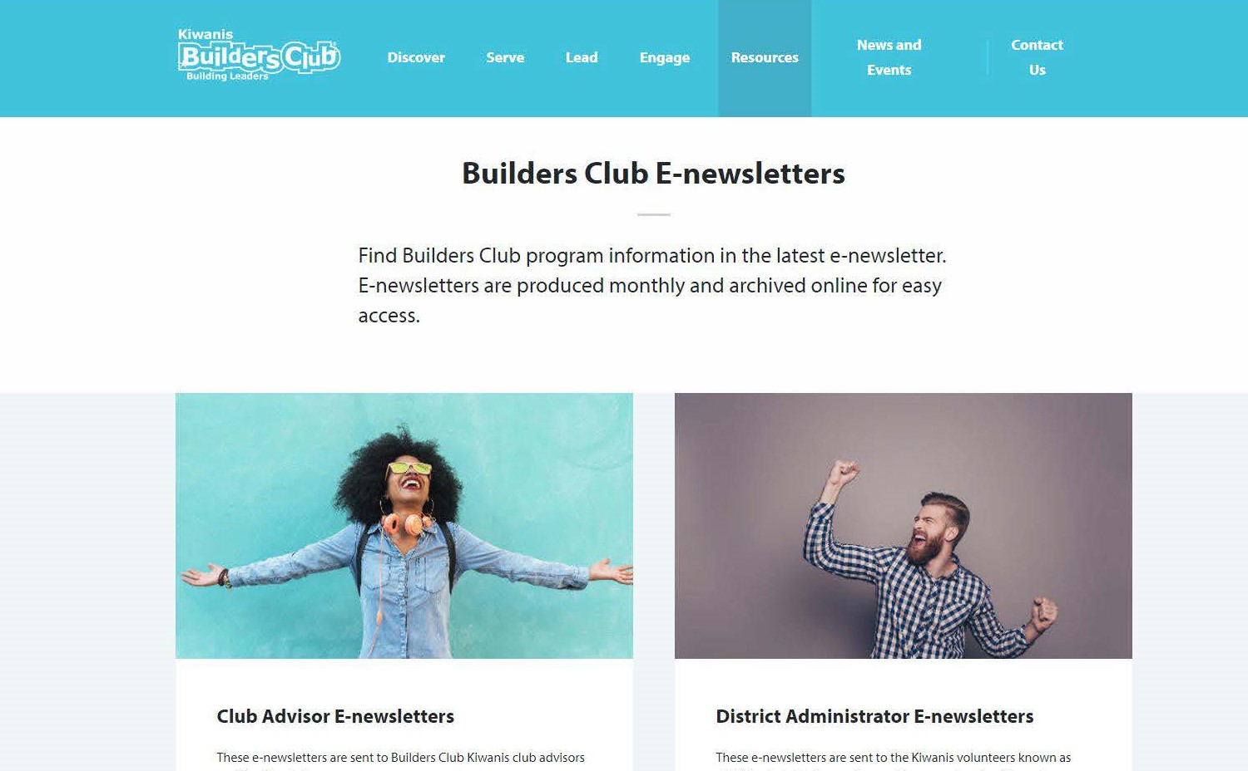
Monthly Advisor E-newsletters
Notes:
Activities and agendas for in-person or digital meetings
All new resources and worksheets
Topics include:
Back to School
Community Needs
Civic Engagement
Anti-Bullying | Culture of Care
Hunger & Food Insecurity
Thankfulness & Gratitude
Happy New Year of Service
Mental Health Awareness
Global Health Challenges

Slide 16
Youth Mentoring and Recognition Programs
K-Kids and Builders Club members can lead these programs at any school including their own.
Notes:
Kiwanis also offers mentoring and recognition programs.

Slide 17
Bring Up Grades
Empowering young students in their academic success:
Recognizes students who raise their grades or maintain good grades from one grading period to the next.
Students set their own goals and participate in peer mentoring, which involves everyone in their success.
When they reach their goals, the entire class celebrates.
Primary/elementary school
Ages 6 - 12
bringupgrades.org
Notes:
Empowering kids in their academic success
BUG recognizes elementary students who raise their grades or maintain good grades from one grading period to the next. Students are motivated to excel because they set their own goals and participate in peer mentoring which involves their classmates in their success. When they reach their goas, the entire class celebrates.

Slide 18
Terrific Kids
A character-building program for young students:
A student-recognition program for attendance, character, behavior and relationships.
Students develop self-esteem, learn perseverance and gain important life skills that help them make smarter choices.
When they reach their goals, the entire class celebrates.
Primary/elementary school
Ages 6 - 12
terrifickids.org
Notes:
A character-building program
This program recognizes students for modifying their behavior. The program encourages kid to become the bet version of themselves. Participants determine what being terrific means to them then develop their own goals and use peer mentoring to hold themselves accountable for the actions they take each week. When a participant achieves their goal they are honored for be a Terrific Kid.

Slide 19
Read & Lead
The power of reading to kids
Small and large kits available on topics such as bully prevention, the environment, hunger, literacy and how ordinary people change the world.
Students read and discuss books as a group and discover how they can make a difference.
Kits include multiple copies of books , reflection question, ideas for follow-up activities and service projects.
This program is a partnership between Kiwanis and Scholastic.
Primary/elementary school
Ages 6 - 12
kiwanis.org/readandlead
Notes:
Introducing the power of reading to kids
K-Kids Read & Lead kids empower kids to make positive changes in their schools and communities. There are small and large kits available on topics such as bully prevention, the environment, hunger, literacy and how ordinary people change the world.
Students read and discuss books as a group and discover how they can make a difference. The kit includes multiple copies of books along with reflection questions, ideas for follow up activities and service projects. The program is in partnership with Scholastic.

Slide 20
How do K-Kids clubs and Builders Clubs help youth thrive?
Notes:
So, how do these programs help?

Slide 21
Social Emotional Learning
Self-awareness
Self-management
Responsible decision-making
Social awareness
Relationship skills
Notes:
We help youth develop important Social and Emotional skills.
Social Emotional Learning focuses on the development of a core set of social and emotional skills that help us in to effectively handle life challenges.
We learn to thrive in academically and socially.
These skills allow us to:
Calm ourselves when angry
Initiate friendships
Resolve relationship conflicts respectfully
Make ethical and safe choices.
Social Emotional Skills
Self-awareness – Knowing what we think and feel, and how thoughts and feelings influence actions and choices.
Self-management – Learning how to handle challenging emotions so that they don’t cause problems; being able to set goals and deal with obstacles.
Responsible decision making – Being able to come up with solutions to problems and consider the consequences of actions on ourselves and others.
Social awareness – Understanding the thoughts, feelings, and perspectives of others and developing empathy.
Relationship skills – Being able to work through conflicts; having strong connections to other people but resisting negative peer pressure.

Slide 22
Growth Mindset
The Growth Mindset allows people to love what they’re doing – and continue to love it in the face of difficulty.
Notes:
Fixed mindset focuses on judgment. Praising intelligence harms motivation. The fixed mindset creates an internal monologue that’s focused on judging. Fear of failure can paralyze an individual’s ability to see new outcomes, and making new attempts to solve a problem (trying something new) stops.
A Growth Mindset focuses on praising effort, encourages youth to love challenges, learn from mistakes, value effort and lifelong learning. The growth mindset creates an inner monologue that is focused on learning and constructive action.
BUG and Terrific Kids use the Growth Mindset model praising the student for his/her effort. Student’s learn that failure or challenges are opportunities to learn a different way to do something. This eliminates the fear of failure and students learn that failures and challenges help them learn. This strengthens perseverance.

Slide 23
How can you help youth?
Notes:
Identify an individual or a committee to become the community advisor(s).
Become familiar with our Youth Protection Guidelines and make sure the community advisor has fulfilled the background check requirement.
Maintain an expense line item in your budget and ensure all dues and fees are paid.
Ensure that club officers receive proper training and help officers and members attend training opportunities beyond the club level.
Build a relationship with the club by attending club meetings and events, hosting or participating in joint activities, and inviting club members to your organization’s meetings.
Build a relationship with the school/host site, which includes regular meetings with school leaders or facility staff.

Slide 24
Build & Support Youth Clubs
Identify advisor(s)
Youth Protection expectations
Add expense item to budget
Provide club officer training & support
Establish familiarity with the club
Strengthen relationship with the school
Notes:
Identify an individual or a committee to become the community advisor(s).
Become familiar with our Youth Protection Guidelines and make sure the community advisor has fulfilled the background check requirement.
Maintain an expense line item in your budget and ensure all dues and fees are paid.
Ensure that club officers receive proper training and help officers and members attend training opportunities beyond the club level.
Build a relationship with the club by attending club meetings and events, hosting or participating in joint activities, and inviting club members to your organization’s meetings.
Build a relationship with the school/host site, which includes regular meetings with school leaders or facility staff.

Slide 25
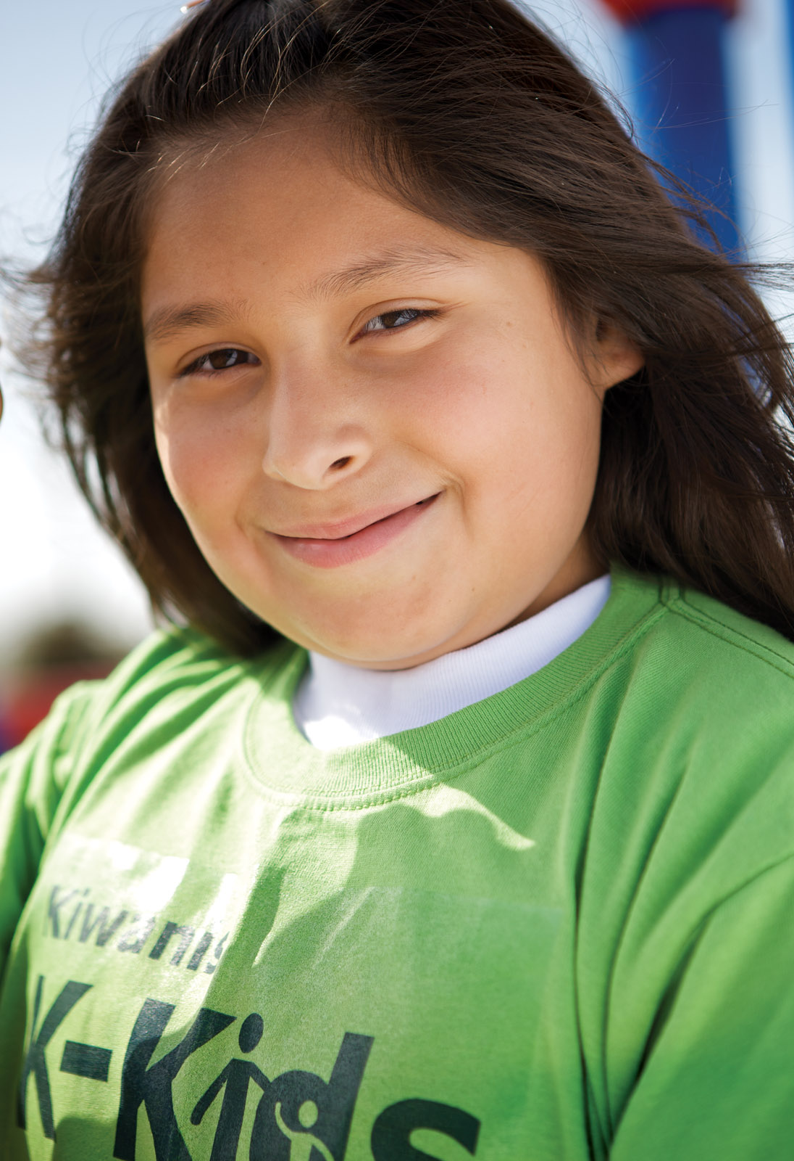
“Never doubt the power of a small group of people to change the world. Indeed, it’s the only thing that every has.
- Margaret Mead
Thank you!
Notes:
Remember, we can make a difference through K-Kids and Builders Club.
Thank you.

