Slide 1

Builders Club
a youth service leadership program of Kiwanis International
Notes:
Welcome
Welcome the group and let them know that everyone has gathered together to learn about their roles as Builders Club members.
Introduce yourself, any club advisors and other Kiwanis volunteers in the room.

Slide 2
Kiwanis family
YOUTH
K-Kids
Builders Club
Key Club
Key Leader
ADULTS
Circle K
Aktion Club
Notes:
Kiwanis family
Kiwanis has clubs for anyone from age 6 to over 100. Builders Club is part of the Kiwanis family.
K-Kids: primary/elementary school – where young leaders learn to help others – see kkids.org for more info
Builders Club: middle/junior high school – building self-esteem at a pivotal age – see buildersclub.org for more info
Key Club International: secondary/high school – learning to lead with compassion – see keyclub.org for more info
Key Leader: ages 14-18 – a life-changing leadership weekend – see key-leader.org for more info
Circle K International: college/university students – the next generation of community leaders – see circlek.org for more info
Aktion Club: adults with disabilities – where development has no disability – see aktionclub.org for more info
Many Kiwanis clubs sponsor one or more Kiwanis family clubs.

Slide 3

What is
Builders
Club?
Largest service
organization for middle school students
More than 45,000 members worldwide
Notes:
What is Builders Club?
Thanks to Builders Club, more than 45,000 middle school children each year have learned they can change the world.
Builders Clubs can be found in middle schools and community-based organizations. Most Builders Clubs are sponsored by a Kiwanis club.
Students lead the club, plan activities, participate in community service projects and celebrate their successes. Through service and leadership opportunities, members develop empathy, self-confidence and compassion.

Slide 4
Core values
Character building
The ability to do the right thing, even when it might be the unpopular choice.
Leadership
The ability to listen, communicate, serve and guide others.
Inclusiveness
Accepting and welcoming the differences in others.
Caring
The act of being concerned about or interested in another person or situation.
Notes:
Core values
Members base their leadership and service on these core values.
Take time to discuss these concepts with the group. Ask them how they feel about living by these core values.

Slide 5
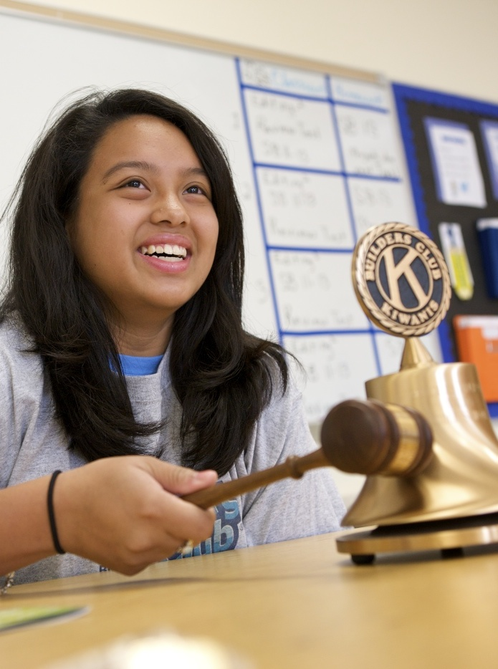
Club
structure
President
Vice President
Secretary
Treasurer
Sergeant-at-arms
Builders Clubs are student-led and allow youth to sharpen their leadership skills.
Notes:
Club structure
Each Builders Club has a student board with elected officers and follows the club’s bylaws. Bylaws clarify the purpose of a Builders Club and provide guidelines for membership, officers, and meetings.
Each year, Builders Club members elect their club officers sometime during the last two months of the academic year. This allows time in the club year for training and mentoring. Elected officers observe and train under current club officers until taking office. They will take office immediately or at the start of the new academic year.

Slide 6
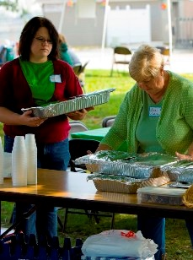
Club
support
Kiwanis advisor
Faculty advisor
Notes:
Club support
The key resource for the Builders Club are the advisors.
Both the Kiwanis club and the school or community organization designate an adult advisor to serve as a mentor to the K-Kids club.
These roles are known respectively as the Kiwanis advisor and the faculty advisor.

Slide 7

Kiwanis advisor
Notes:
Kiwanis advisor
The sponsoring Kiwanis club appoints a Kiwanis volunteer to the Builders Club. This person is known as the Kiwanis advisor. Kiwanis clubs are required to have a clear criminal history background check—conducted and verified by Kiwanis International—for any member serving as a Kiwanis advisor. The Kiwanis advisor serves as a liaison between the Builders Club and the Kiwanis club.
He or she:
Promotes a connection between the two clubs,
Works with the faculty advisor,
And, attends club meetings.

Slide 8

Faculty advisor
Notes:
Faculty advisor
The school or community organization appoints a staff member to serve the Builders Club. This person is known as the faculty advisor. The faculty advisor serves as a liaison between the Builders Club and the school or community organization.
He or she ensures the club:
Operates in accordance with school policies,
Helps to keep the club viable,
And, attends club meetings.

Slide 9

Support to advisors
Notes:
Support to advisors
Builders Club advisors get support from a few different places.
A local resource is the Builders Club district administrator. The district administrator is a Kiwanis member appointed by Kiwanis district leadership to support Builders Clubs in the area. This Kiwanian is dedicated to the success of the organization. This person is also the liaison to Kiwanis International.
A community resource is Builders Club members’ parents when engaged effectively. Advisors keep members’ parents involved by:
Communicating consistently by email or other forms of communication,
Providing updates during both school and summer months,
Inviting parents to regular club meetings and service projects,
Creating special roles for parents to act as liaison between the club and the school’s Parent Teacher Organization,
And, educating and training parents to serve as public advocates of the club.
An international resource is the Kiwanis International Office, located in Indianapolis, Indiana. Staff members produce literature and publications, create online advisor education, manage social media for the Kiwanis family, and more.

Slide 10
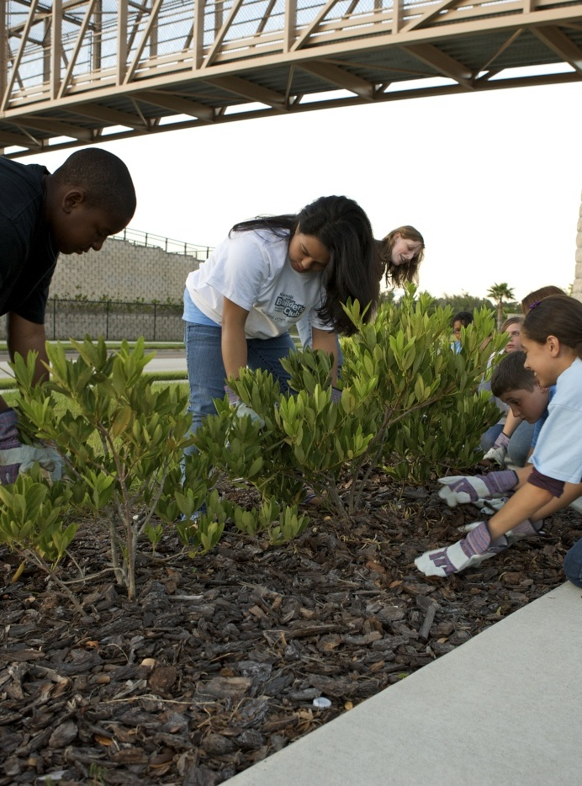
Why
Builders
Club?
Hands-on service
Fundraising and philanthropy
Awareness building
Notes:
Why Builders Club?
Builders Club teaches children leadership skills through service. Planning and taking part in service projects a great way for club members to gain leadership skills and make a difference in the community.
Most clubs have a goal each semester to plan one project in each of the three listed categories.
Examples include:
Making special welcome baskets for students relocating to a school.
Show appreciation to teachers through thank you notes, treats, or classroom chores.
Food or clothing drives.
Hosting a bake sale.
Sponsoring a speaker to bring attention to a particular topic.
Hosting a movie night by showing a documentary addressing a specific cause or message.

Slide 11
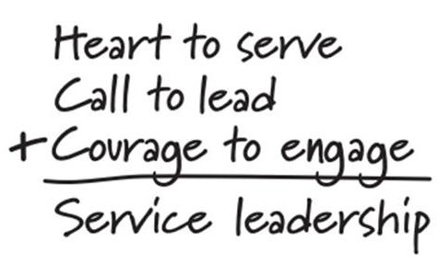
Builders Club service leadership model
Notes:
Builders Club service leadership model
The primary educational objective of Builders Club is to prepare members to be the most engaged members of their current and future communities.
By participating in Builders Club and experiencing service leadership, members discover their heart to serve, answer their call to lead and summon the courage to engage.
When students discover their heart to serve, they decide that serving others is a new, exciting way of life. When students answer their call to lead, they step forward when the easier choice might have been to stand still. When students summon the courage to engage, they decide to live a life of collaboration and not isolation.

Slide 12

Working
together
Through Builders Club, the school and the club members have a direct connection to the community through the sponsoring Kiwanis club.
Notes:
Working together
Here are just a few ways a Kiwanis club and a Builders Club work together:
The Kiwanis advisor informs the Kiwanis club about what the Builders Club is doing.
The Kiwanis club invites Builders Club members to help with service projects.
The Kiwanis club invites Builders Club members to attend Kiwanis club meetings.
The Kiwanis club is available to deliver programming for the Builders Club. Example: Career Day or a club program speaker.

Slide 13

Starting a
Builders Club
buildersclub.org/charter
Notes:
Starting a Builders Club
The first step is finding advisors, members and a place to meet.
Your home base (and meeting place) may be at a middle school, a community center, or somewhere else. A Kiwanis club could sponsor your club—offering both financial support and hands-on guidance—and a Circle K club or Key Club can co-sponsor. Who will help steer your club in the right direction? It takes two: an advisor from your site and an advisor from your local Kiwanis club.
Once you’ve laid the groundwork for your club, it’s time to get organized, file paperwork, train club leaders and build enthusiasm.
The chartering process makes your club a reality. Put all the pieces together. Get together with new members to adopt club bylaws, officially elect officers and directors, plan your club’s meeting schedule and start brainstorming service project ideas. Make time to train officers, create a budget and set goals for your club.
Once your club is official, you’ll be ready to reach out to the community and make a difference through meaningful service projects.
Empower yourself with liability information, project ideas and tips on working with youth.
Visit buildersclub.org/charter for more info.

Slide 14

Web and
social media
buildersclub.org
facebook.com/buildersclub
twitter.com/buildersclub
pinterest.com/buildersclub
Notes:
Web and social media
Encourage the group to connect with Builders Club online.

Slide 15

“Builders Club has taught me how to help people that are affected by poverty and homelessness. By participating in service projects, I have learned a lot about the struggles of others and the true meaning of empathy.”
Amber, 7th grade, Florida district
Notes:
Thank You
Ask the group if they have any questions.

